Slide 1
Unique structures of Nepal
Done by the students of grade six
Kavya school
Kathmandu
Nepal

Slide 2
Swayambhunath stupa
Swayambhunath stupa is one of the most interesting place to visit in Kathmandu valley and its unique structure makes it very special.
It is made in the model of stupa with wide base which is painted in white color, the color to represent peace.
It has two eyes in the four parts of its structure which symbolize the eyes of the light of asia lord Gautam Buddha.
It is enlisted in the world heritage site by UNESCO.

Slide 3
PASHUPATINATH TEMPLE
It is the temple of the god of the gods lord Shiva.
Kathmandu valley is known as the city of thousand temples.
Pashupathinath is the one of them and it is the most celebrated and biggest temple.
The architecture of the temple is based on pagoda style with the golden peak which is known as Gajur.
It is also enlisted in the world heritage site by UNESCO.

Slide 4
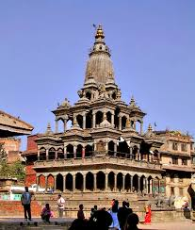
Krishna Mandir
It is the holy temple of lord Krishna.
It has got unique structure as shown in the picture.
It was built in the medieval age of 16th to 17th century.
It is situated in the Patan durbar square area which is covered with other various temples with different structures.
the architecture of the temple is based on shikher style.
The durbar square area is also enlisted in the world heritage site by UNESCO.

Slide 5
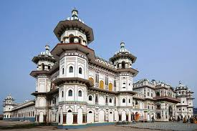
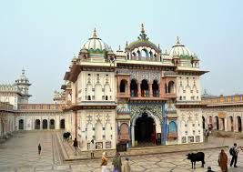
JANAKI TEMPLE
Janaki temple is situated out of Kathmandu valley in the district Janakpur.
It is the largest temple and has very unique as well as large structure.
It is the temple of goddess Sita the daughter of king Janak and the queen of Ayodhya kingdom.
It is always celebrated and the people go there to worship as well as to visit and refreshment.

Slide 6
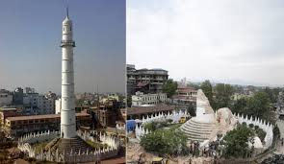
Dharahara
It was the largest tower made in cylinder shape in our country.
It is situated in the middle or heart of the Kathmandu valley.
It was built by the late prime minister of Nepal Bhimsen Thapa.
From the tower whole Kathmandu valley was visible.
It is said that it was built with the paste of pulses because cements and rods were not found at that time.
Unfortunately due to the massive earth quake of 2015 it was destructed. Lots of people died inside it.
It is under renovation now.

Slide 7
Thank you
Our country is full of uniqueness and these structures are one of them. All the building were built in medieval period when our country was not unified and was in states.
Medieval age is known as golden period in history of Nepal. These art and architecture was the base to know weather a state is rich or not. The competition of making the state beautiful, the kings of each states built the structures and Kathmandu valley is full of different unique structures.
We thank to those Malla and Lichchhavi Kings of Medieval age (636 b.s -1825 b.s) for this beautiful Kathmandu Valley.

Slide 8
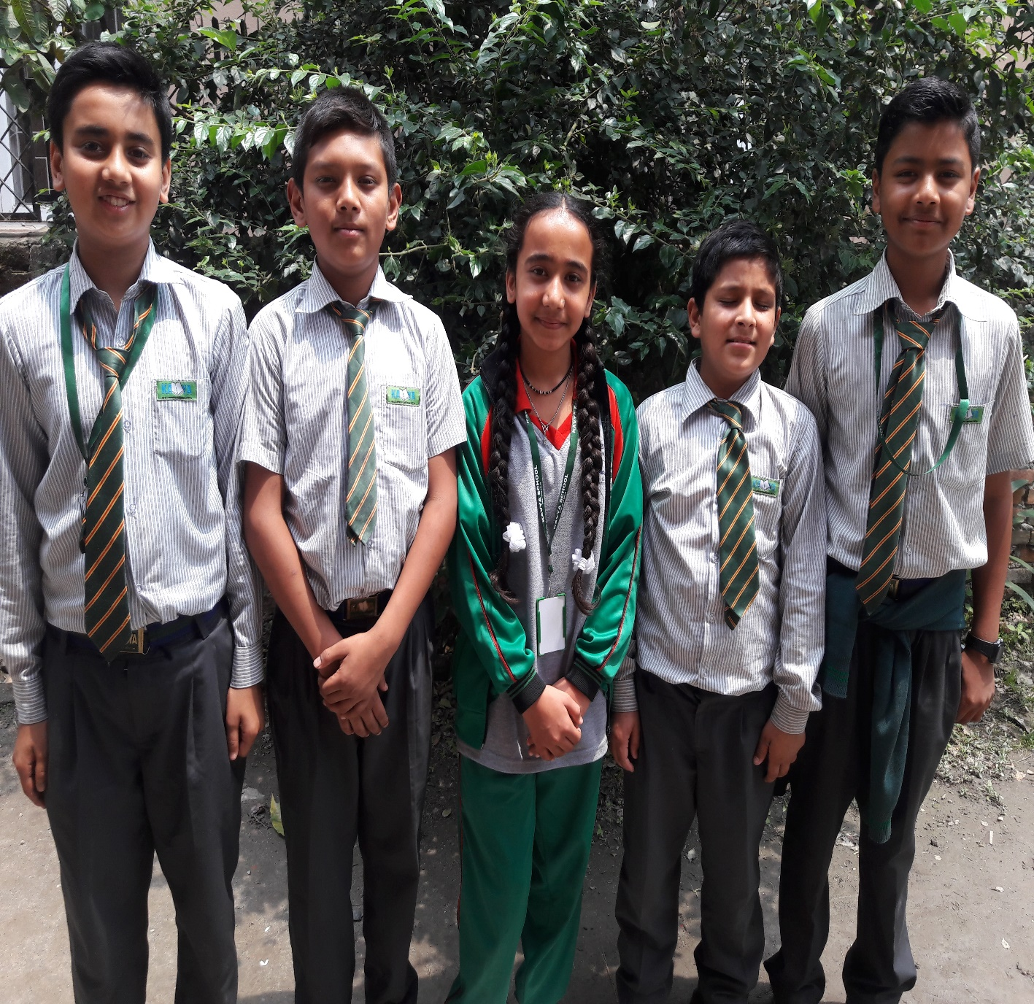
Group members
Sujita Chaulagain
Kushal Panta
Deep Singh Mahara
Sumiran Bohara
Smohit Baral

