Slide 1
Wonders In Our Country: United States
By
Delara & Kaitlyn

Slide 2
Hello,
Welcome to the United States. The two of us will be showing you the wonders in our country. We have many scenes to show you.
So let’s get started!

Slide 3
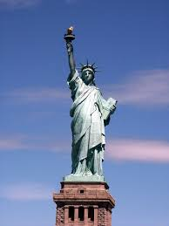
The Statue of Liberty
The Statue of Liberty is located in New Jersey, near New York City. The French gave it to the people of the United States as a gift. It was designed by French sculptor Frédéric Auguste Bartholdi and built by Gustave Eiffel. It was given in 1886. This is a big tourist attraction for Americans and people around the world. It is on an island so it is a fun experience taking a ferry to see it.

Slide 4
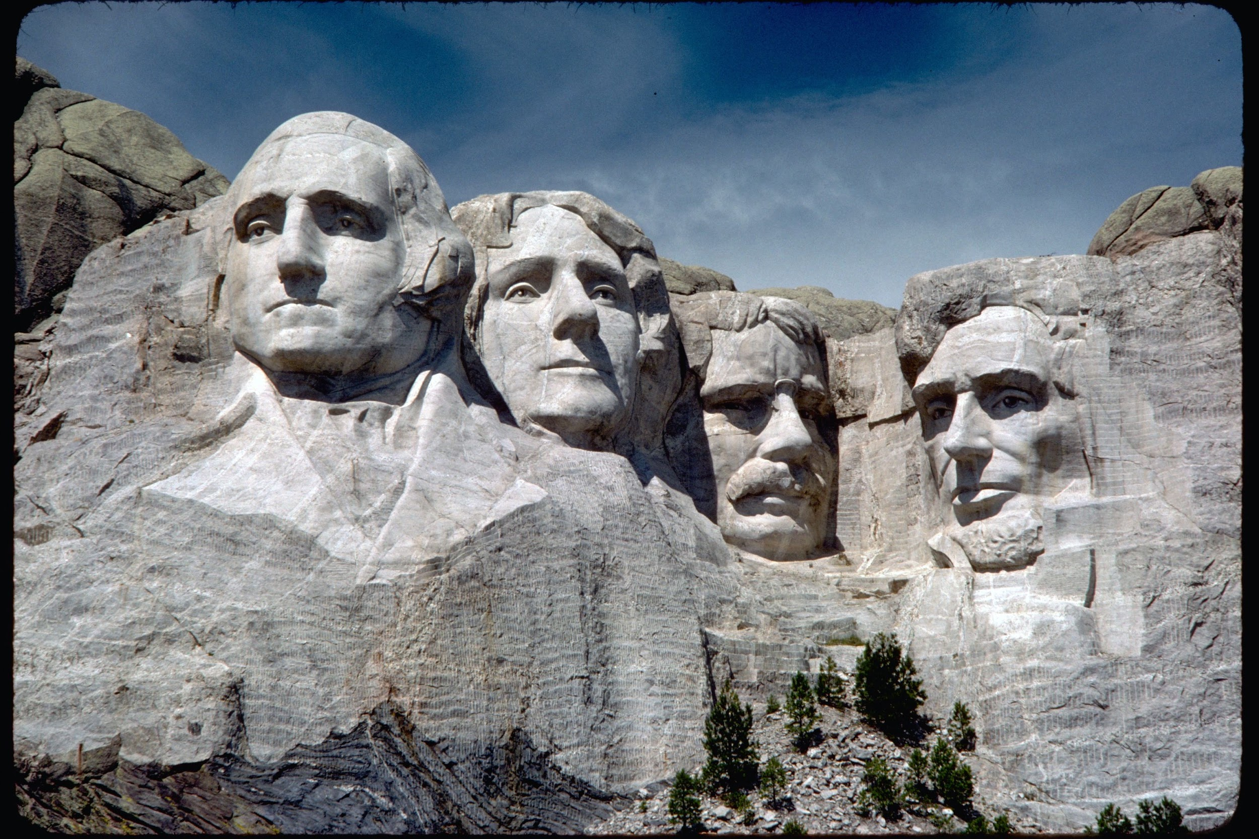
Mount Rushmore
Mount Rushmore is in South Dakota. In 2016, it was 75 years old. A local historian Doane Robinson came up with the idea to promote tourism in South Dakota. Gutzon Borglum, a famous Dutch American sculptor made it until his son took over after his death. The people who are on the sculpture are our previous presidents; George Washington, Thomas Jefferson, Theodore Roosevelt, and Abraham Lincoln.

Slide 5
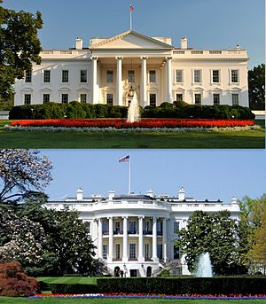
The White House
Front
The White House is the official residence and workplace of the President of the United States. It is located at the country's capital, Washington, DC. There are 132 rooms, 35 bathrooms, and 6 levels in the White House. It has been the house of the president since John Adams (#2 president.) I, Delara have taken a tour in the West Wing. One of the main rooms is the Oval Office. This is a oval shaped office where the President works.
Back

Slide 6
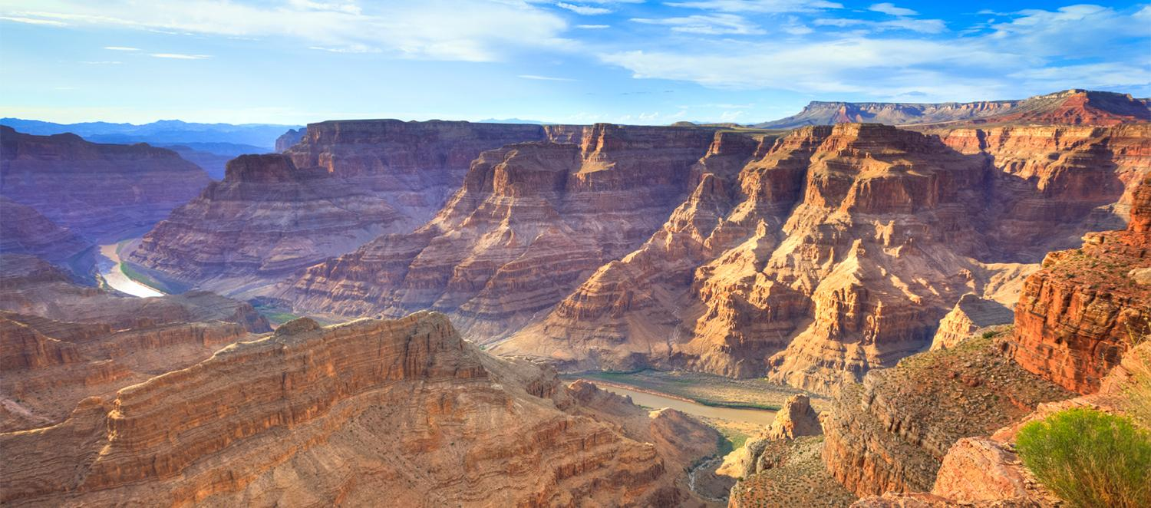
The Grand Canyon
The Grand Canyon is located in Arizona. It was formed by the Colorado River over millions of years. The Grand Canyon is 277 miles long and is around 6000 feet deep. At the Grand Canyon you can do a lot of fun stuff like hiking and rafting. It is one of the most popular National Parks in the United States.

Slide 7
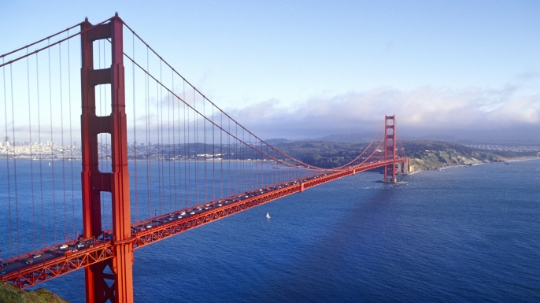
The Golden Gate Bridge
The Golden Gate Bridge is a man made bridge located in San Francisco, California. The Golden Gate Bridge took four years to be build. Some workers died during construction. The project started on January 5, 1933, during a difficult economic time called the Great Depression. It is famous because of its dramatic location and golden color.

Slide 8
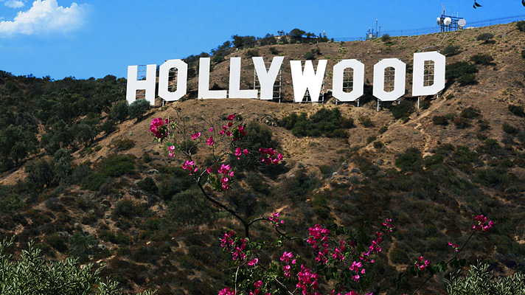
The Hollywood Sign
The Hollywood sign might look just like nine white letters, but it is way more than that. This is a famous landmark standing on Mount Lee in the Hollywood Hills area. This landmark is part of the Santa Monica Mountains. The sign once read Hollywood Land, but then it was shortened. Everyone loves this place because this is where movies and television shows are made. You can see a lot of celebrities in Hollywood. That is why the sign became so famous.

Slide 9
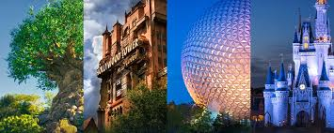
Walt Disney World
Walt Disney World is located in Orlando, Florida. It is a theme park where many Disney characters come to life. Walt Disney World has 4 parks: Epcot, Magic Kingdom, Animal Kingdom, and Disney’s Hollywood Studios. Our favorite park is Magic Kingdom! There are also two water parks called Disney’s Blizzard Beach and Disney’s Typhoon Lagoon. We have both been there before. I have been there about 8 times. Also there is another park called Disneyland in California.

Slide 10
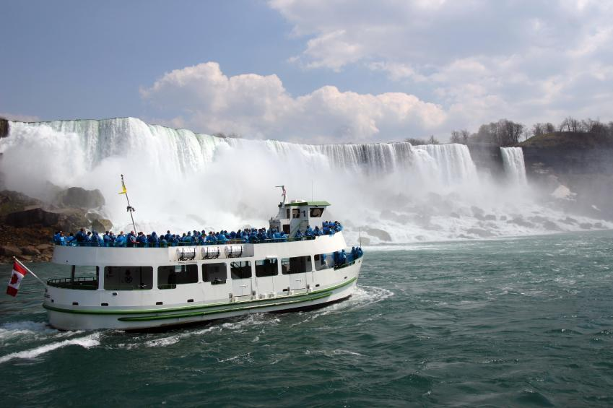
Niagara Falls
Niagara Falls is shared by New York, United States and Ontario, Canada. On the Canadian side it is 2,200 feet wide and on the American side it is 850 feet wide. The falls are 167 feet tall. This place is a huge tourist attraction because of the boat ride call ed The Maid of the Mist. The Maid of the Mist boat goes righ underneath the waterfall. You have to wear ponchos because you get soaked with water.

Slide 11
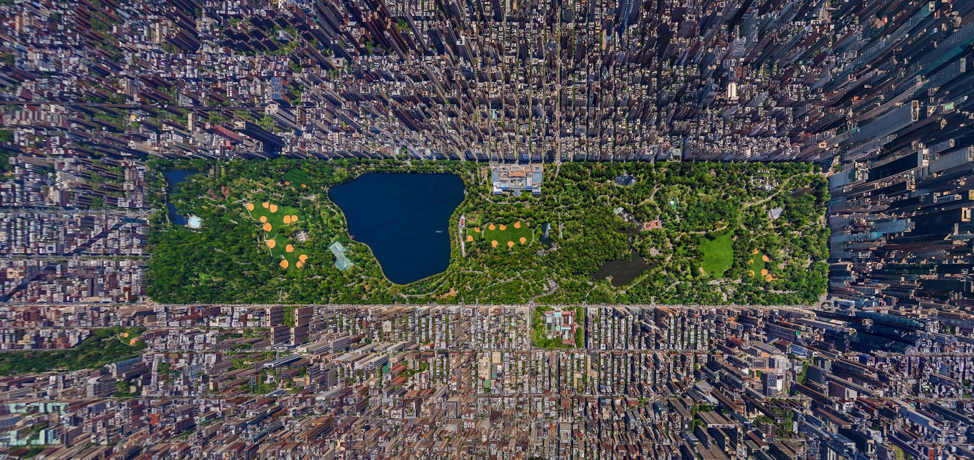
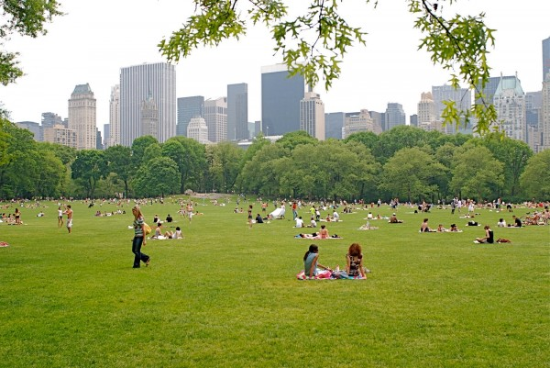
Central Park, New York City
Central Park is an urban park in Manhattan, New York City. Central Park is the most visited urban park in the United States, with over 40 million visitors a year. The park was established in 1857. It was on 778 acres of the city’s land. In 1858, Frederick Law Olmsted and Calvert Vaux, a landscape architect and an architect, respectively, won a design competition to improve and expand the park with a plan they titled the "Greensward Plan.” Today there are many activities to do there. Maybe you can have a picnic, take a bike ride, and then take a nap. Today the park is now 843 acres.

Slide 12
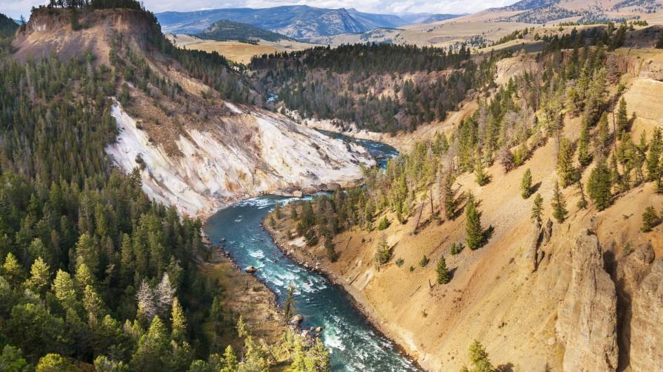
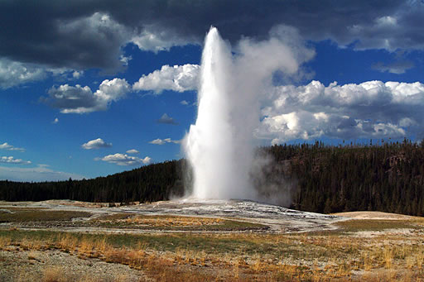
Yellowstone National Park
Yellowstone National Park is located in Wyoming. The park spreads into parts of Montana and Idaho. Yellowstone is a beautiful park. It is a nearly 3,500-square-mile wilderness recreation area atop a volcanic hot spot. It features dramatic canyons, alpine rivers, lush forests, hot springs and gushing geysers, including its most famous, Old Faithful. It's also home to hundreds of animal species, including bears, wolves, bison, elk and antelope.

Slide 13
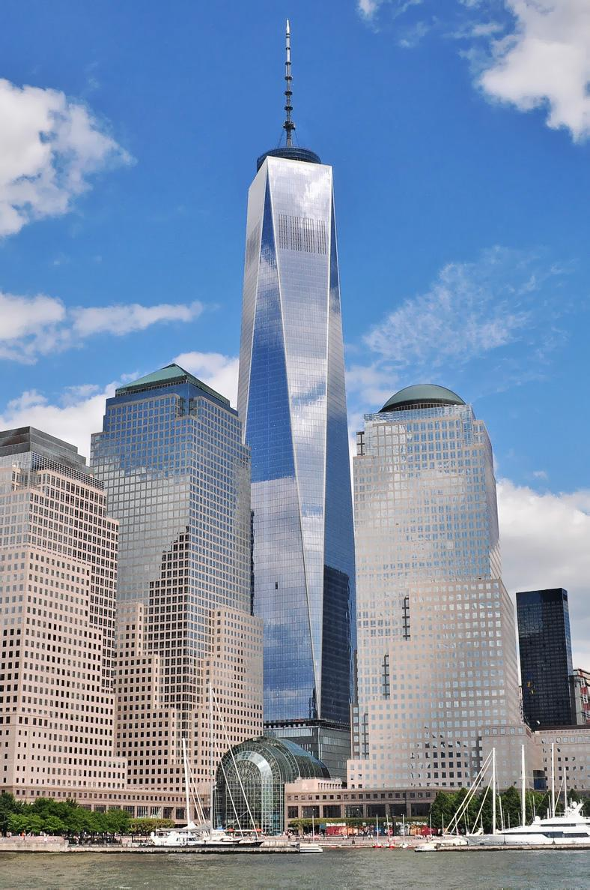
The Freedom Tower: World Trade Center
The World Trade Center is located on 285 Fulton Street in New York. It is the tallest building in New York. The tower houses 2.6 million square feet of office space. From above, the tower appears to twist 45 degrees, but it doesn't. The edges of the base are cut to create eight even-sided triangles so the building can reflect light and create an optical illusion. The tower is made of recycled material. Renewable energy sources such as water and sunlight will power the building. Emergency items, such as generators, ventilators, and water are located inside the core of The World Trade Center.

Slide 14
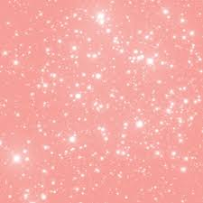
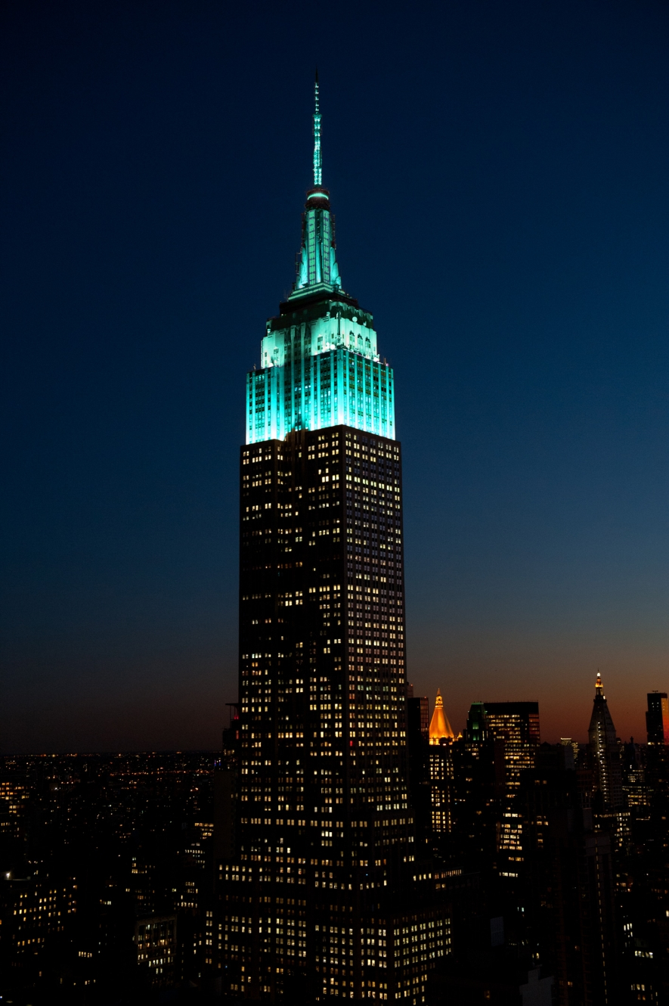
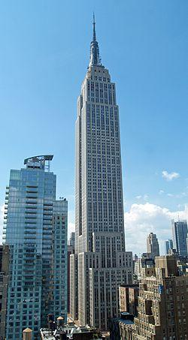
The Empire State Building
Daytime
The Empire State building is a 102 story skyscraper located on Fifth Avenue in New York City. It has a roof height of 1,250 feet, and with its antenna included, it stands a total of 1,454 feet tall. It stood as the world's tallest building for nearly 40 years. The Empire State Building is currently the fifth-tallest completed skyscraper in the United States and the 34th-tallest in the world. It is also the fifth-tallest freestanding structure in the Americas.
Night time

Slide 15
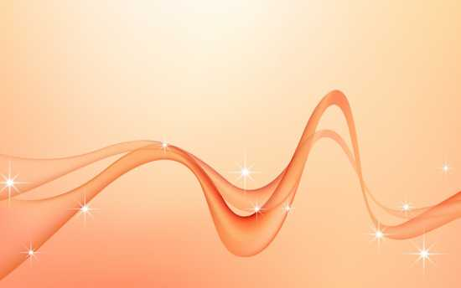
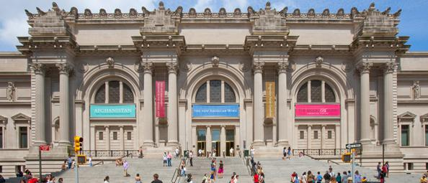
The Metropolitan Museum of Art
The Metropolitan Museum of Art is located on 1000, 5th Avenue in New York City. It displays over 5,000 years of art from around the world for everyone to see and enjoy. Since it was founded in 1870, it has always been more than just a treasury of rare and beautiful objects. Everyday, art comes alive in the Museum's galleries and through its exhibitions and events, revealing both new ideas and unexpected connections across time and across cultures.

Slide 16
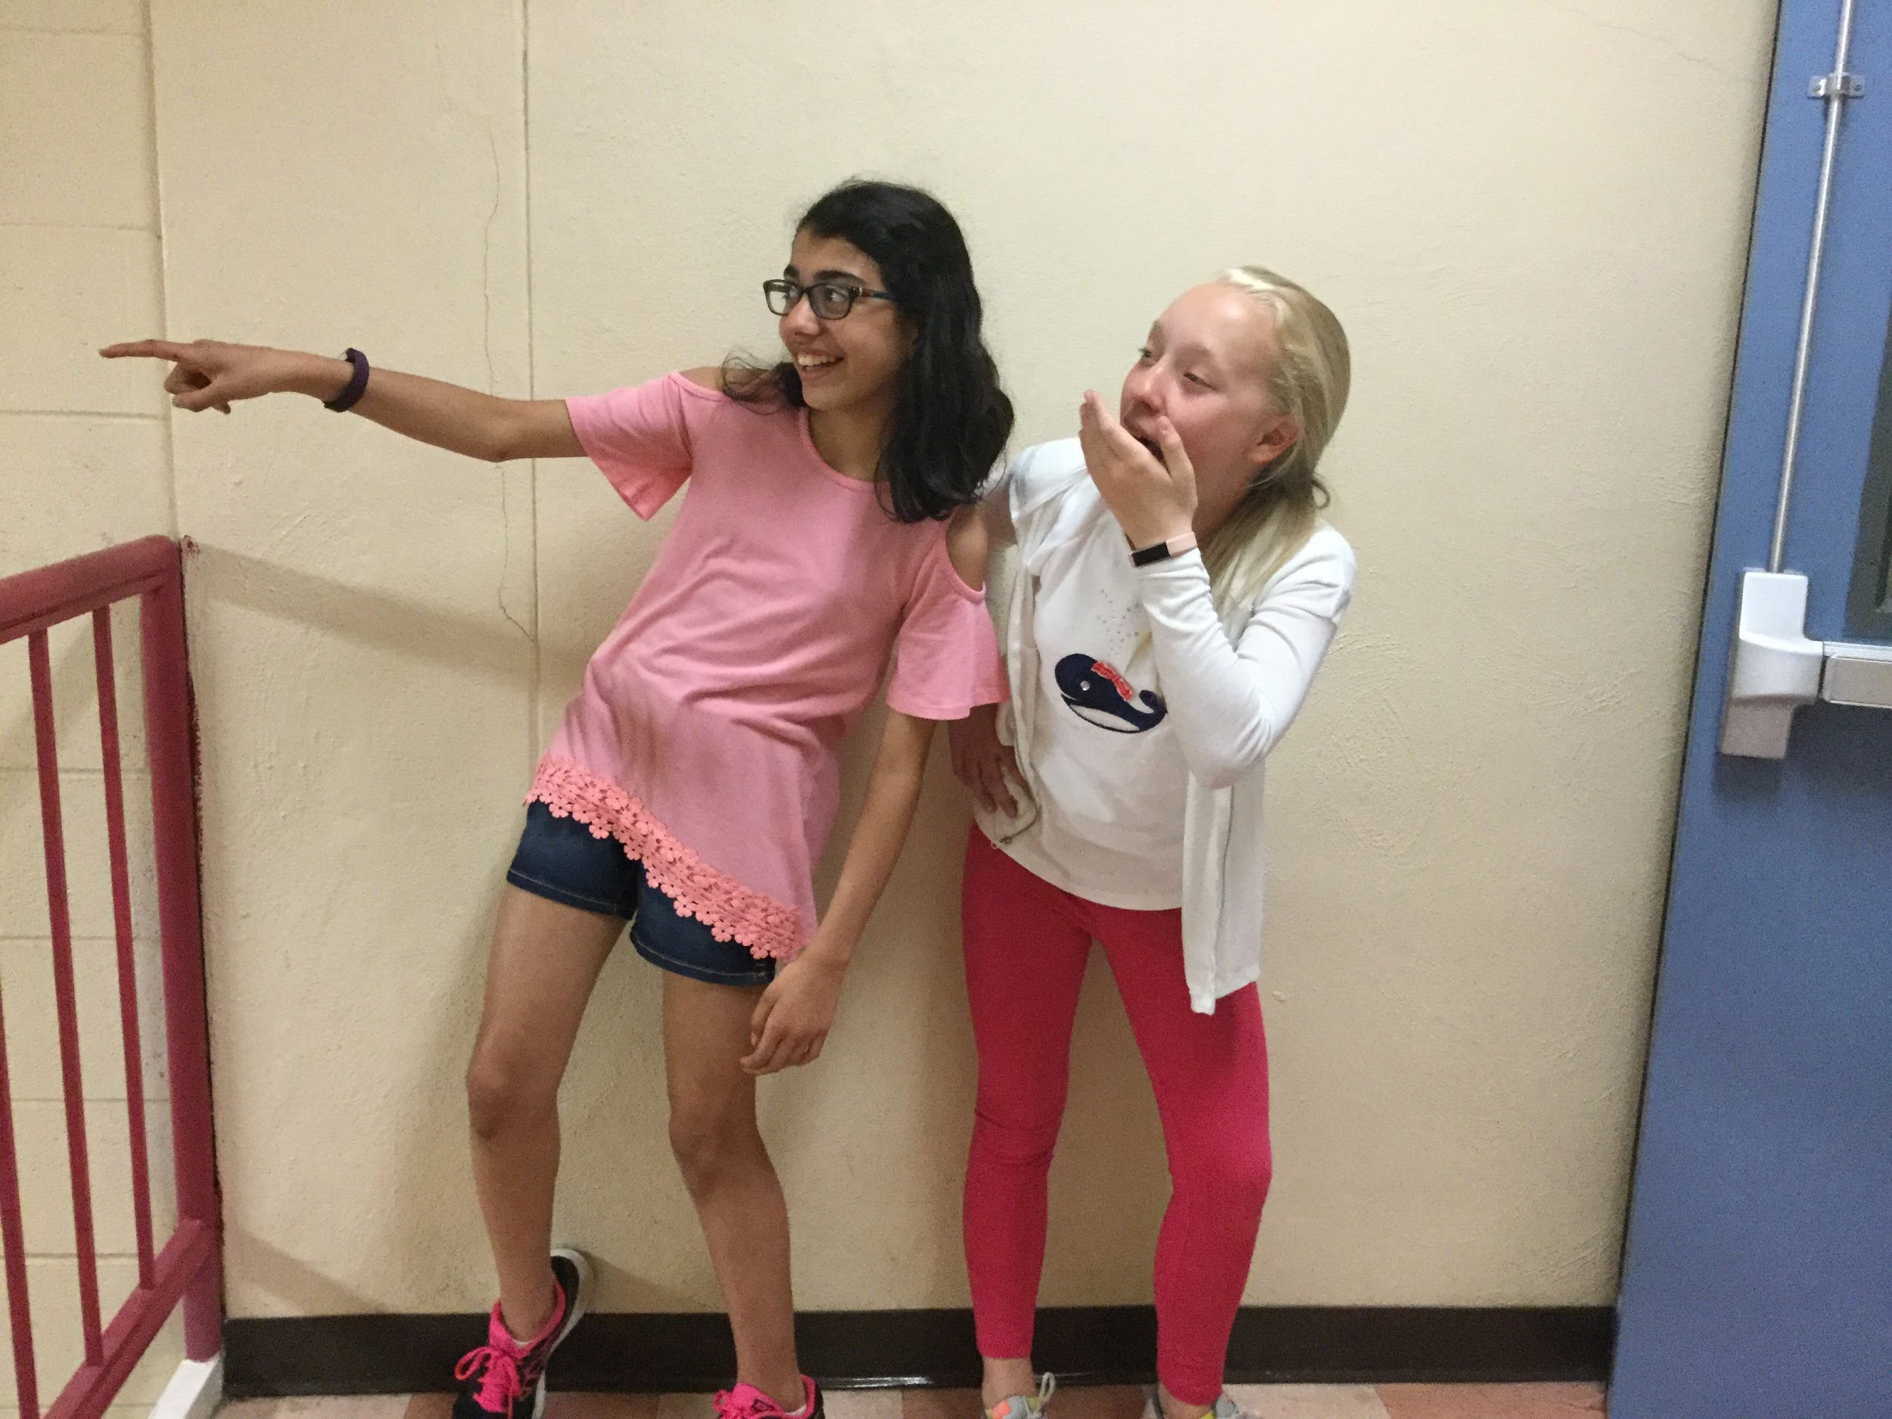
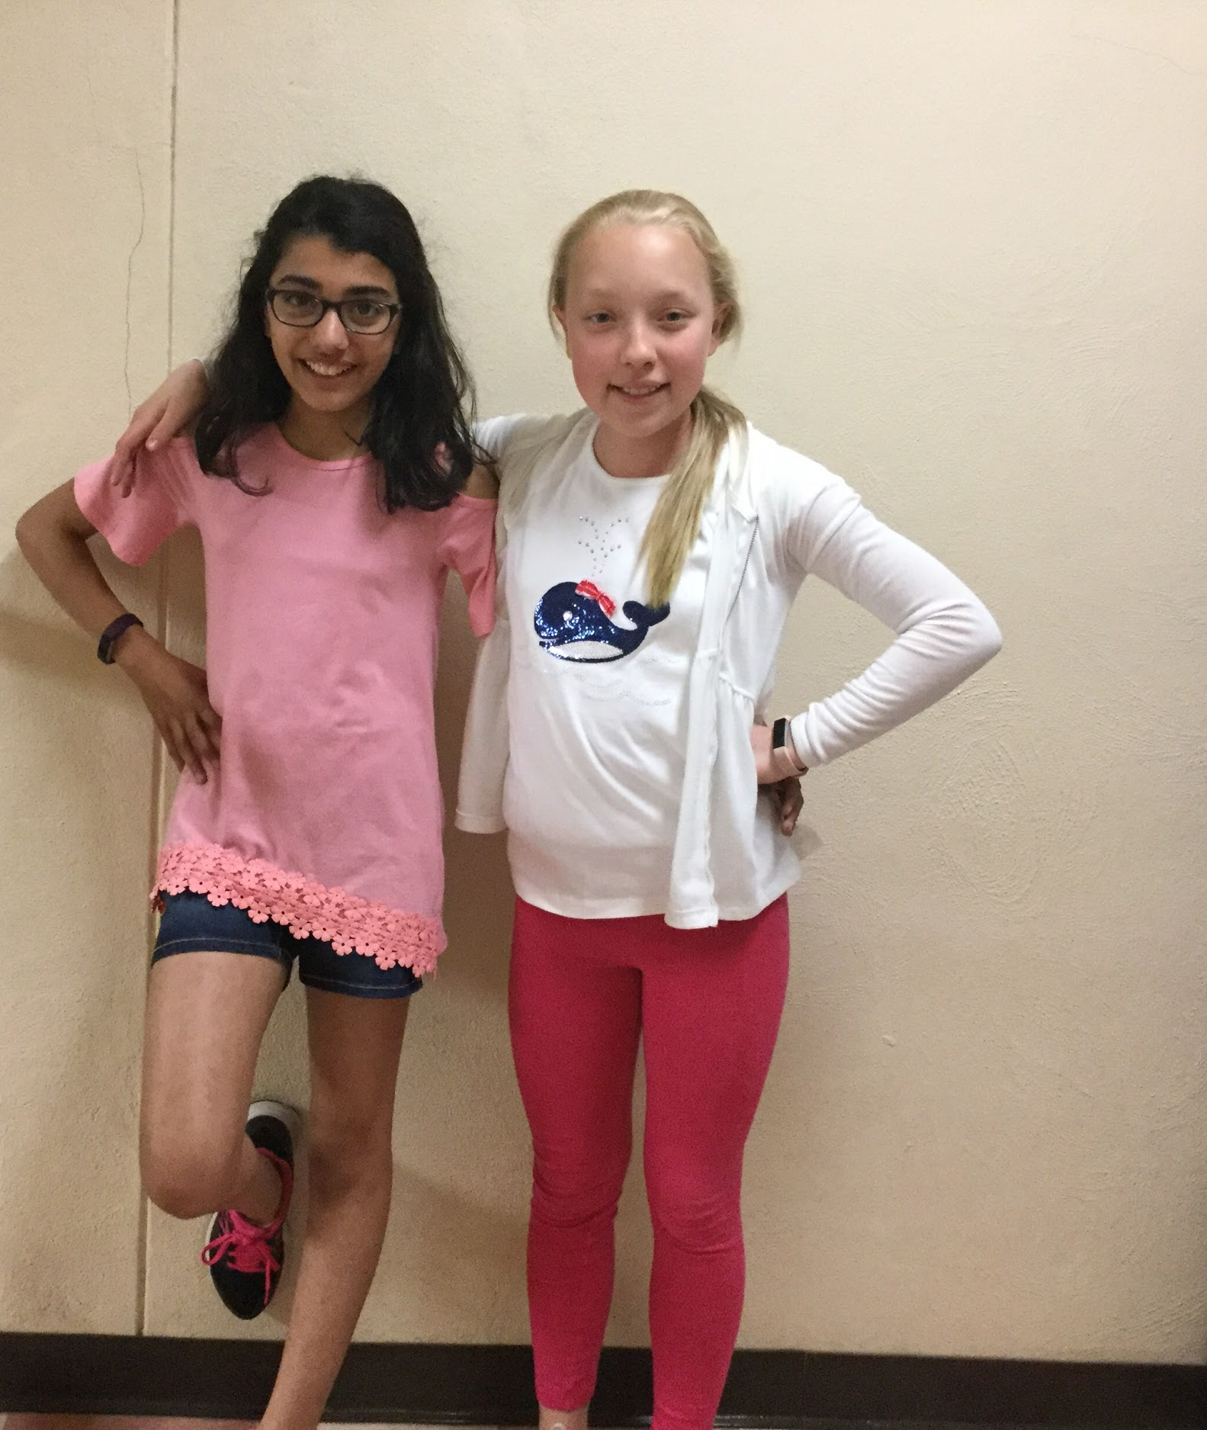
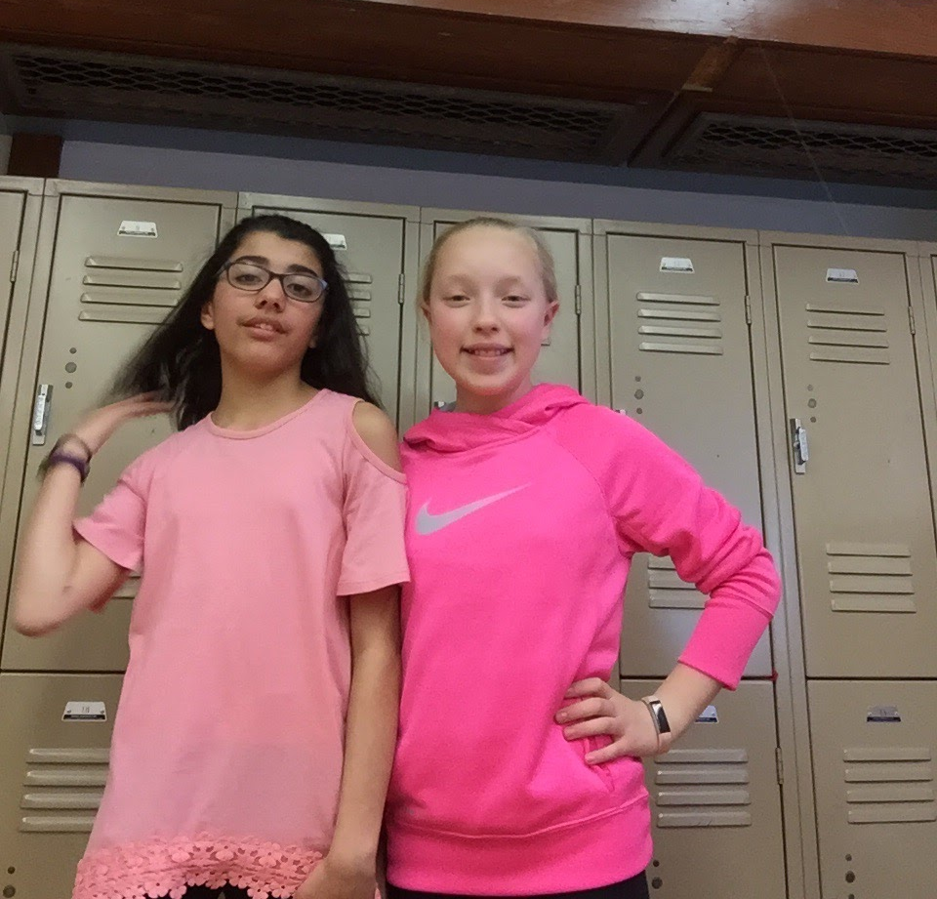
This Is Us
I am Katie
I am Delara

Slide 17
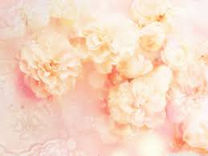
About Us
Hello,
I am Delara. I loved working on this project with my best friend. We have known each other since kindergarten so it is pretty easy doing this with someone I know. My two favorite slides that I worked on were the Hollywood Sign and the White House. I have been to almost all the wonders we have talked about. I hope you enjoy the slide, and we hope you learned a lot about the wonders in the United States.
Hello,
I am Katie. I have been to Walt Disney World about 8 times and some of the other landforms and human made landforms. My best friend, Delara and I had a very good time working on it together! My two favorite landforms are Walt Disney World and Yellowstone National Park. We hope you enjoy learning about the things that we listed.

Slide 18
Thank You
We enjoyed working on this for you

