Slide 1
ENDANGERED ANIMALS
REPUBLIC OF MOLDOVA

Slide 2
ENDANGERED ANIMALS
The biodiversity of the Republic of Moldova is conditioned by the geographical position and its territory is located at the confluence of the three bio-geographical areas: Central-European, Eurasian and Mediterranean. Unfortunately, because of human activity, many plants and animals are endangered. In 1976 appeared the first edition of the Red Book of the Republic of Moldova and it contained 50 species of endangered plants and animals.

Slide 3
ENDANGERED ANIMALS
After 25 years, in 2001 appeared the second edition of the book, and the number of endangered plants and animals increased considerably - 126 plant species and 116 species of animals. The flora of the Republic of Moldova includes over five thousand species of plants. More than 15 thousand species of animals are meeting in the Republic of Moldova. The Red Book of the Republic of Moldova includes 116 species of rare, vulnerable and endangered animals. The most endangered of them are reptiles.

Slide 4
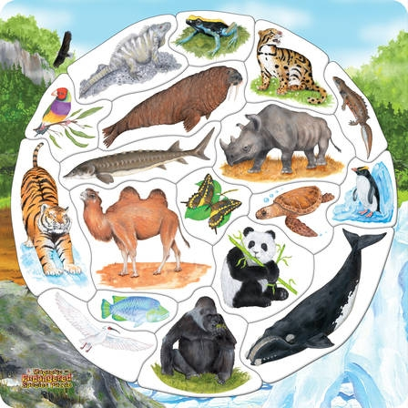
Top 10 critically endangered animals from Moldova

Slide 5
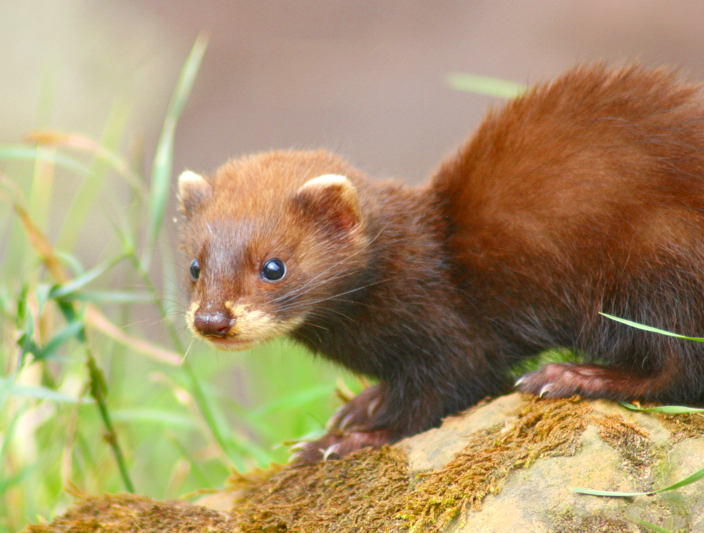
ENDANGERED ANIMALS
1. European Mink - it has totally brown fur, except lips. It feeds on aquatic creatures, but also on birds and small mammals.
Эта фотография, автор: Неизвестный автор, лицензия: CC BY-SA

Slide 6
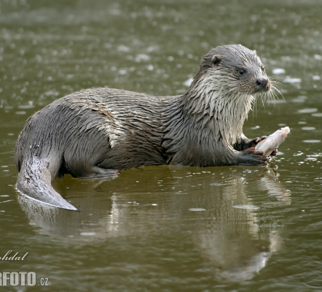
ENDANGERED ANIMALS
2. Otter- has glossy fur with short and frequent hair. They feed on frogs, fish, crustaceans and other aquatic invertebrates.
Эта фотография, автор: Неизвестный автор, лицензия: CC BY-SA

Slide 7
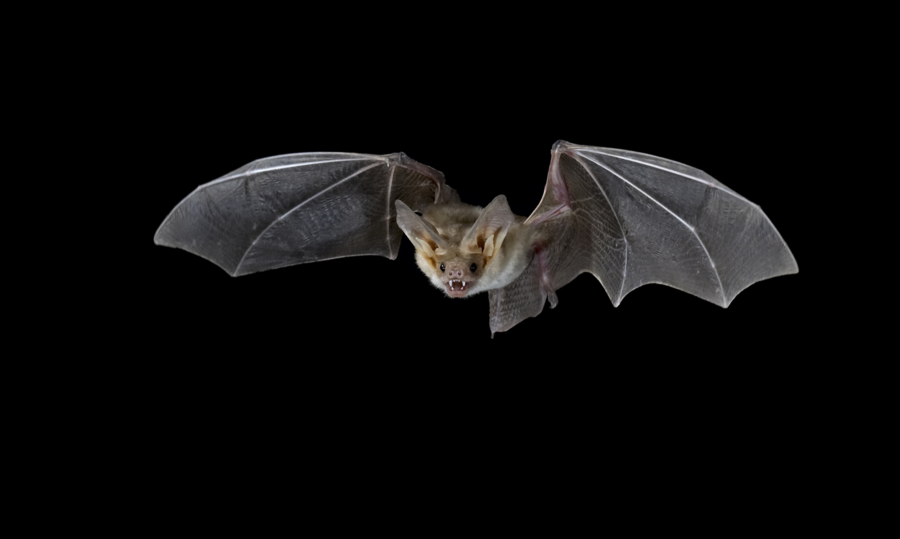
ENDANGERED ANIMALS
3. Snubbed Bat- has almost dark gray fur with shades of gray and brown, long and narrow wings. Feeds insects and agricultural pests.

Slide 8
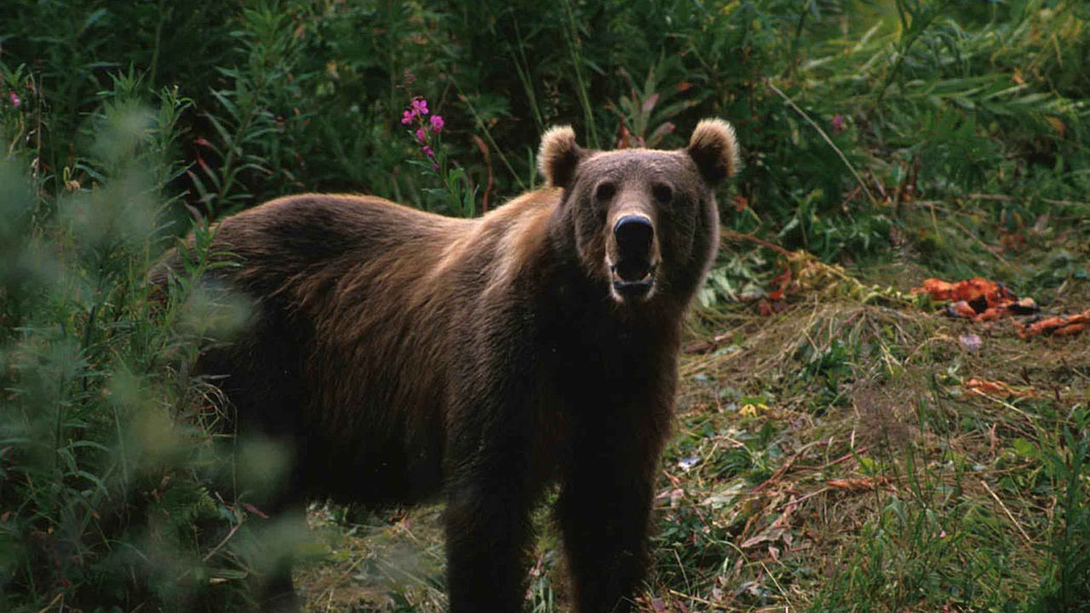
ENDANGERED ANIMALS
4. Big Bear - has soft foam, short neck, bulky head, large eyes, short beak. It feeds on rodents or insects that they hunt at night.
Эта фотография, автор: Неизвестный автор, лицензия: CC BY-SA

Slide 9
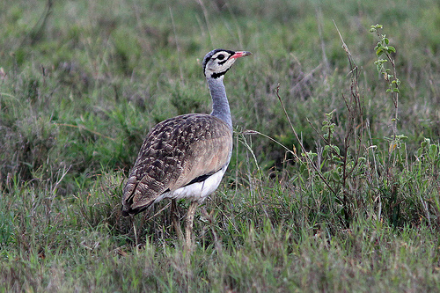
ENDANGERED ANIMALS
5. Small Bustard - low height, semi-long neck, medium beak. It feeds on vegetation, green beans and peas, but also insects and small invertebrates.
Эта фотография, автор: Неизвестный автор, лицензия: CC BY-NC-ND

Slide 10
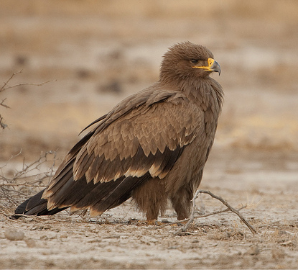
ENDANGERED ANIMALS
6. Steppe Eagle - large bird with tail and tip of black wings. It feeds on small animals, birds and reptiles.
Эта фотография, автор: Неизвестный автор, лицензия: CC BY-NC-SA

Slide 11
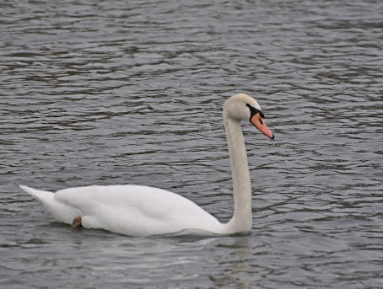
ENDANGERED ANIMALS
6. Steppe Eagle - large bird with tail and tip of black wings. It feeds on small animals, birds and reptiles.
Эта фотография, автор: Неизвестный автор, лицензия: CC BY-NC-ND

Slide 12
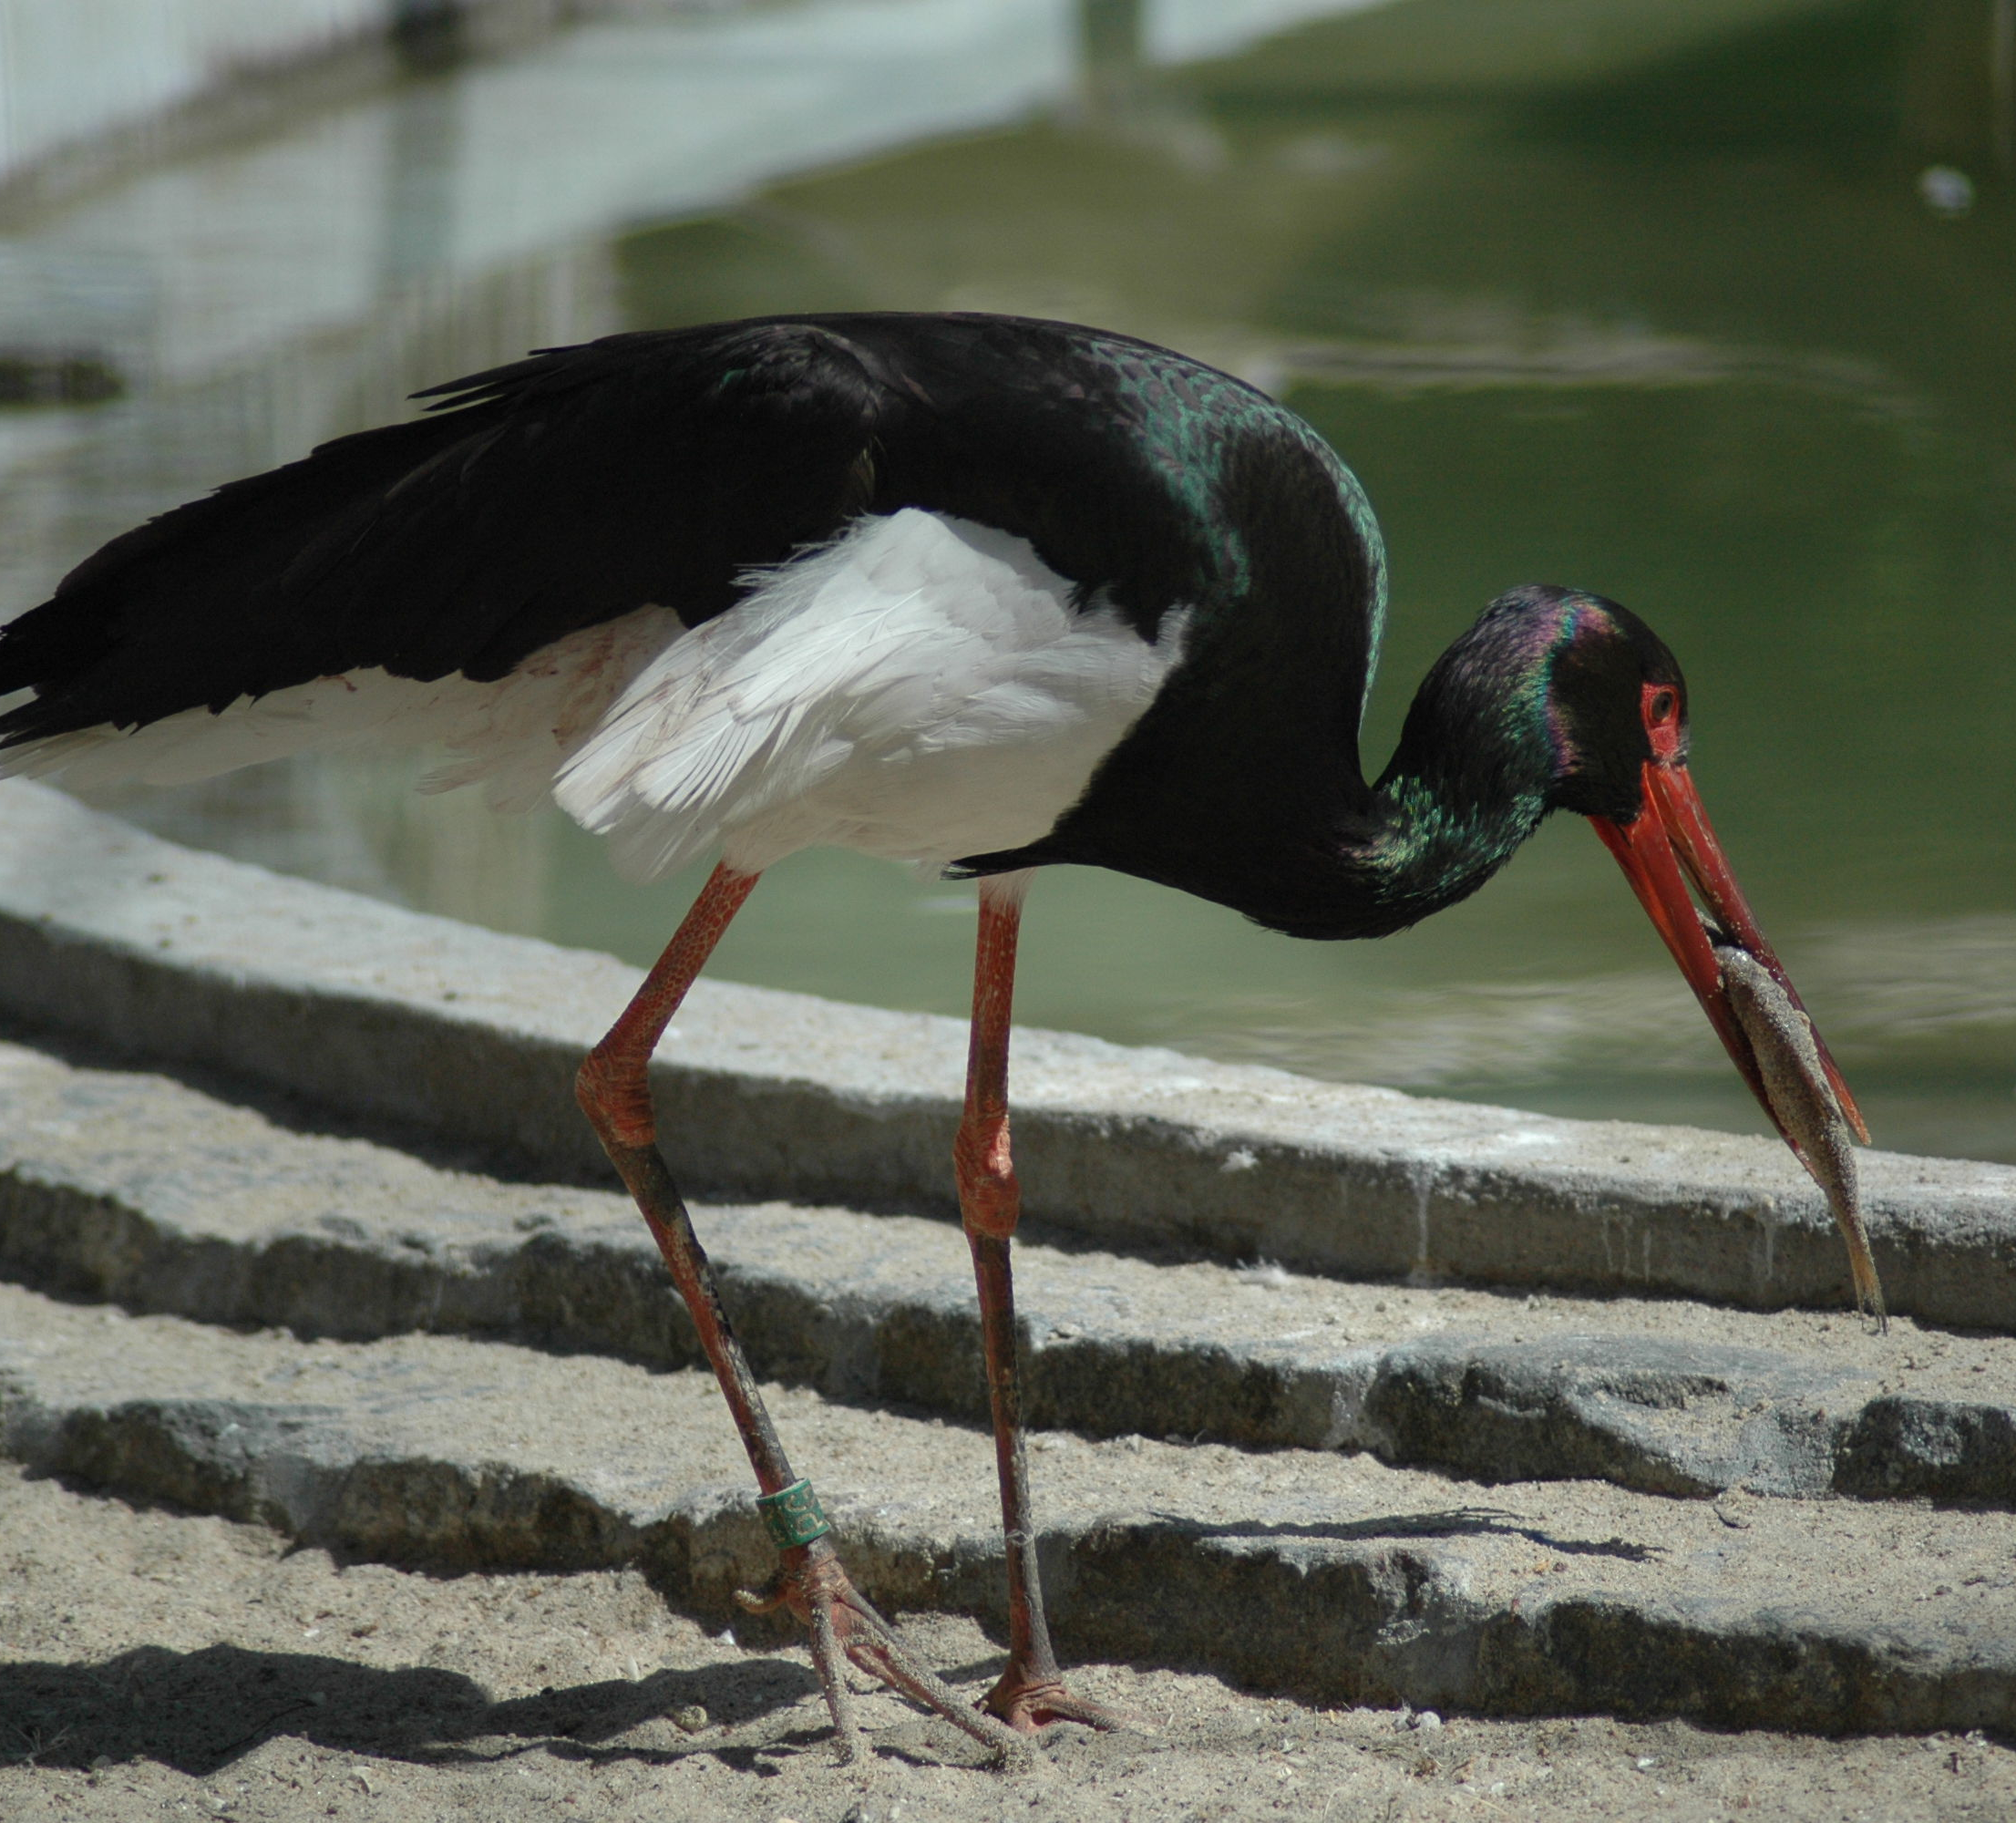
ENDANGERED ANIMALS
8. Black Stork - almost black plumage, the abdomen is white, the legs and the beak are long. She feeds on fish, insects, frogs, snakes.
Эта фотография, автор: Неизвестный автор, лицензия: CC BY-SA

Slide 13
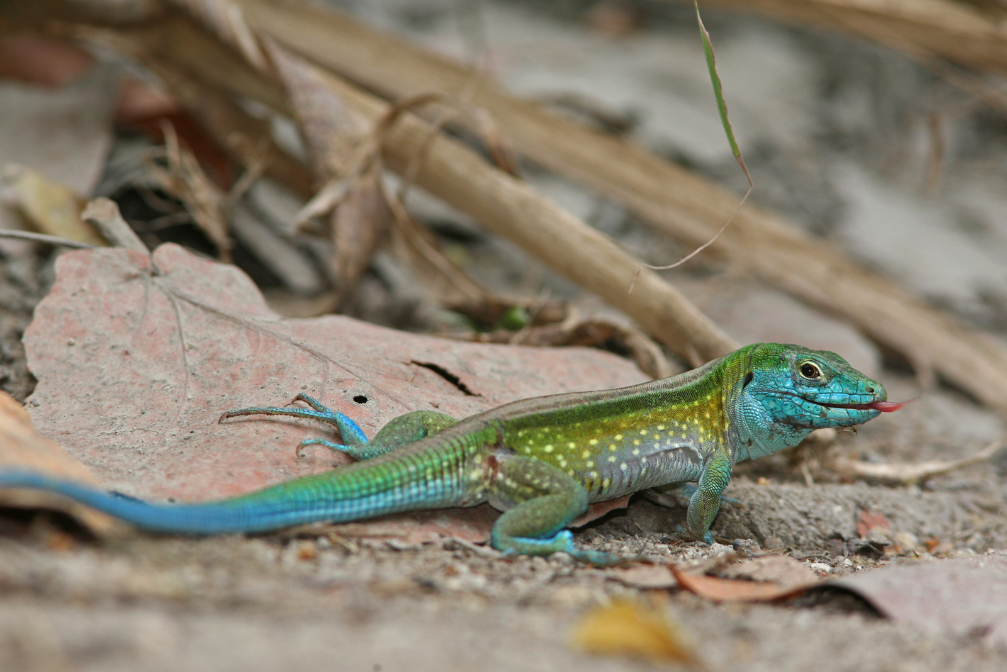
ENDANGERED ANIMALS
9. Multicolor Lizard - fleshy skin, thick brown with white and black spots, short limbs. It feeds on earthworms, flies, caterpillars.
Эта фотография, автор: Неизвестный автор, лицензия: CC BY-SA

Slide 14
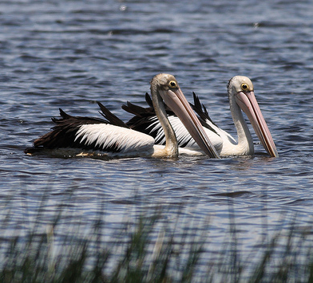
ENDANGERED ANIMALS
10. Common Pelican-white plumage and the tip of the wings black, the long beak and beneath it there is a yellow-orange bag that serves them as a net. They feed on sick or isolated fish in ponds, but also with other poultry and household waste.
Эта фотография, автор: Неизвестный автор, лицензия: CC BY-NC-SA

Slide 15
ENDANGERED ANIMALS
Basically, these animals are almost no longer found in the Republic of Moldova, but they are still hunted by people who then sell them at a considerable price.
People, let’s be more human and let’s not destroy our world.

Slide 16
ENDANGERED ANIMALS
Done by the pupils
from the High School ‘’B.P.-Hasdeu’’
from Drochia, Moldova

