Slide 1
What is Pollution?
the presence in or introduction into the environment of a substance which has harmful or poisonous effect.
Industrial pollution is generally referred to the undesirable outcome when factories (or other industrial plants) emits harmful by-products and waste into the environment such as emissions to air or water bodies (water pollution), deposition on landfills etc (land pollution)

Slide 2
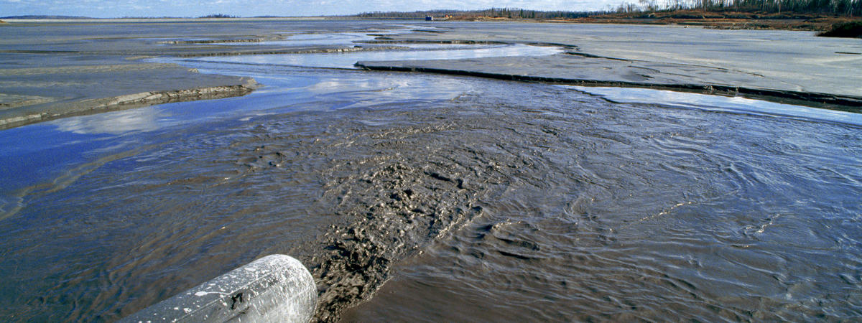
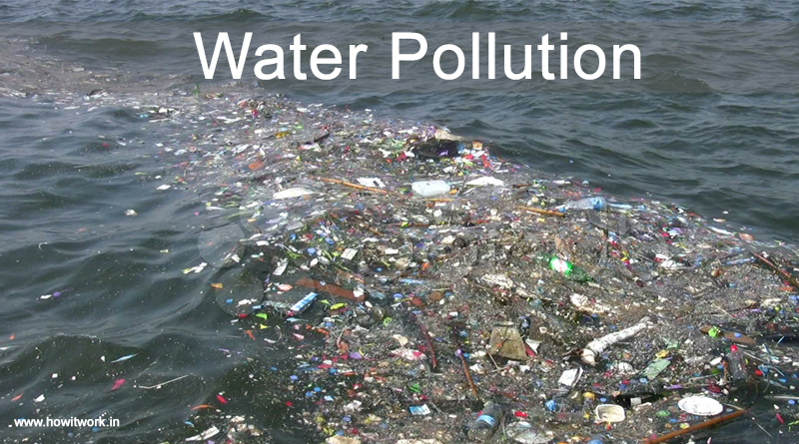
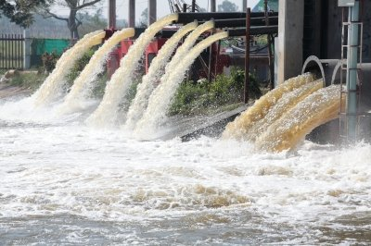
What is water pollution?
Water pollution is the contamination of water bodies.

Slide 3
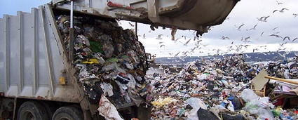
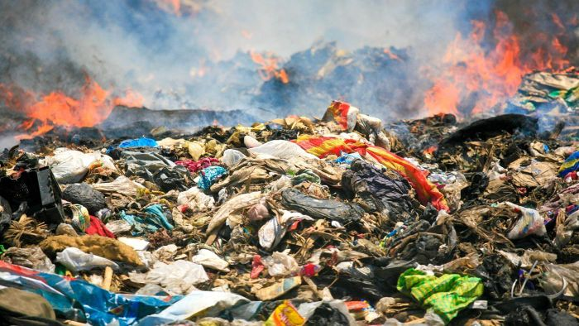
What is land pollution?
Land pollution, in other words, means degradation or destruction of earth's surface and soil.

Slide 4
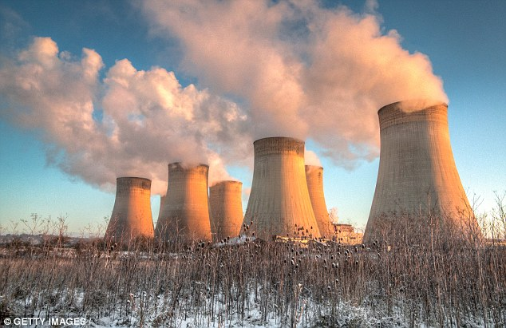
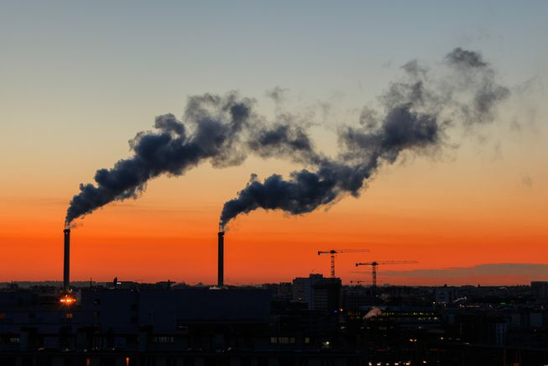
What is air pollution?
Air pollution is a mixture of solid particles and gases in the air.

Slide 5
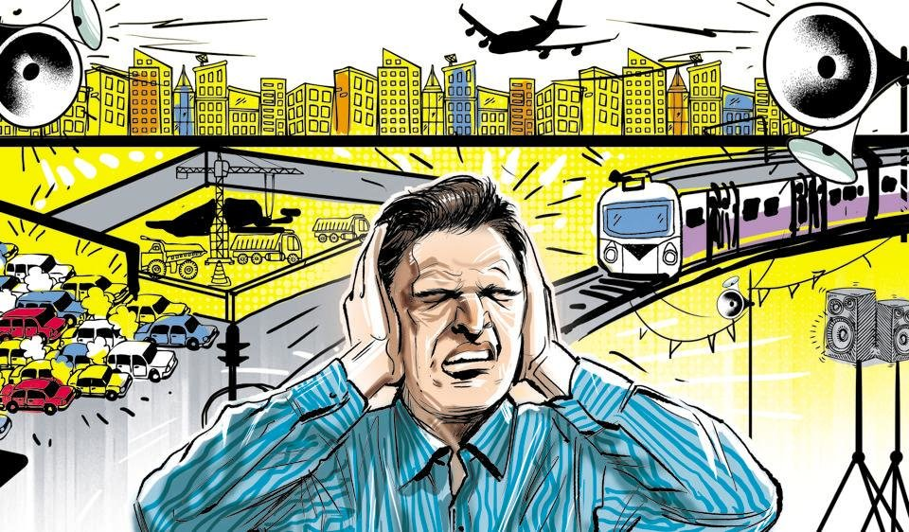
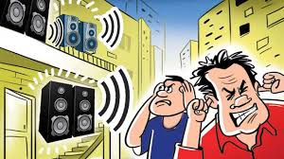
What is Noise pollution?
Noise pollution, also known as environmental noise, is the propagation of noise with harmful impact on the activity of human or animal life.

Slide 6
FACTS:
Pollution is one of the biggest global killers, affecting over 100 million people
Over 1 million seabirds and 100,000 sea mammals are killed by pollution every year.
Each year 1.2 trillion gallons of untreated sewage, stormwater, and industrial waste are dumped into US water.
Approximately 40% of the lakes in America are too polluted for fishing, aquatic life, or swimming.

Slide 7
THE END

