Slide 2
What is peace ?
Peace is the harmony between different social groups characterized by non-violence or conflict between behaviors, and they are free from fear of violence. The prevailing concept is the absence of enmity and reprisals. Peace also suggests sincere attempts at reconciliation among nations.

Slide 3
Why we are suffring from absence of peace ?
At least 108 million people were killed in wars in the twentieth century.
Anytime we see anyone as “the enemy,” we prevent peace. Anytime we let robotic thinking rule our brain, we prevent peace.
Whenever we allow ourselves to think ethnocentrically and don’t challenge our and their thinking, we prevent peace.
Traditional ways of bringing about peace only create more conflict. We need to change our thinking, and therefore how we act.
World wars are also reasons which obstructed peace achivement.

Slide 4
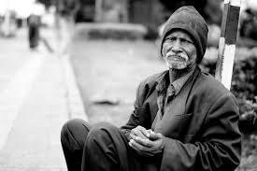
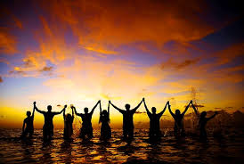
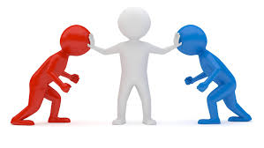
How to achieve peace ?
I believe that in order to achieve peace in the world it is necessary that people live in good conditions, happily, that they do not need anything. It is also desirable to avoid the most important causes of wars: delusions of grandeur, greed among the rulers.
We could also achieve it by saying no to bullying and standing with one another to reach our goals.
We must fight hate, teach tolerance, and seek justice.
We should eduate people and help the poor.

Slide 5
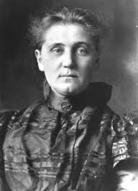
One of the famous peaceful activists
Jane Adams

Slide 6
Jane Addams, known as the "mother" of social work, was a pioneer American settlement activist, social worker, public philosopher, sociologist, public administrator, protestor and author.
She was born Born on 6 September 1860, Cedarville, IL, USA
Jane Addams was the second woman to receive the Nobel Peace Prize. She founded the Women's International League for Peace and Freedom in 1919.
she worked to help the poor and to stop the use of children as industrial laborers.
She ran Hull House in Chicago, a center which helped immigrants in particular.
At the end of her life, Jane Addams was honored by the American government for her efforts for peace.
She died on May 21,1935. Cause of death was Cancer. Place of death was Chicago, Illinois in United States of America.

Slide 7
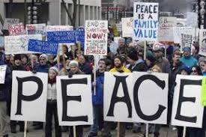
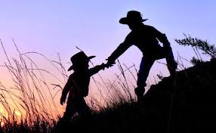
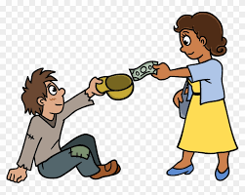
How do we express peace ?
We smile
We Participate in protests
We help each other
We give charities to the poor

Slide 8
Organizations for peace
Greenpeace is defined as the non-violent, independent and international NGO for environmental protection. Greenpeace is an international organization. Greenpeace is present on all continents and oceans thanks to its 28 national and regional offices and its three boats.

Slide 9
Greenpeace is uses non-violent, creative confrontation to expose global environmental problems, and to force the solutions which are essential to a green and peaceful future. Greenpeace's goal is to ensure the ability of the earth to nurture life in all its diversity.

Slide 10
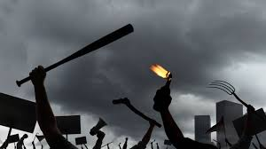
What are the main causes and effects of violence ?
Causes:
Not being educated about different kinds of people, people having easy access to guns and other weapons when they are not mentally well.
Effects:
Bullying, suicides, and sometimes murder

Slide 11
How can we stop violence in schools ?
With protests and awarenesses, defend students not guns.
Security.
Keep guns and weapons away from classrooms, do not arm teachers.

Slide 12
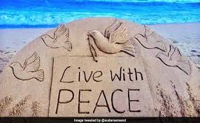
How could you live in peace ?
1) List down all of the bad and good impressions. 2)Remember: the present is called present, as it is a gift indeed. 3)Be thankful for everything you have 4)Help others who needs 5)Offer a helping hand to your friends 6)Practice the joy of sharing with others 7)Realise that when you are happy and peaceful , you make others be peaceful as well

Slide 13
My future plan for peace
To achieve peace I see that everyone should play a role step by step, from the smallest action to the biggest organization.
That’s why my plan is based on building people personality since they go to school . I will give my project to the ministry , so like that pupils will know the imoprtance of peace early and they will use their knowldege to achieve it.

Slide 14
What are the main causes and effects of violence among youth?
Causes:
Not being educated about different kinds of people, people having easy access to guns and other weapons when they are not mentally well
Effects:
Bullying, suicides, and sometimes murder

Slide 15
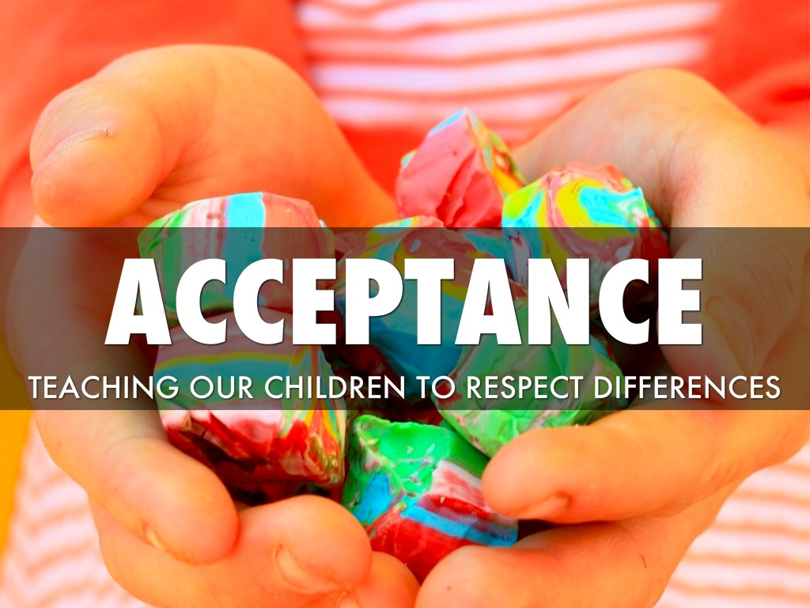
6 Actions to stop violence in schools
Educate children early about acceptance
Do not allow bullying
Don’t be a bystander
Be open to others / don’t become a bully yourself
Make anti-bullying decorations
Understand that we are all different, and we must accept each other to have peace

Slide 16
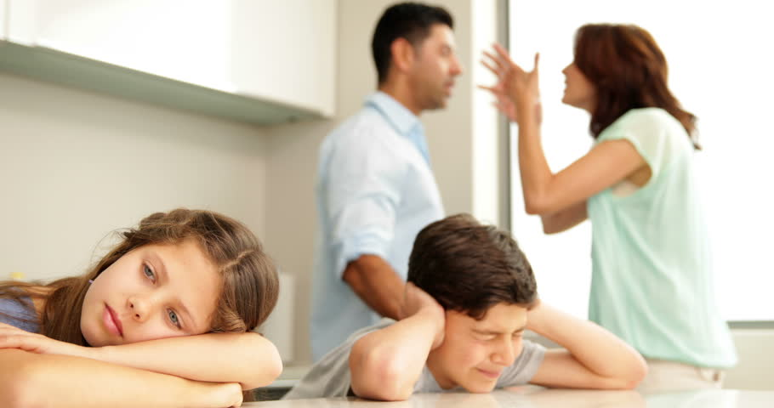
What are the main forms of violence?
Emotional abuse
No parental presence
Physical abuse
Domestic abuse
Verbal abuse
Sexual abuse
Date rape
Lack of consent
Drug abuse

Slide 17
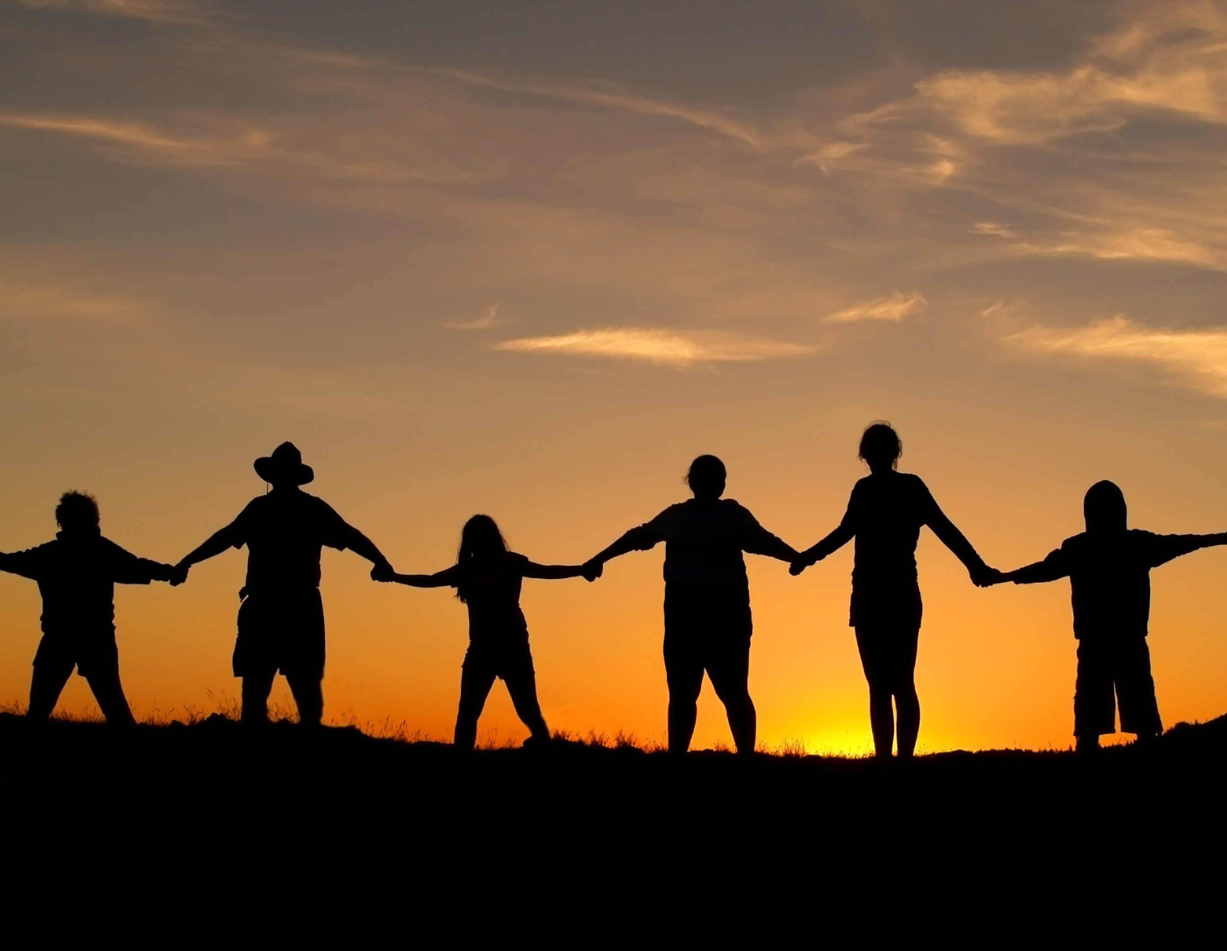
How can we keep ourselves safe?
-Awareness
Watching out for one another
-Technology
Using it to talk and close the gaps in our community
-Protest
-Promote peace in Community events

Slide 18
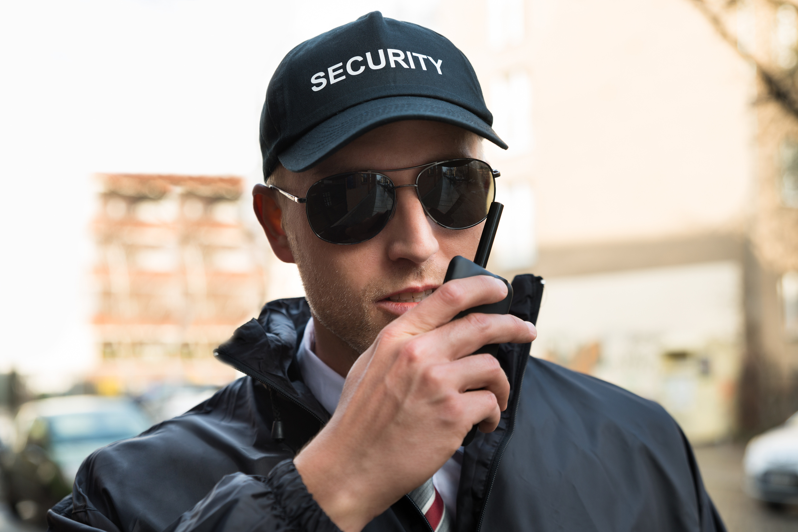
How can we stop violence in school?
Protest and awareness, defend students not guns.
Security
Keep guns away from classrooms, do not arm teachers

Slide 19
Thank you
Mohamed Seddik ben yahia students

