Slide 1
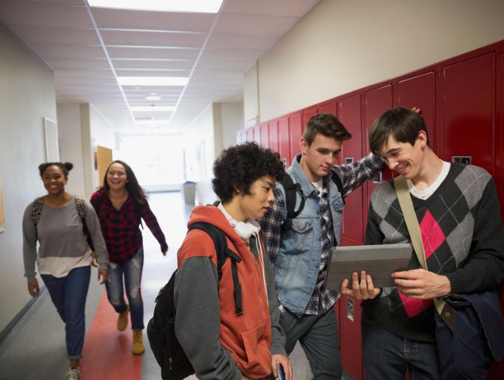
Violence Among Youth

Slide 2
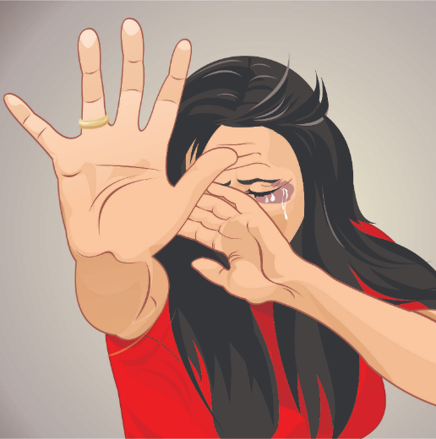
What violence is?
Violence - use of physical force or power directed against another person, group of persons or community, resulting in bodily injury, death, psychological trauma or various kinds of damage

Slide 3
What is violence?
School violence is just one of the manifestations of daily violence. Debates on
the relationship between the concept of "right to safety" and the school environment has come to Europe
constant and constant development, with differences from country to country, becoming officially a problem
following an expert meeting, organized by the European Commission in Utrecht, in
1997. The media are increasingly paying attention to violence, contributing to
raising awareness.

Slide 4
Statistics
Every 7 minutes one teenager dies from violence. The average age of victims – from 15 to 19 years old.
60-70% of victims do not seek help
95% of cases involving adolescent violence do not reach court.
The reason for these terrifying numbers is the attitude of society towards violence. 40% of residents believe that the person provokes rape herself.

Slide 5
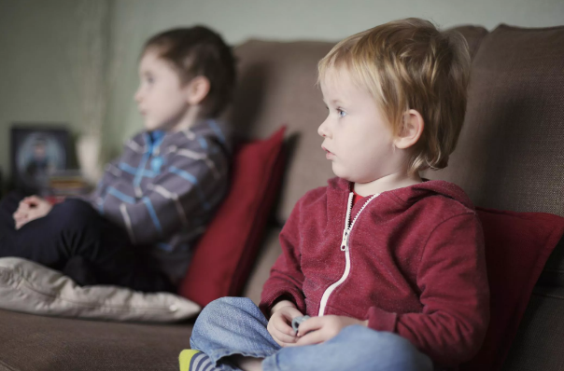
Causes of violence among youth
Media Influence
Violence in the media can influence your teen and can cause them to act aggressively. The 'media' here is defined as anything your teen sees, hears or interacts with that can be found on the Internet,
on television, in magazines, at the movies, in video games, in advertising, etc.

Slide 6
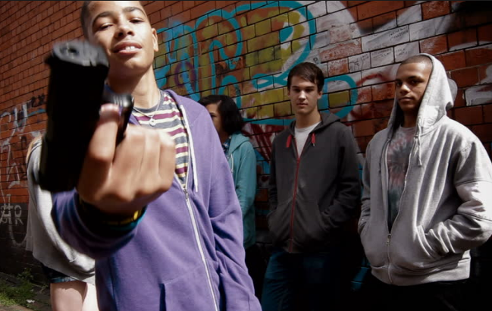
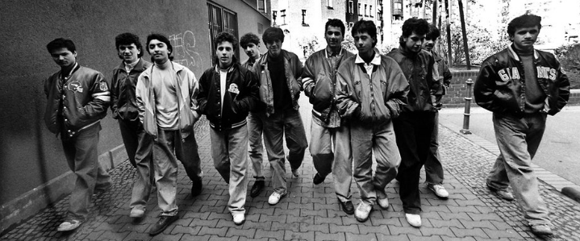
Teen's Neighborhood
Teen's neighborhood can cause your teen to act more aggressively. If you live in a neighborhood where teens are forced to join gangs to survive and fighting is the norm, the teen is apt to act aggressively and participate in violent behaviors.

Slide 7
Domestic and Child Abuse
Children who live with violence in the home can become violent people. If a teen is living with domestic abuse in their home, they are learning how to abuse. As child abuse is seen as a cycle, children of
abuse can become the aggressors. This aggressive behavior often starts in their teens.

Slide 8
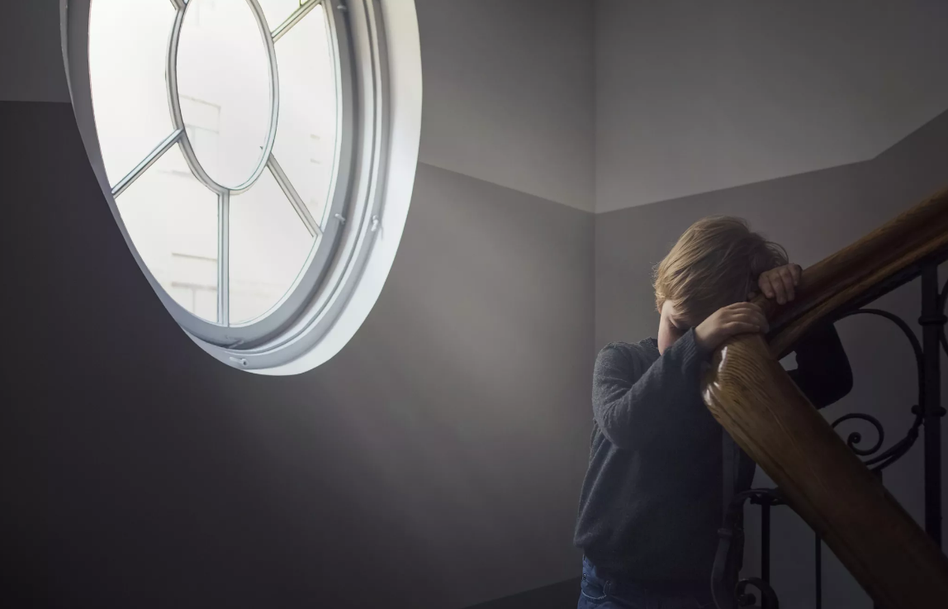
Insufficient Parental Supervision
Teens who received insufficient supervision by their parents or parental figures are prone to engaging in aggressive behaviors or criminal activity because they make poor choices. When parents do not take an active role in their teen's life, teens go out of control. They make friends with the wrong people,
they don't strive to do their best in school and they stop caring about their future. Teenagers need fair and firm discipline - this is one of the reasons why.

Slide 9
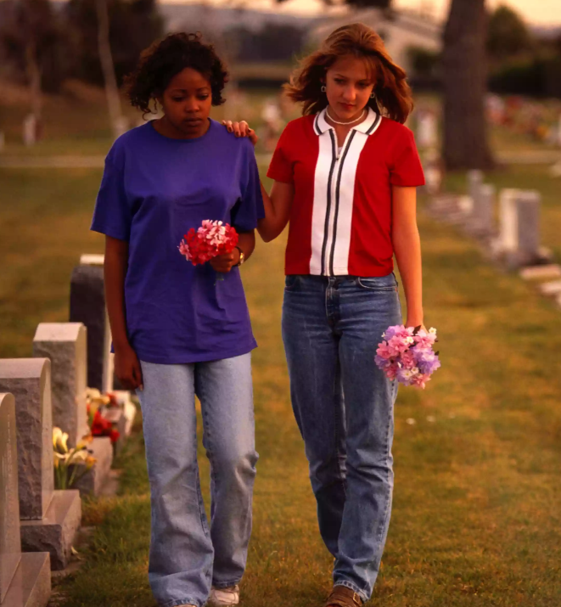
Traumatic Events
Dealing with traumatic events can cause violent behavior in teens. For instance, if the teen loses a friend in a car accident that they were also involved in they could get angry at the fact that they were the one that lived. As anger is a normal stage of grief, a violent outburst from this teen seems almost justified.

Slide 10
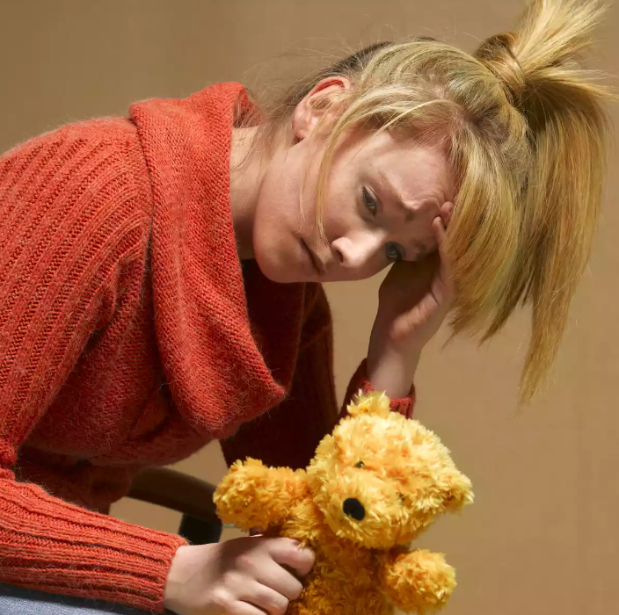
Mental Illness
Mental illness is also another cause of violence among teens. Mental health issues that are being diagnosed today, all have aggressive behaviors or angry feelings as common symptoms.
Mental illness sometimes hides behind other causes of youth violence. For instance, a teen with bipolar disorder may be using drugs. If this teen becomes violent, the drug use could hide the fact that the bipolar illness is part of the cause.

Slide 11
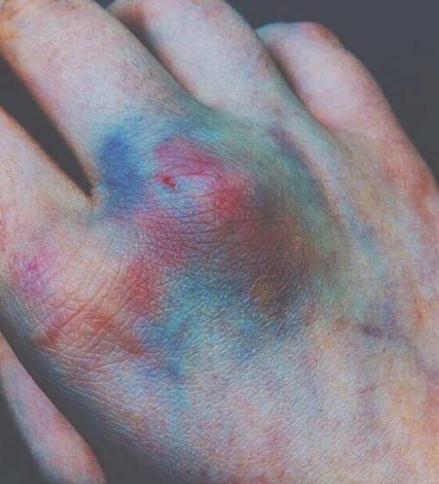
Effects of teens violence
Youth violence has serious and lasting effects on the physical, mental, and social health of young people.
Mental effects: Irritability, low-self-esteem, sadness, anxiety, depression, insomnia , poor performance, negative behaviour
Physical effects: bodily injury, death, psychological trauma or various kinds of damage.

Slide 12
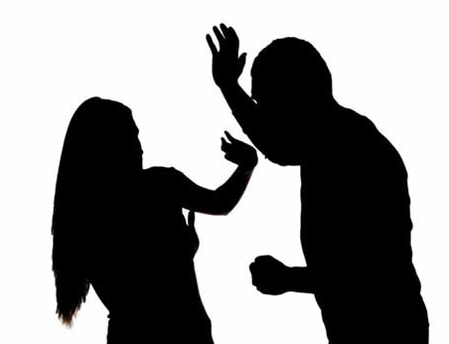
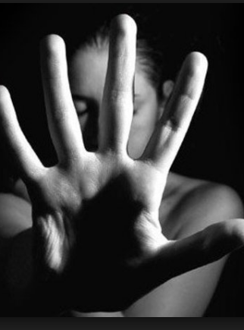
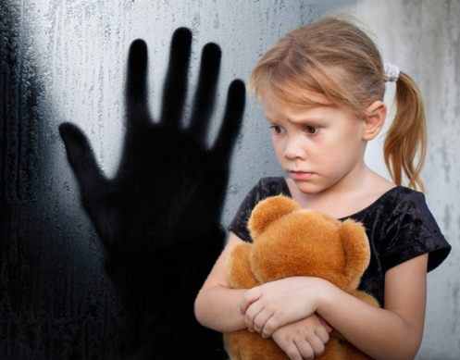
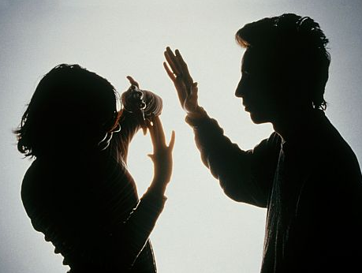
Main forms of violence
physical
sexual
Psychological
Spiritual
Community
neglect

Slide 13
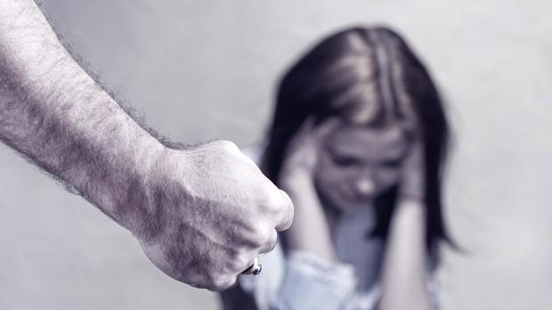
Physical violence
It’s the simplest and most obvious type of violence. In which a person is beaten or shackled, either by a part of the body or by a tool. It also includes any actions that result in bodily harm even if the manipulation of food, treatment or temperatures that an individual needs

Slide 14
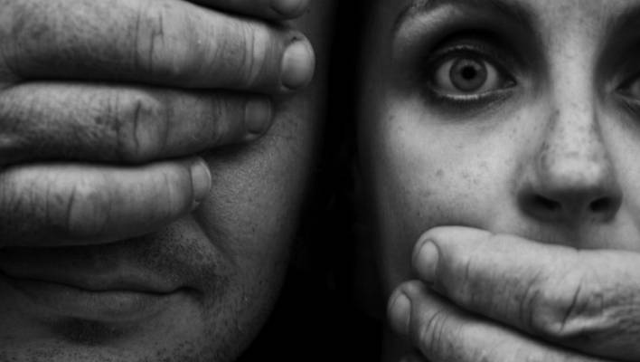
Sexual violence
This type of violence when forced to practice any act of sexual coercion is not necessarily a complete relationship, but it is sufficient to compel any kind of physical abuse to utter words of sexual content to the other.

Slide 15
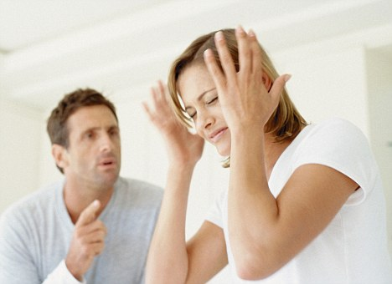
Psychological violence
Psychological violence is a species that has a great impact on self and I think everyone has been exposed to it at some point in his life. It is when he says or does something that causes the other to feel stupid or worthless. But not limited to: blame, jealousy, ridicule, damage to third parties' property.

Slide 16
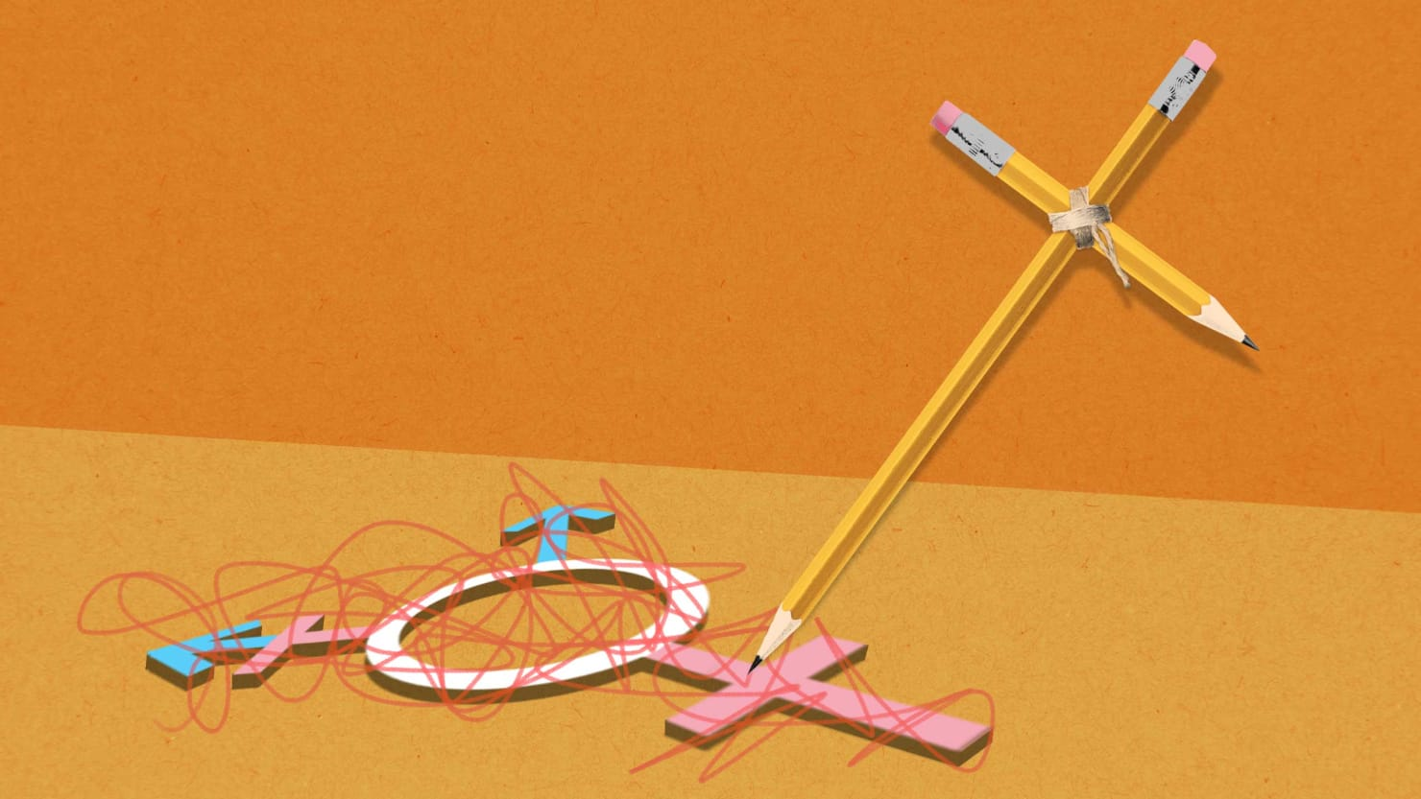
Spiritual violence
Is to exploit someone's spiritual and religious beliefs in which a person believes in guiding him and controlling his actions. Ridicule his religious beliefs, try to force him to change his religion, or prevent him from practicing his religion and religious beliefs.

Slide 17
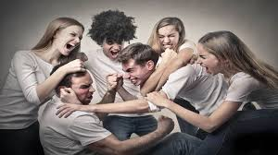
Community violence
Community violence is the cause of a person's harm because of the prevailing customs and traditions of society. At the top of these acts are social violence: female genital mutilation, early marriage, stoning, infanticide, exile and other acts of aggression that are due to community beliefs.

Slide 18
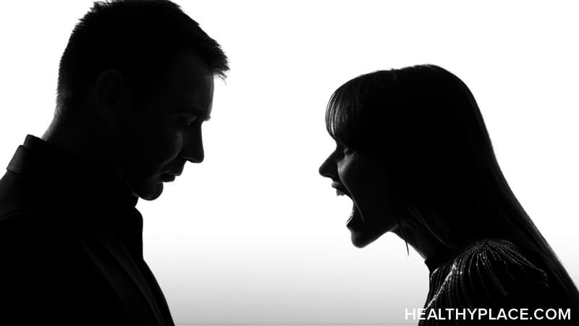
Verbal violence
Verbal violence may be one of the most common forms of violence, whether its users realize it is violence or not, writing or pronouncing insults and words towards someone.

Slide 19
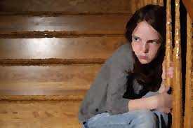
Neglect
In my personal opinion, neglect is one of the worst forms of violence simply because it may occur without realizing the culprit, and its effects are severe in the psychological state, especially since childhood. Negligence is violence when the party responsible for providing care or attention to one is negligent in his or her responsibility.

Slide 20
How can we keep ourselves save?
Know your rights—everyone has the right to be safe and free from harm at home and in the community
Stay in regular contact with people who support you and respect your decisions.
Worry about yourself
Stay out of drama
Be open minded
Respect others’ opinions
Communicate with staff
Seek healthcare service/counselors
Normalize mental health
Involve yourself in meaningful activities that give you enjoyment, strength and comfort. Go on outings with friends, volunteer, attend church, join a gym, or visit your neighbours.
Inform someone!

Slide 21
Actions to reduce violence in school What to do to reduce violence ?
The necessary measures and effective means of reducing the phenomenon of violence must be taken such as :
Integrate human rights and protect against violence and physical integrity into school curricula to reinforce these concepts.
Promote a culture of love and understanding, encourage the use of reason and praise the smart
Provide job opportunities and create income sources that enable young people to build families.

Slide 22
Learn how to deal with anger without resorting to violence by proving that it is not the appropriate way to resolve differences
Cooperation with clergy to spread a speech that promotes the principles of respect and solidarity among members of society.
To reinforce the concept of dialogue among young people and to give them the opportunity to express themselves and their needs.

Slide 23
Work with school officials to make policies protecting minority groups in school
Staff should be more understanding and open minded of different lives and situations
Have more mental healthcare providers at school
Provide outside speakers and resources to help motivate and involve all students
A space for students to voice their opinions
and actually be heard and understood. And
possibly a change could be made.

Slide 24
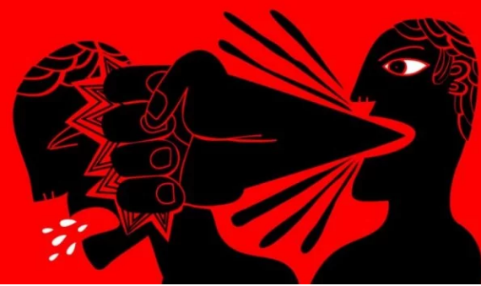
For many people, ... only physical violence truly qualifies as violence. But, certainly, violence is more than killing people, there are actions that kill people slowly. We must insist that violence also refers to that which is psychologically destructive, that which demeans, damages, or depersonalizes others.

Slide 25
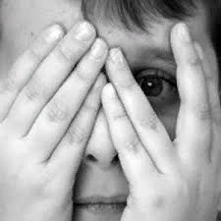
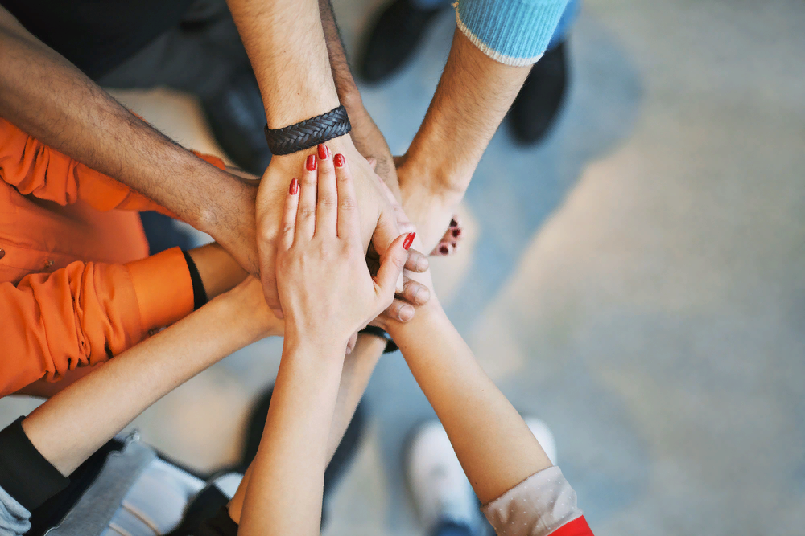
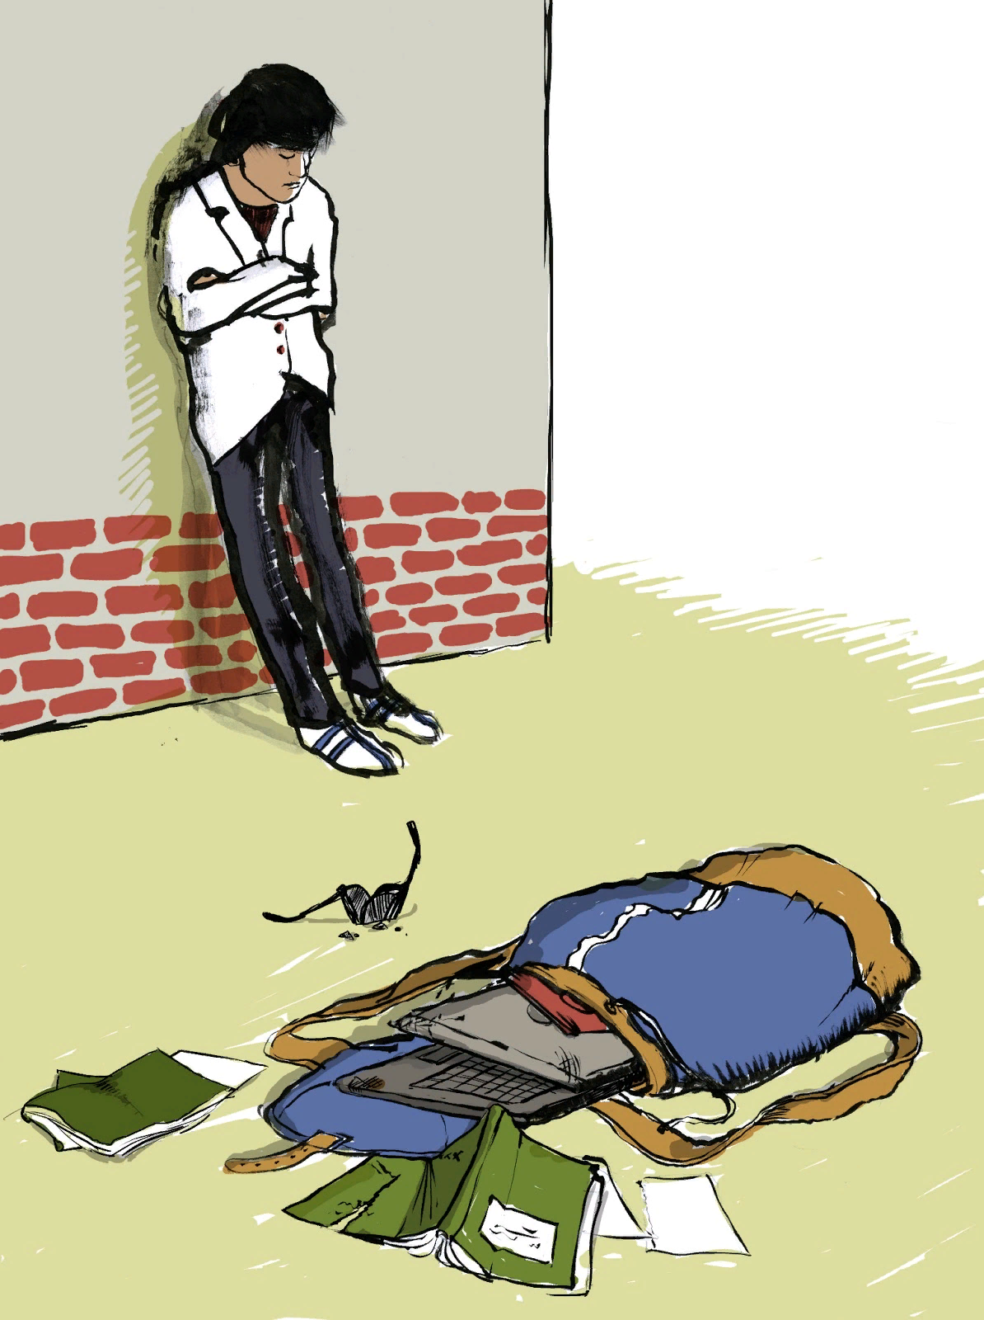
Motto: ”Violence is the last refuge of incompetence.”

Slide 26
Thanks for watching!

