Slide 1
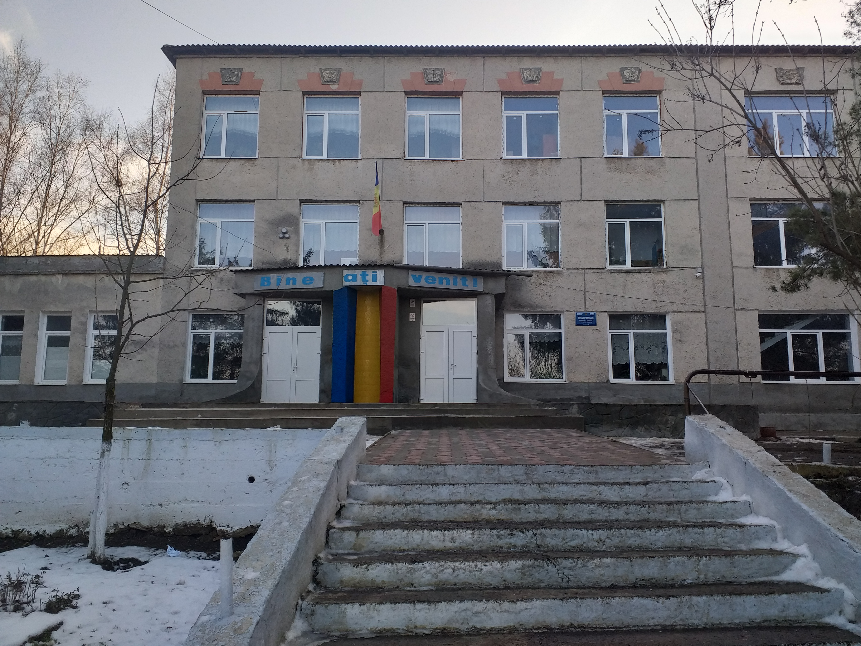
My school

Slide 2
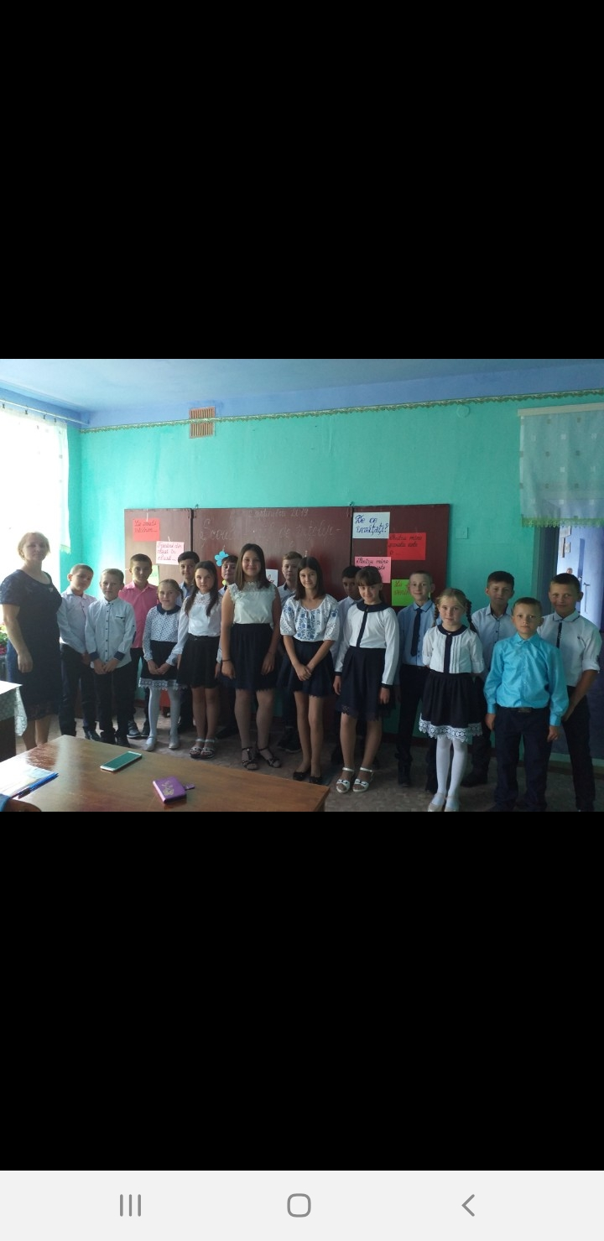
My classroom

Slide 3
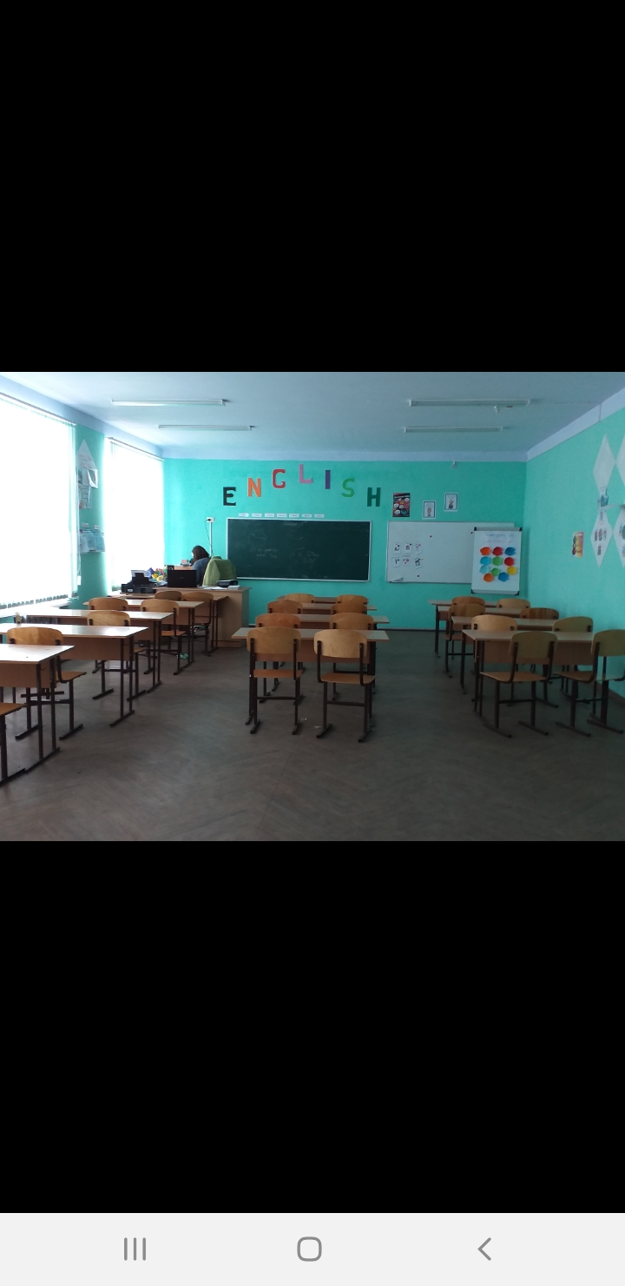
English class

Slide 4
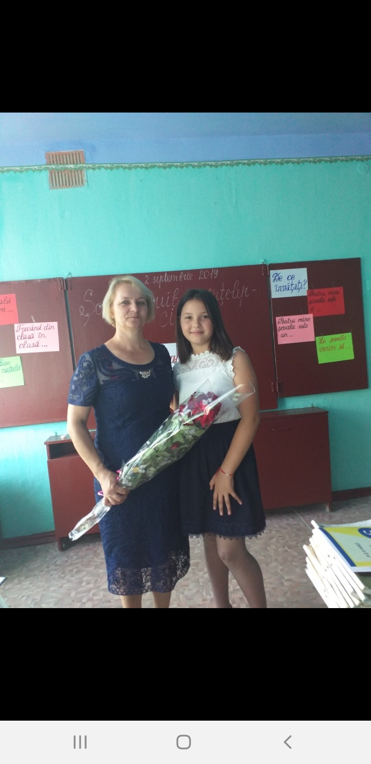
My teacher

Slide 5
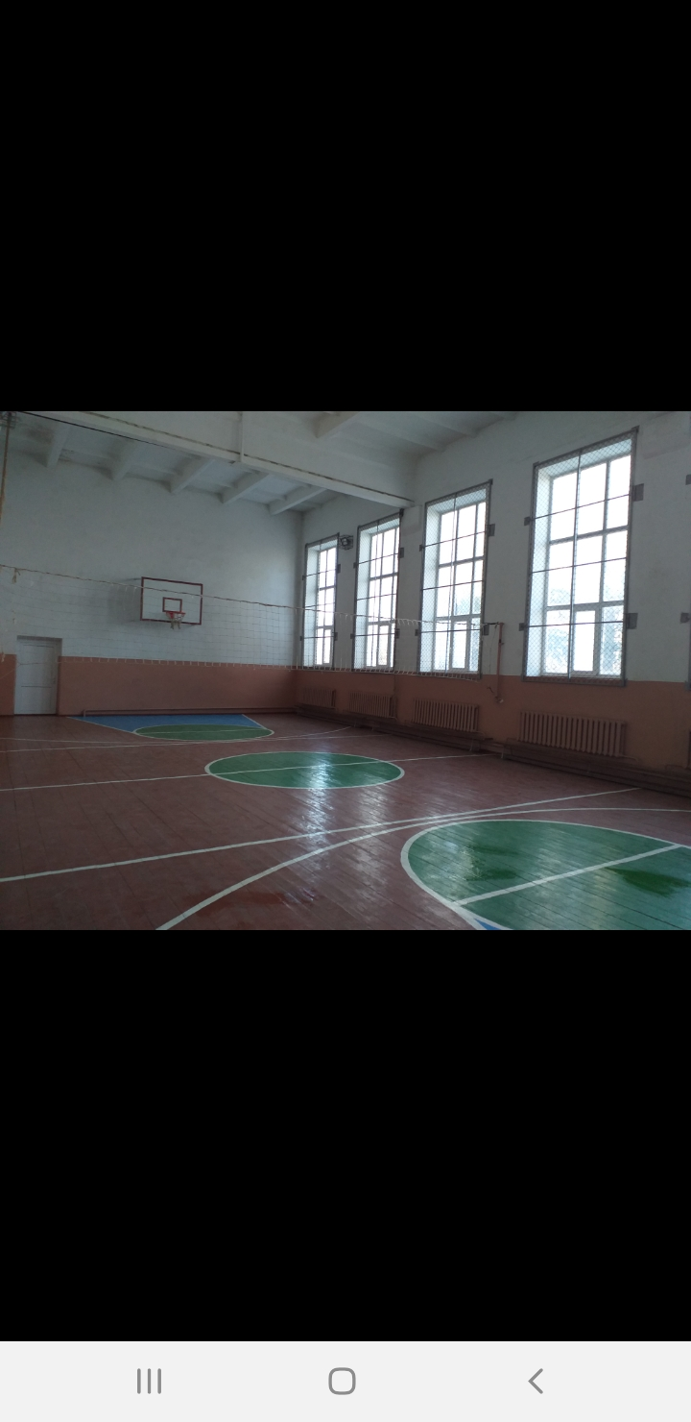
Gym

Slide 6
Thank you!
Elaborated by Mîţu Ana

