Slide 1
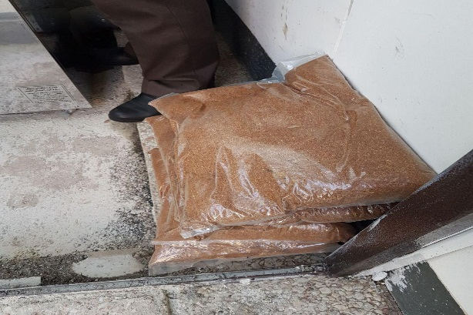
Compost production
The daily capacity of 10 kg in school

Slide 2
Project goals
Wet and dry waste separation at source
Stop producing about 73 percent of greenhouse gases
Increasing the value of dry waste
Use of compost fertilizer produced for the cultivation of cultivated soil
Helping to preserve the environment
Recycling 10 kg of garbage daily in a composting machine and producing 2.5 kg of natural compost

Slide 3

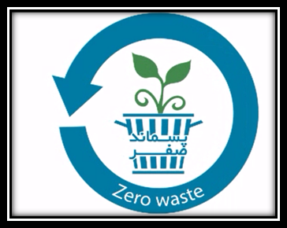
Step by step to produce compost

Slide 4
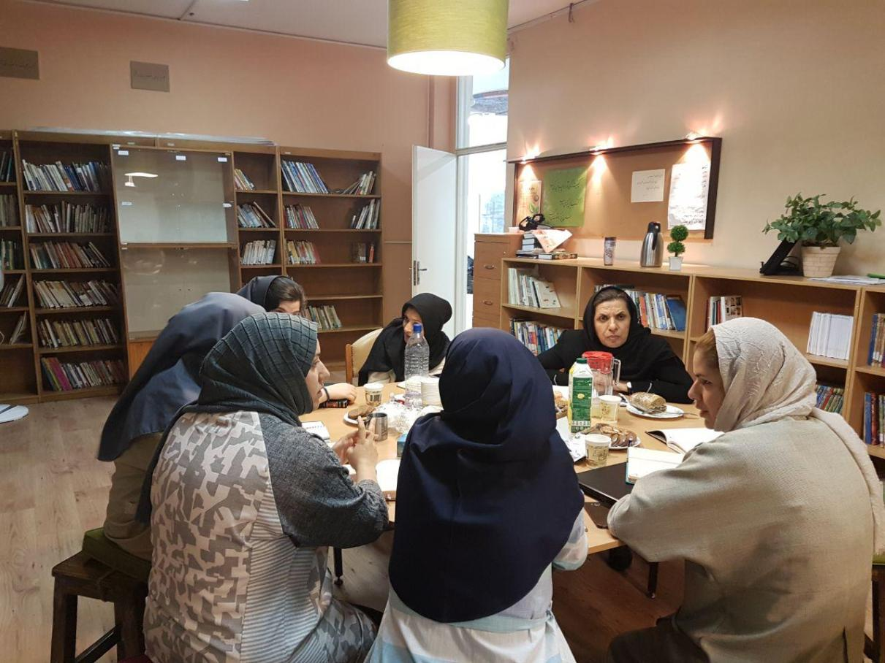
Project Guidance

Slide 5
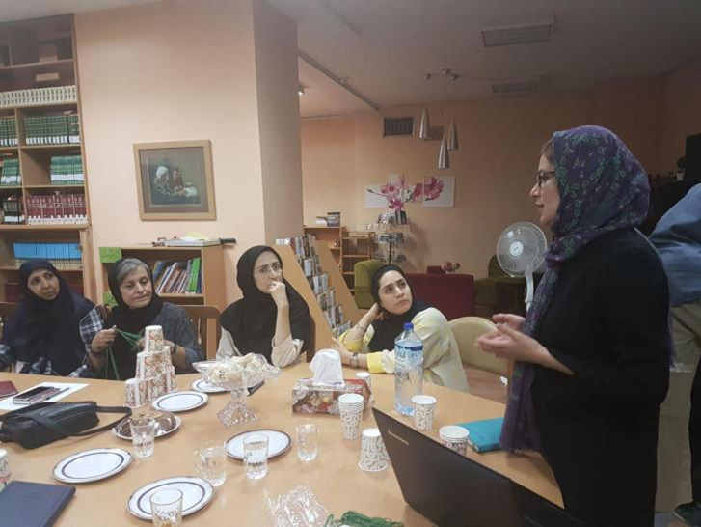
Start training courses for teachers and school staff

Slide 6
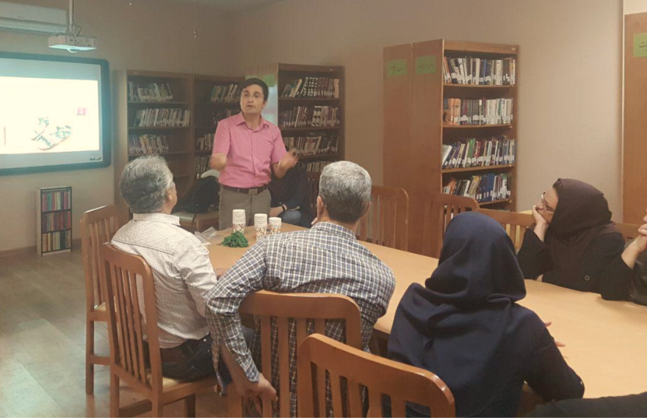
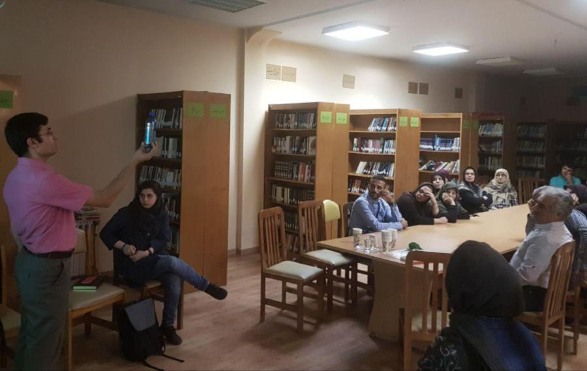
Invite environmental and waste expert for training and workshop for the school services

Slide 7
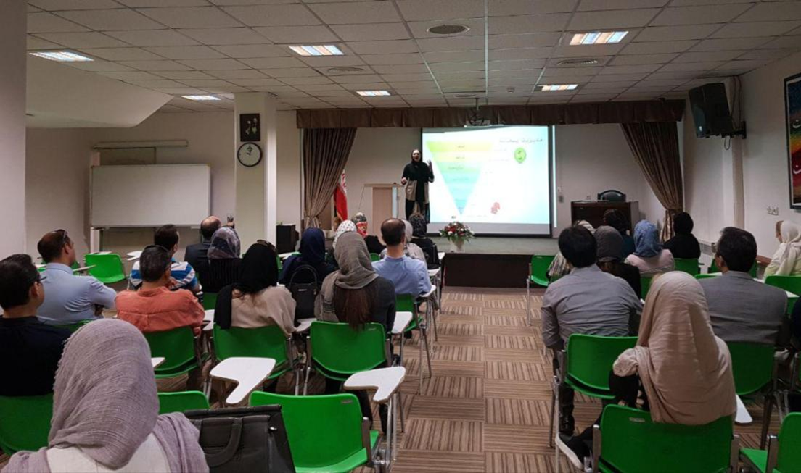
Teaching Families for All School Grades

Slide 8
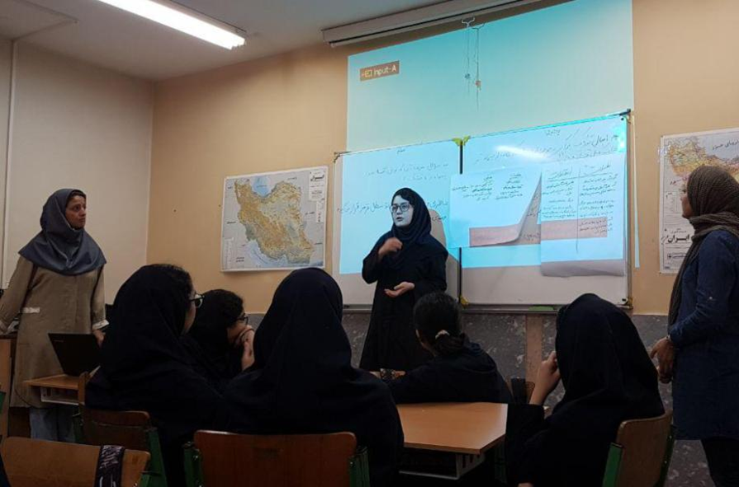
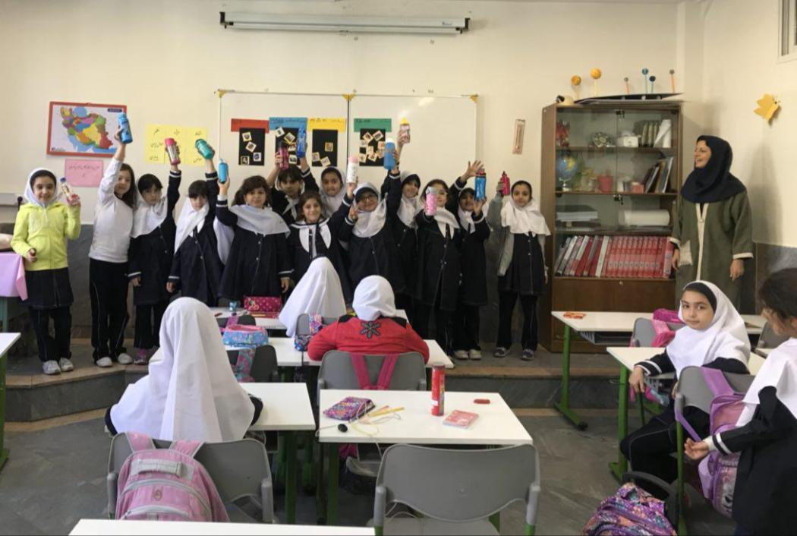
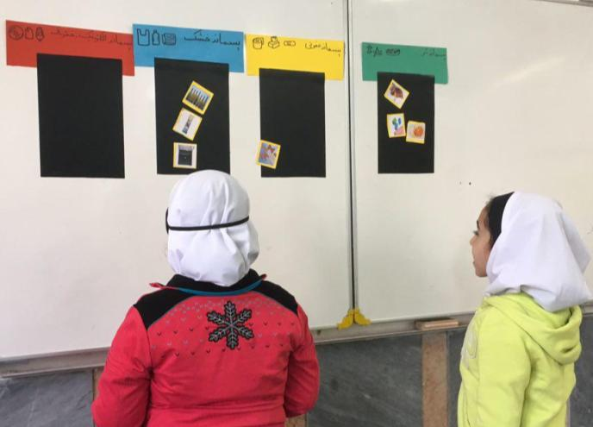
All levels of school education

Slide 9
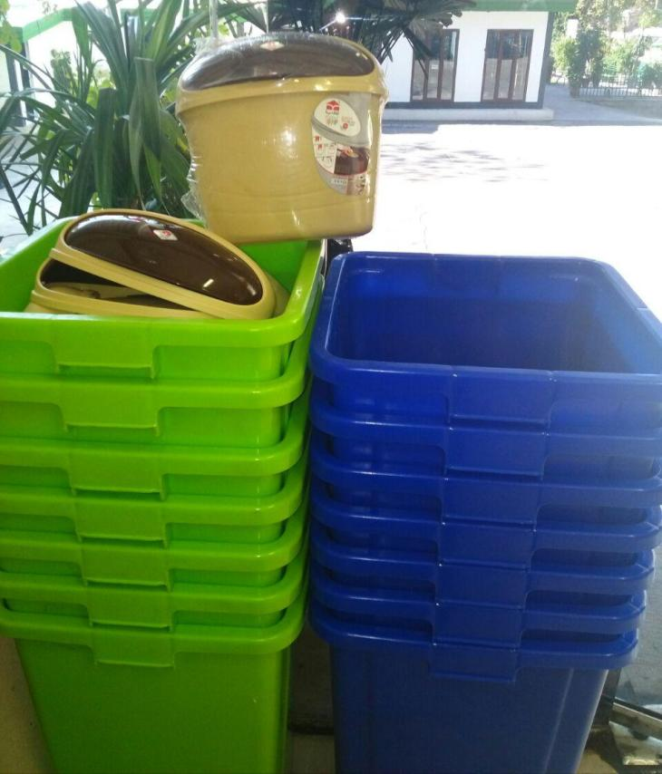
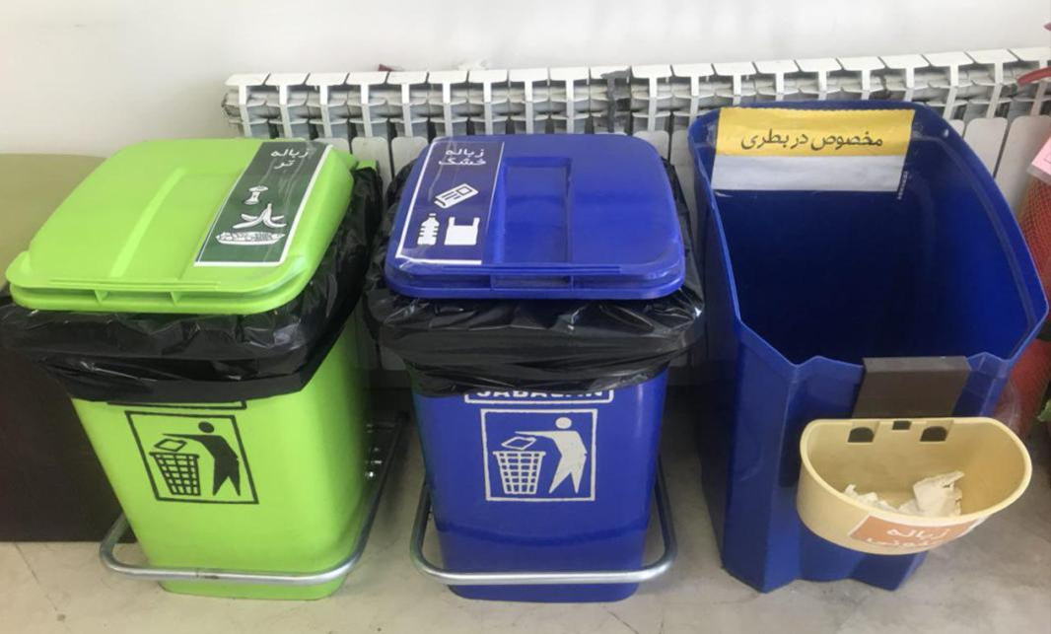
Preparation of infrastructure

Slide 10
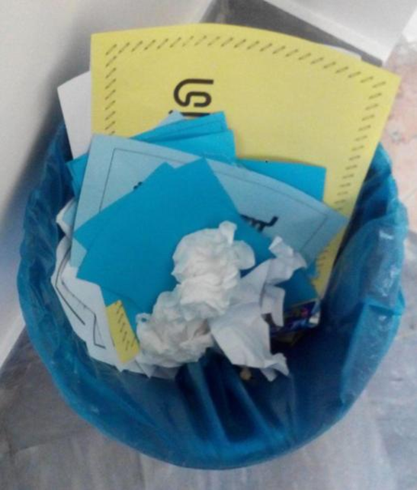
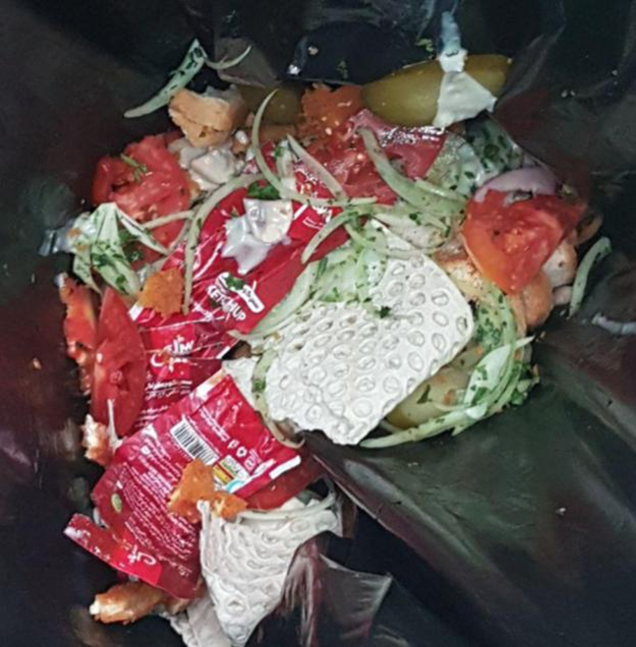
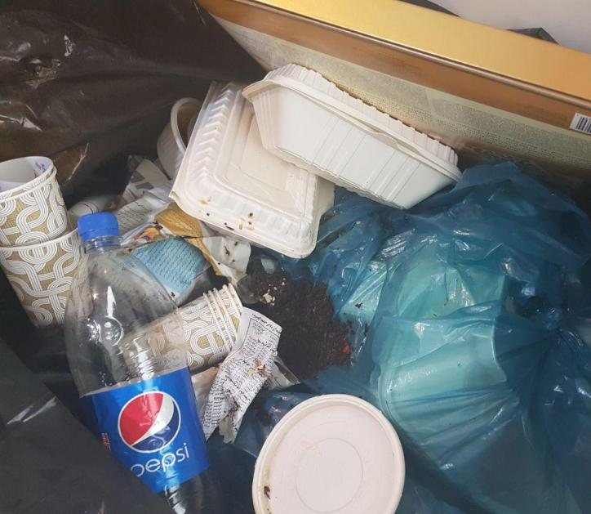
The situation before the start of the project

Slide 11
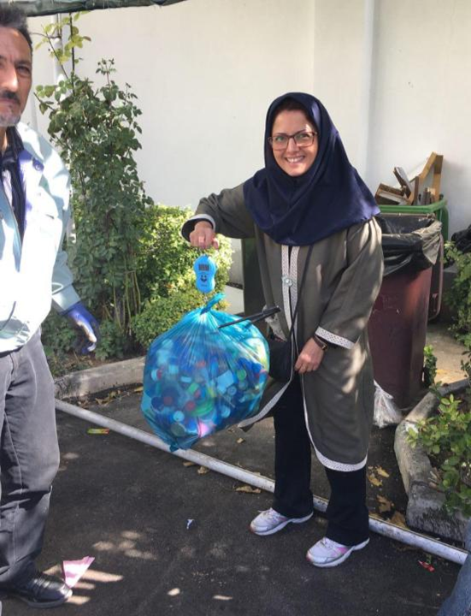
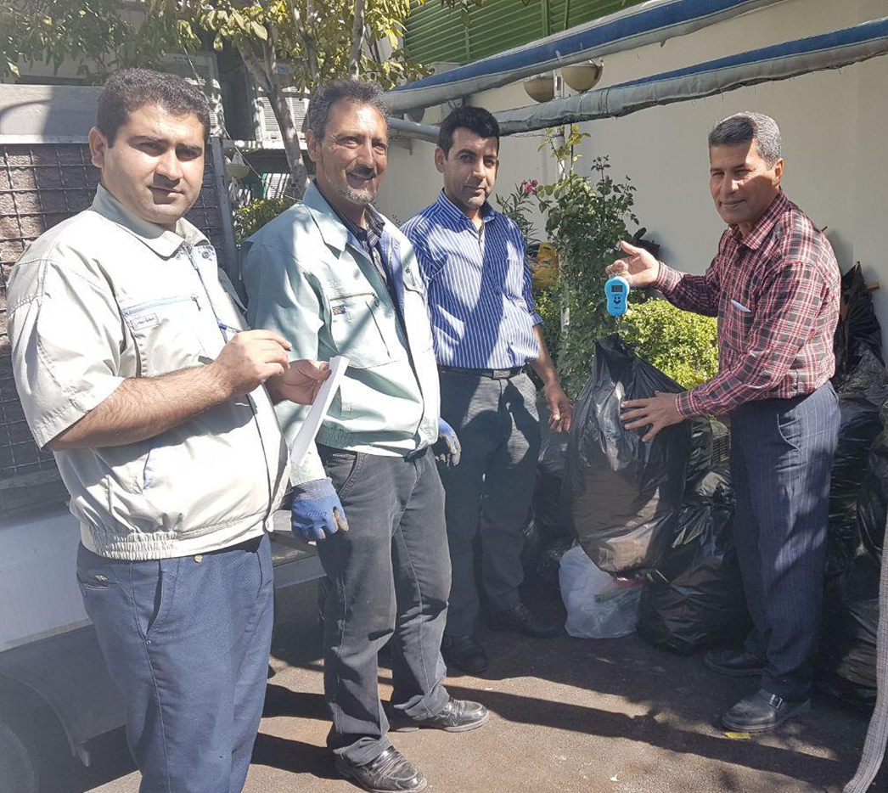
Sale of dry waste to the contractor

Slide 12
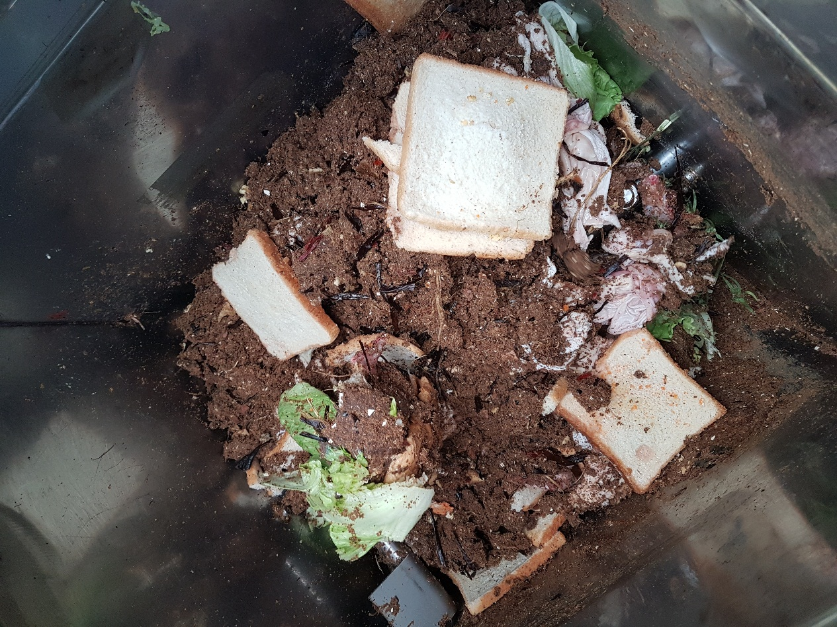
In the compost, mixes of substances such as animal manure, soil, plant waste such as straw and leaves, and very shredded branches and kitchen waste, including peel of fruits, unrivaled fruits, vegetable waste, edible residues, peeled egg skin, sawdust

Slide 13
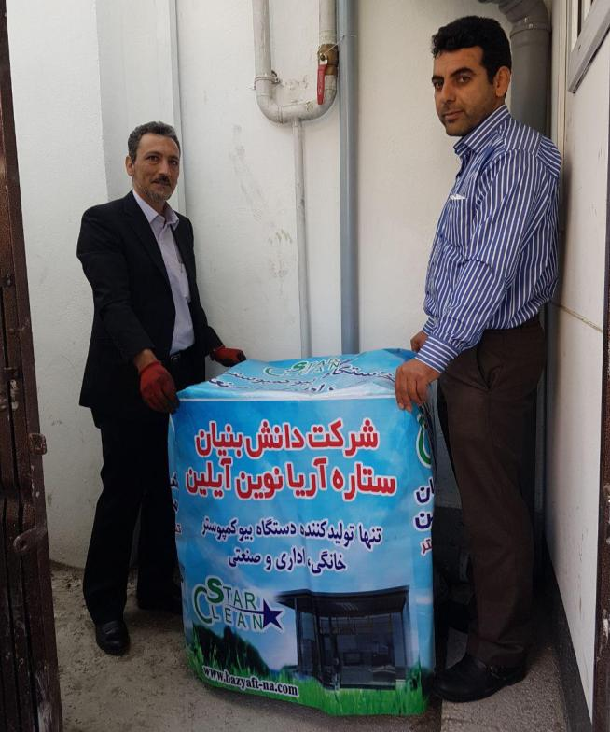
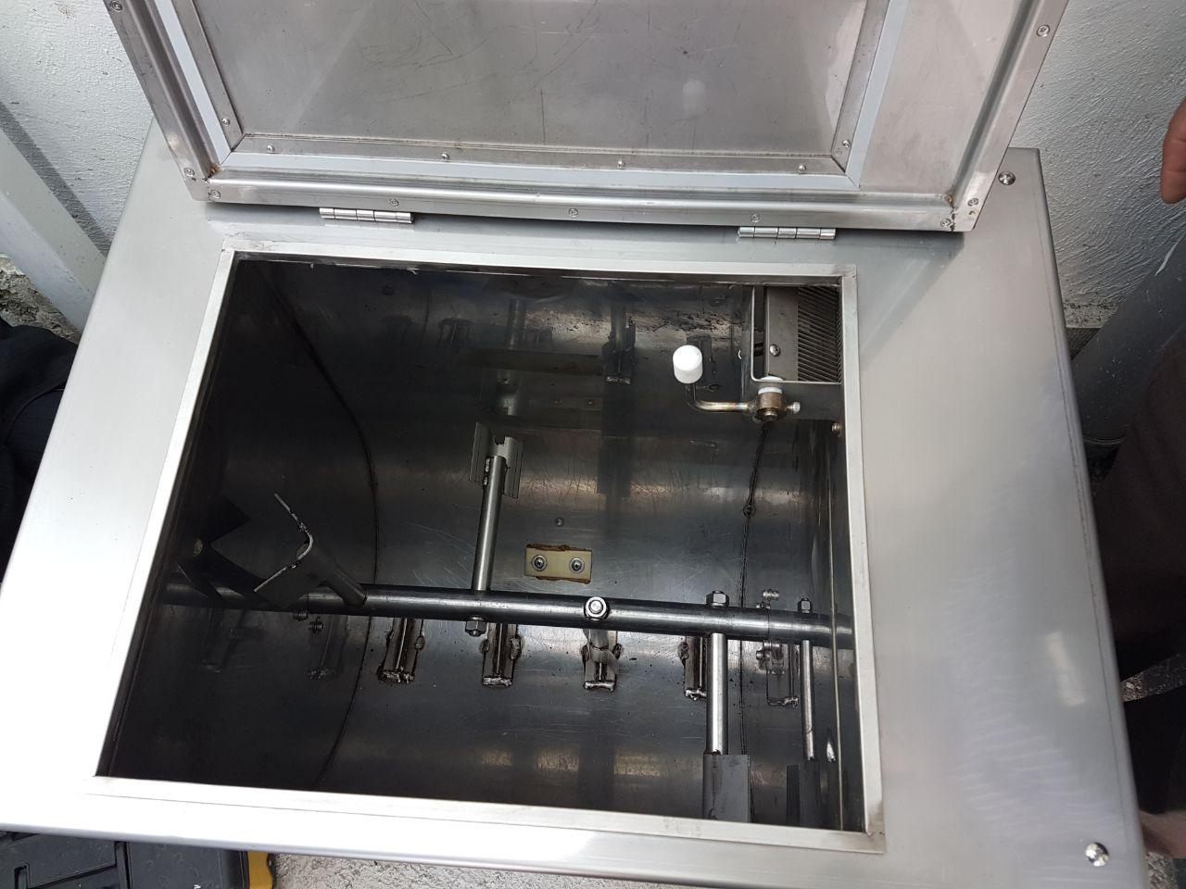
buying composting machine

Slide 14
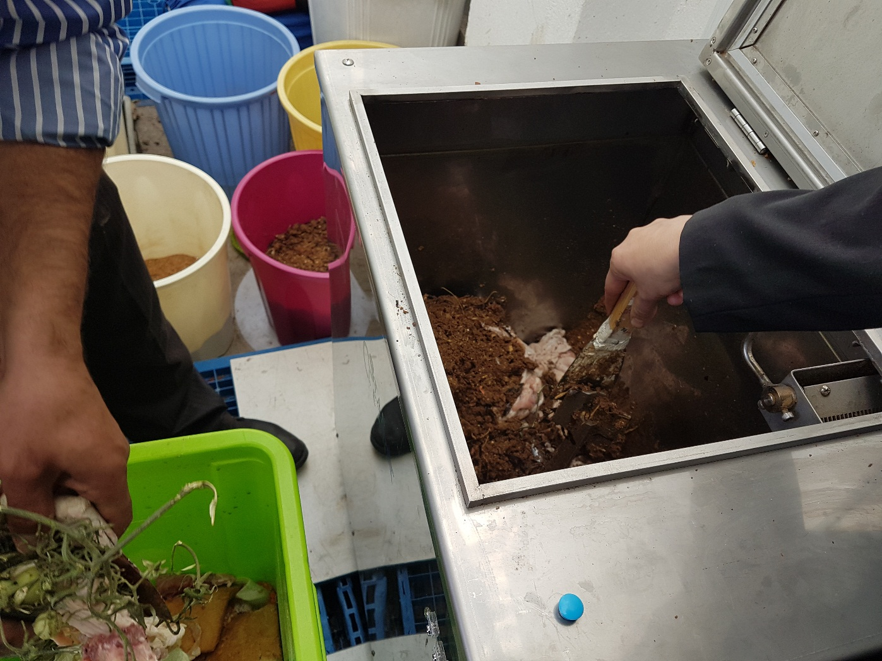
Garbage on the composting device was placed around the clock

Slide 15
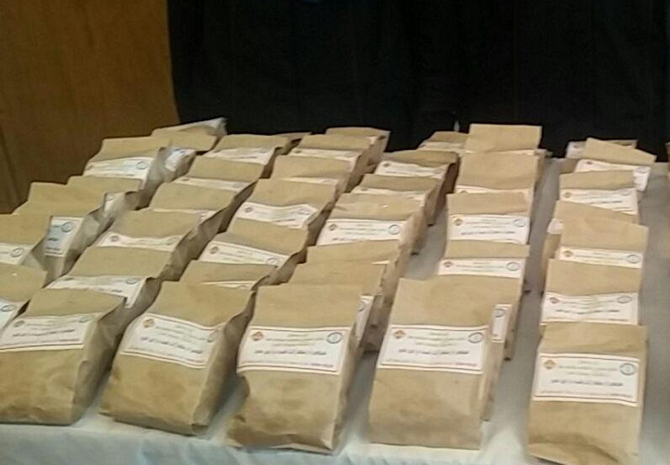
The first product of the school composting machine

Slide 16
Doing the project at home
1- Separate garbage
2- pour the saw dust into the waste bin
3- add peel of fruits, unrivaled fruits, vegetable waste, edible residues, peeled egg skin and other kitchen waste (Except animal wastes
4- You can add tree leaves in each step
5-Stir it up whenever its height has risen slightly
6- To prevent the spread of bad smell can add it garden soil
7- When it looks like a fertilizer, add it to the soil of your garden or green area

Slide 17
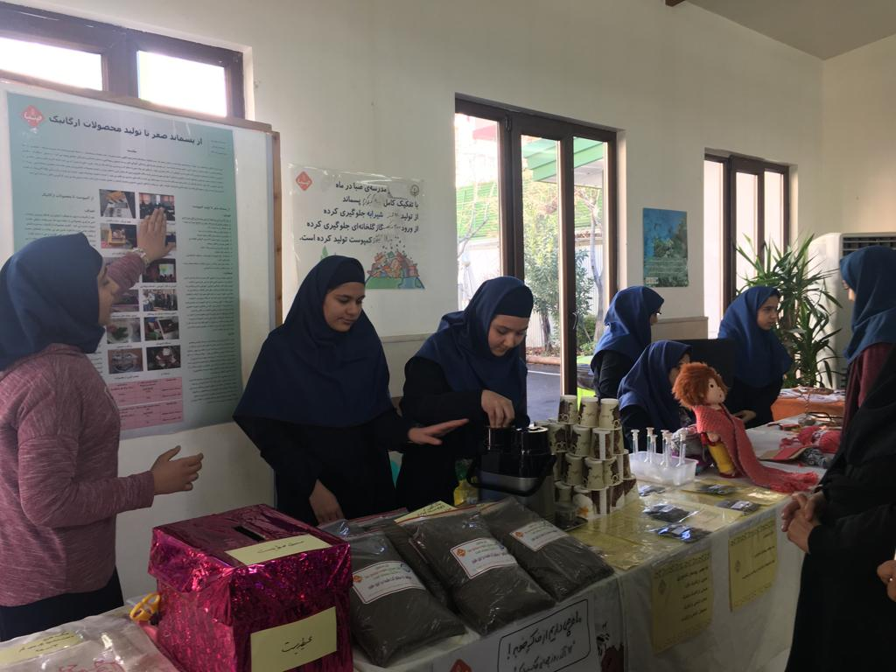
Beautiful packaging and supply of soil and fertilizer and sell it to students with school logo

Slide 18
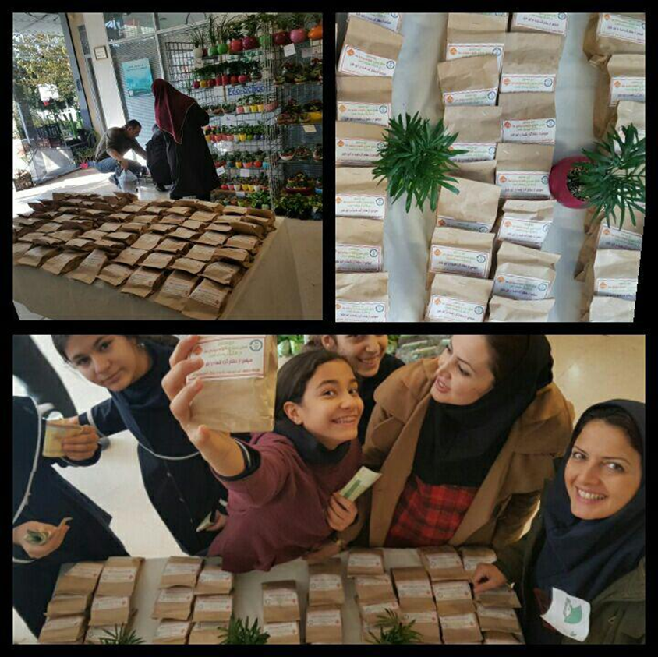
The use of natural compost is one of the best alternatives to chemical fertilizers.

