Slide 1
Global learning My school project
Crew mates
Mariam Mohamed
Hannah yasser
Hana Mohamed
Jasmine mamdouh
Kenda Abdelrahman

Slide 2
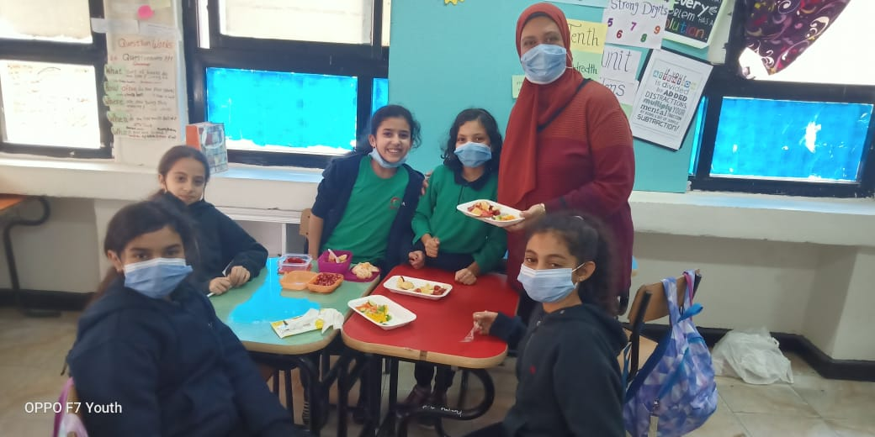
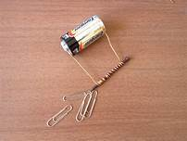
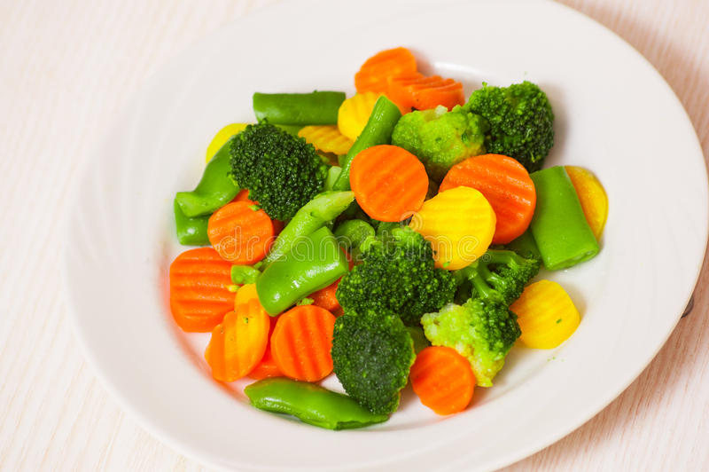
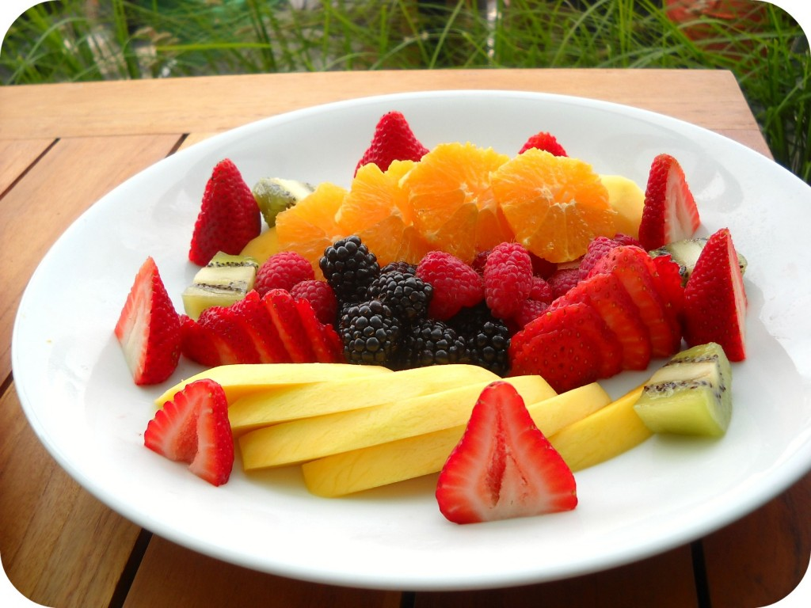
Our school activities
We have many school activities like:
electro magnet.
Mixture of fruits and vegetables.
In our science class we made a healthy dish party with our best director ever.

Slide 3
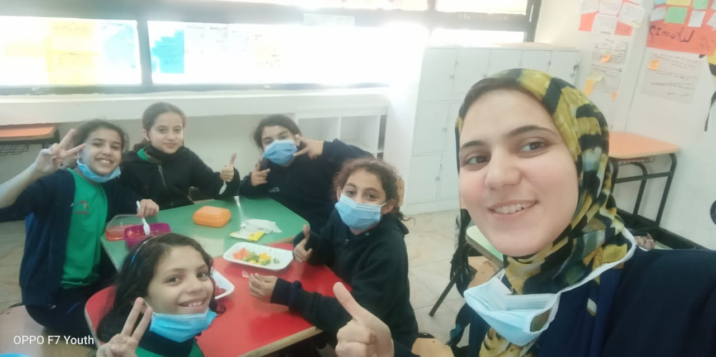
Why I love my teachers
There are lovely teachers in our school that can give us gifts and they laugh a lot with us.
In the English session our teacher always give us free time at the end of the session.
Our English teacher let us eat any time in the session and let us drink any time because we have to drink a lot to be hydrated.
We have a perfect novel in the English and Arabic.
We are lucky students to have these teachers.

Slide 4
What will I want to change in my school
The school is nice but I want to change somethings:
I want to make the playground bigger.
I want to have every day German session , English session longer so do the Math.
Go a lot of trips.
Make a lot of activities.

Slide 5
Why I love my school
I love my school , because I learn new things.
I see my friends and the real reason why I love my school is because its really a place that a person grows up.
Its really like your home.
I think I go to school more than I sit at my home so its my second home!

Slide 6
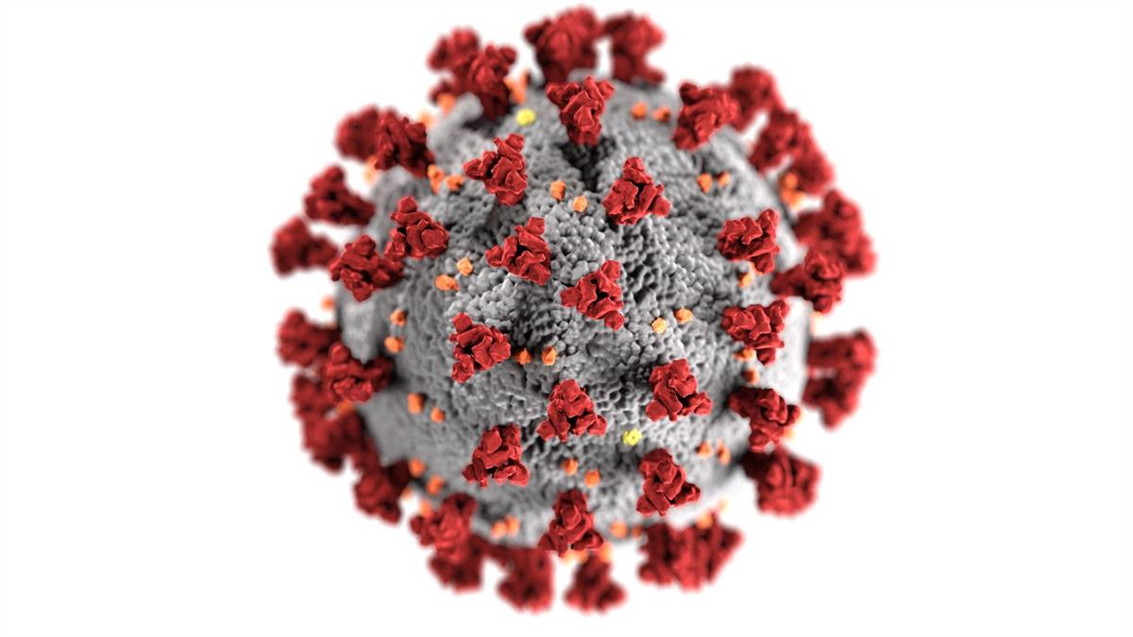
How to be safe from covid-19
Hey guys today I will talk about how to be safe from covid-19 in school.
First we have to clean our hands with hand sanitizer
You must to wear your mask.
We must have social distance between you and your friends.
Don’t use others things.
Don’t put your hands on your face.
Those things you should do in your school because to be safe from covid-19.

Slide 7
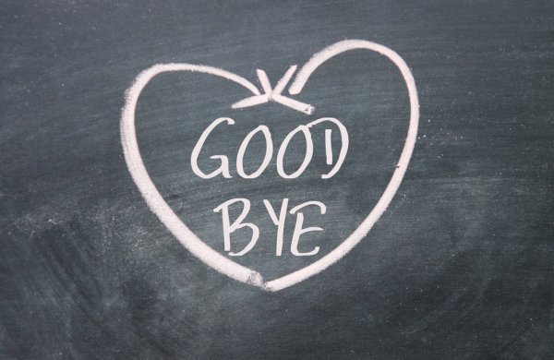
Thank you for reading our presentation… Hope you like it...

