Slide 1
Hey, my name is Zlata.
I live in Ulyanovsk.

Slide 2
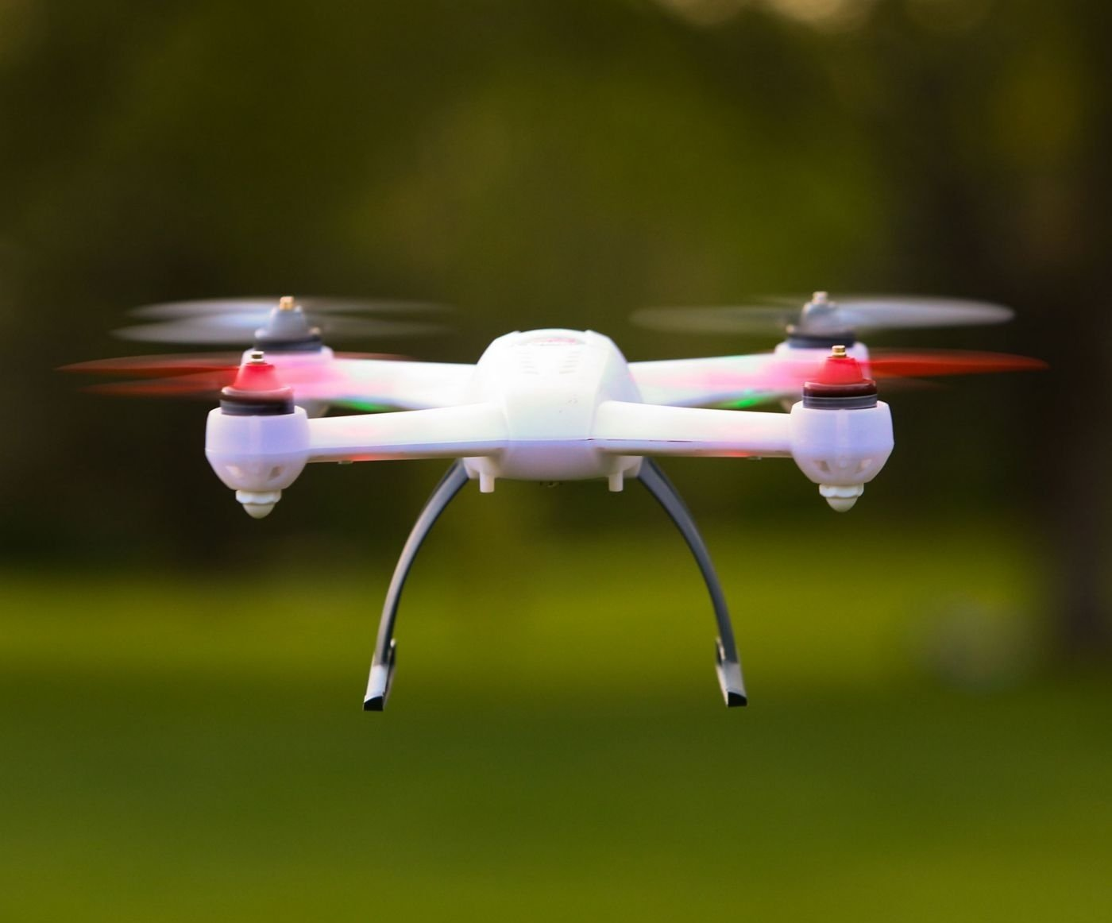
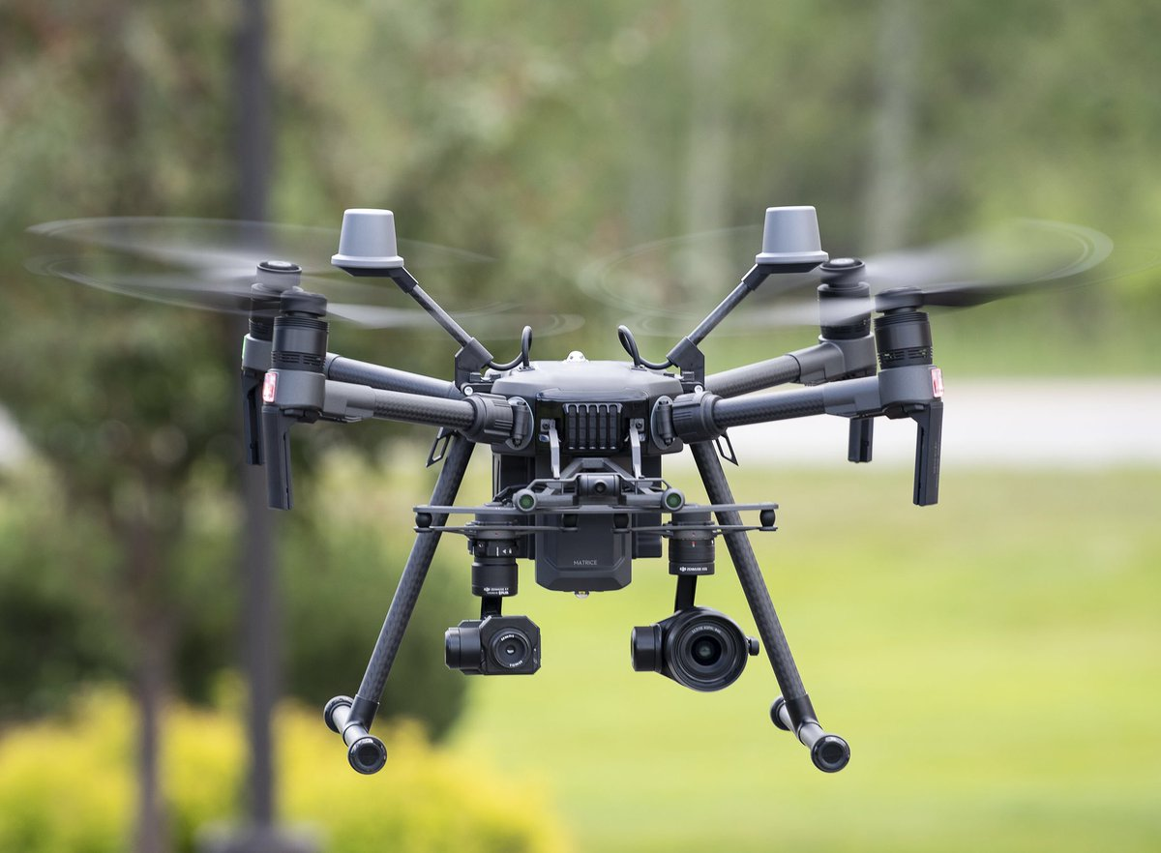
My hobby
My hobby is programming, collecting and controlling the drone.

Slide 3
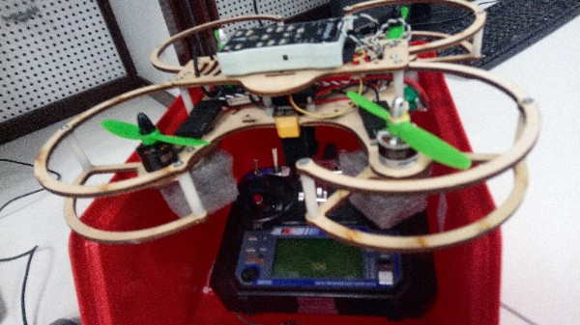
To build the desired frame quadcopter, flight controller, battery, ESC, motors, screws, power Board, remote control and transmission

Slide 4
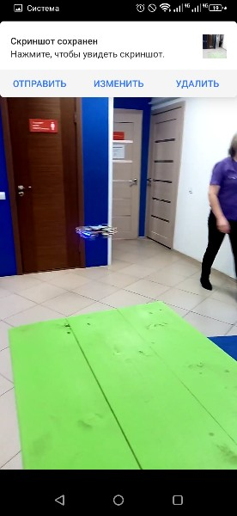
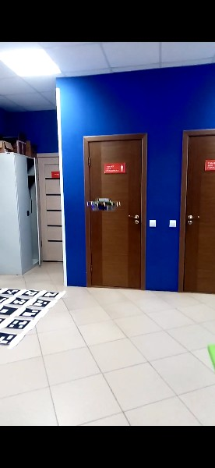

Slide 5
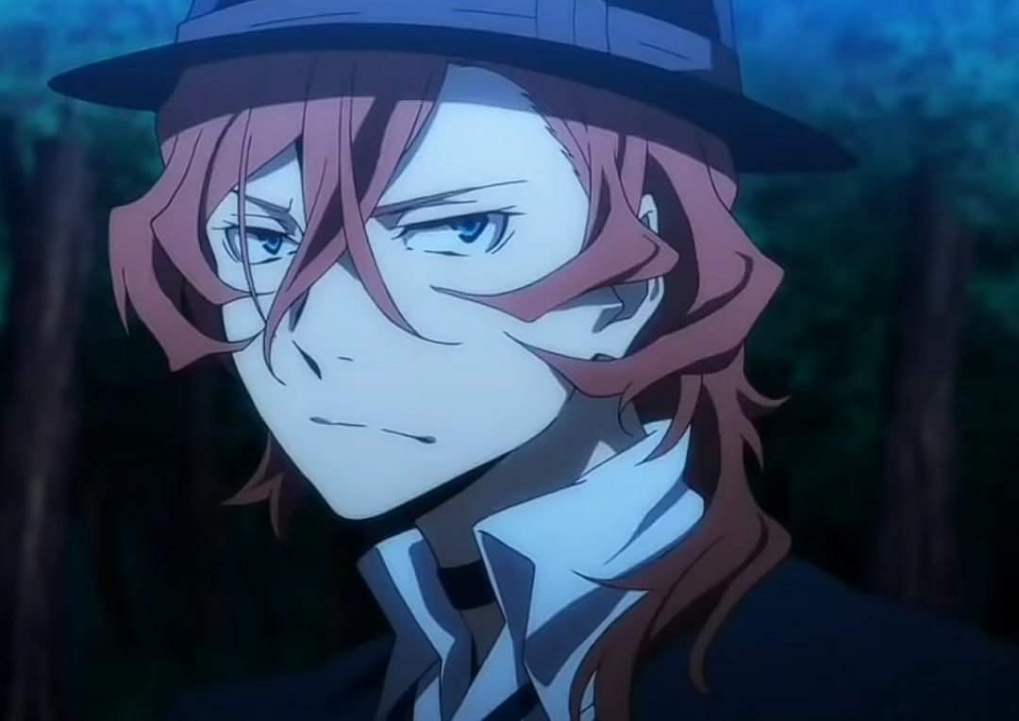
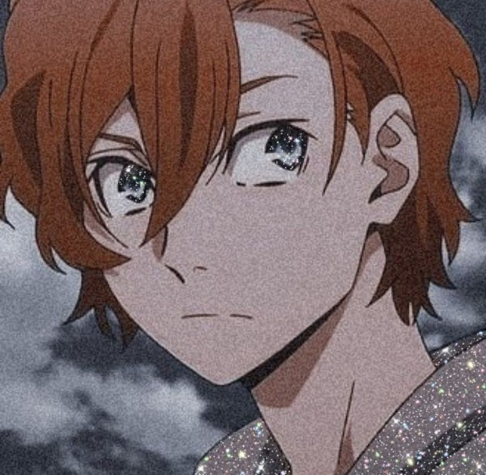
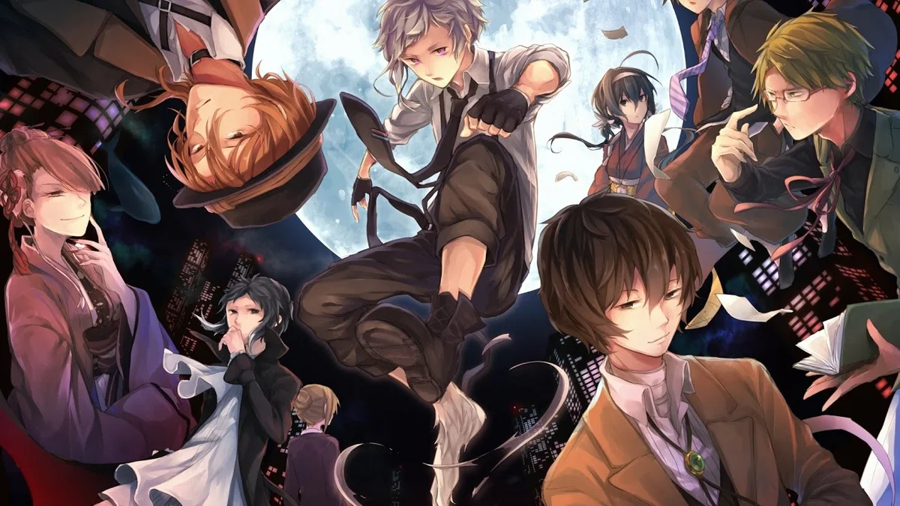
I really like Anime. I have watched "Bungo Stray Dogs “ recently. My favorite character is Chuya Nakhara

Slide 6
Here is my school 63

Slide 7
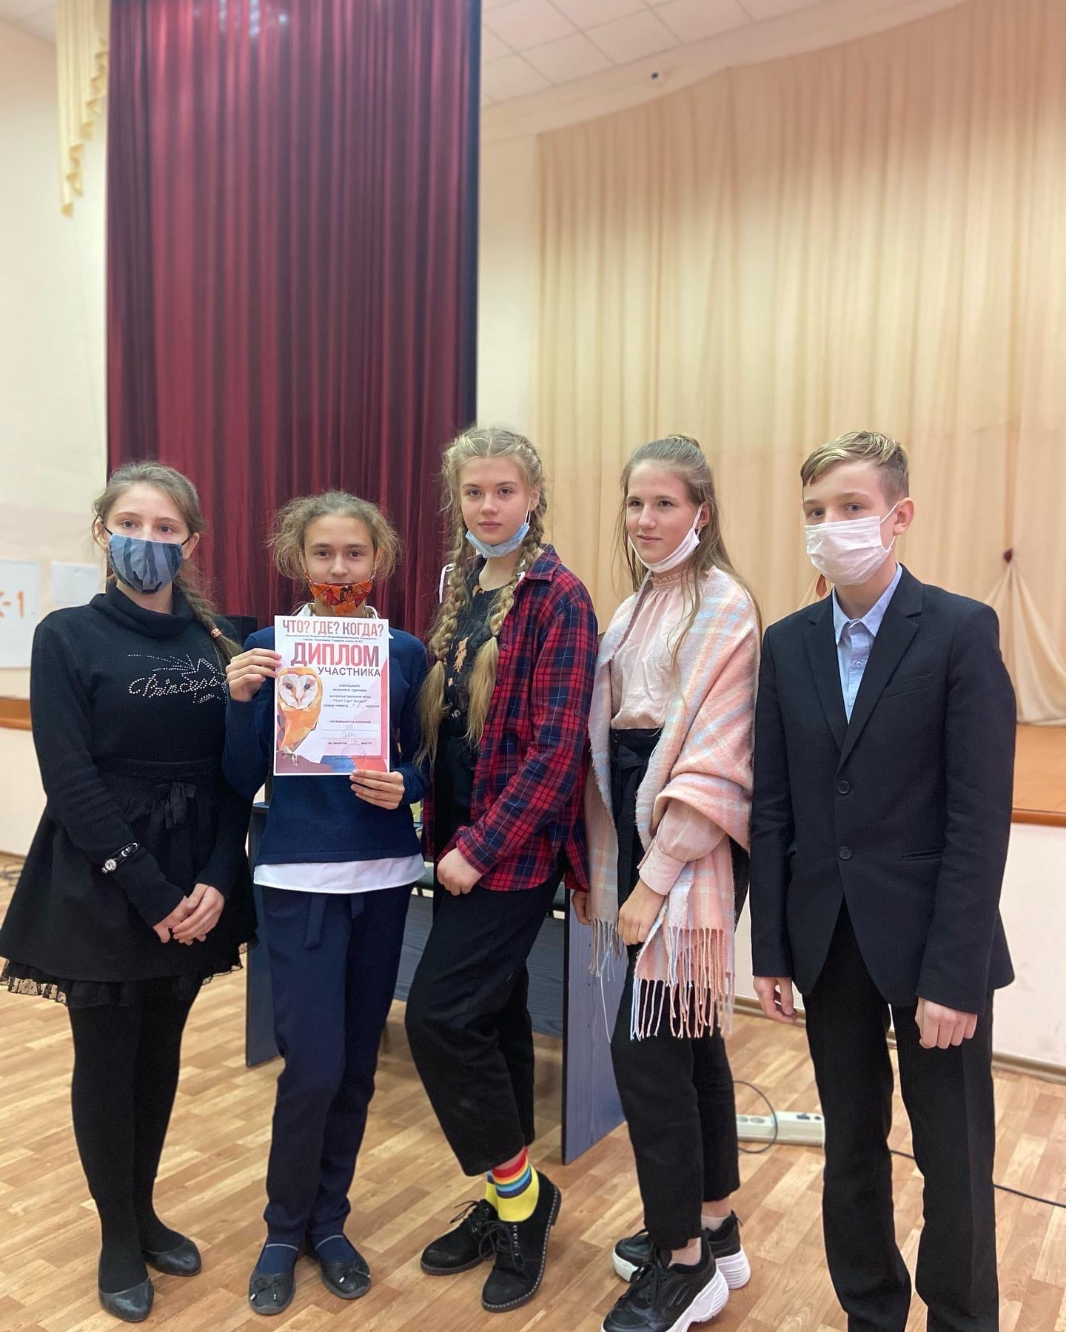
I like to participate in all sorts of events

Slide 8
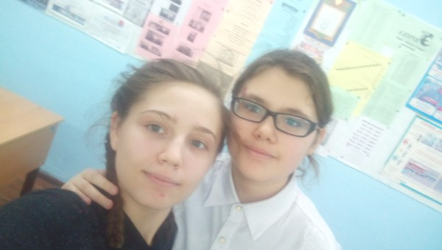
Here's my school uniform. I am to the left from my friend

Slide 9
In my free time I like to listen to music and play
Click to hear the music

