Slide 1
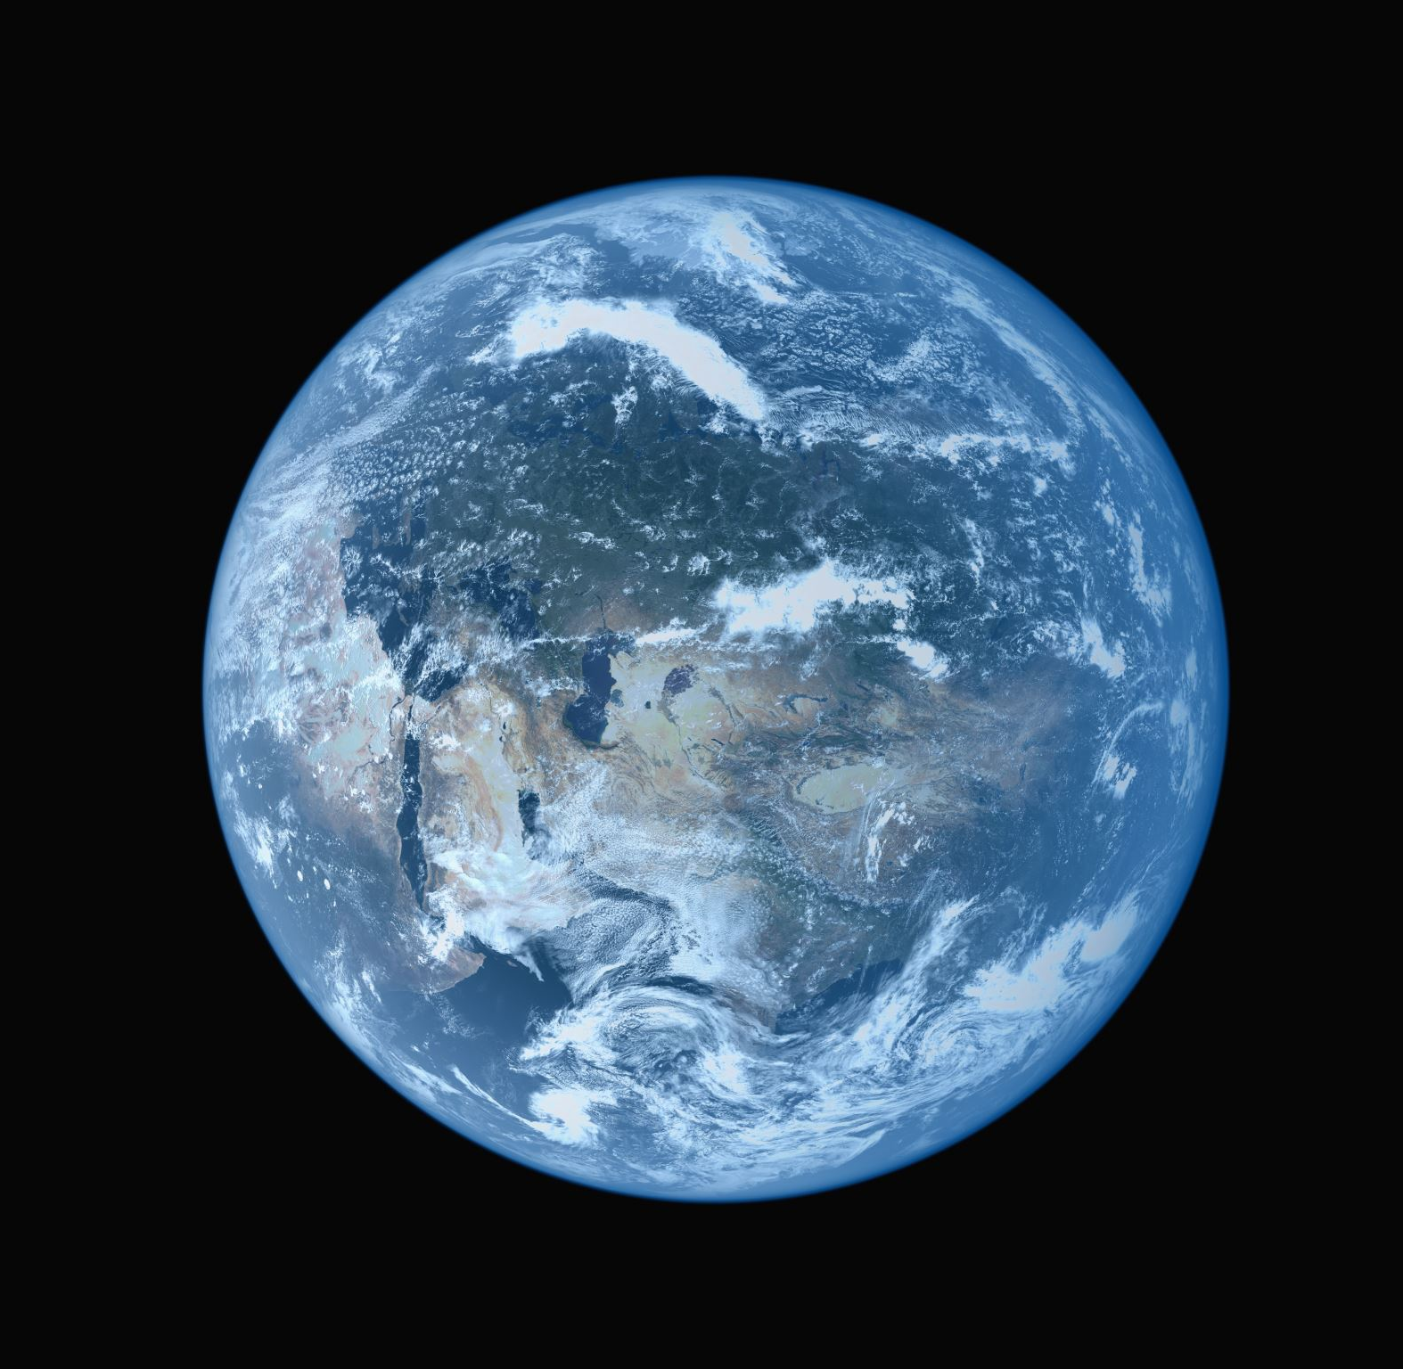
Global issues
St.Paul High school (class 201), Taiwan in collaboration with "Troyeshchyna" Gymnasium, Ukraine

Slide 2
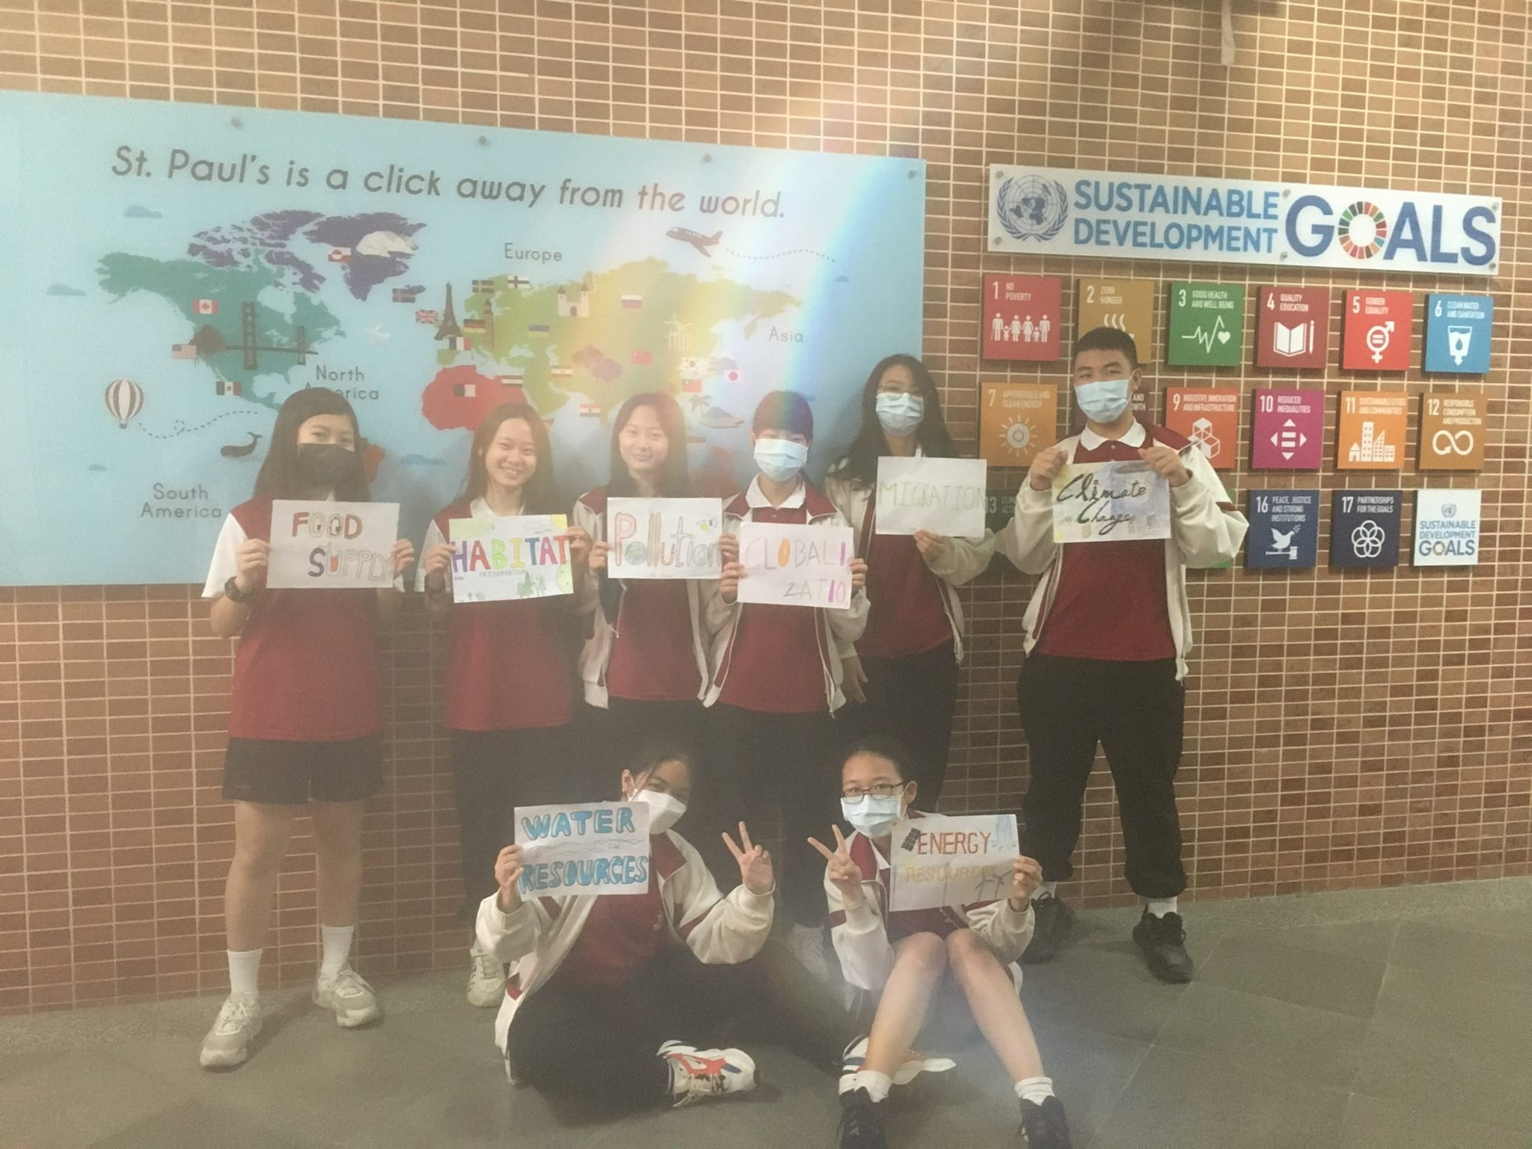
Our teams’ leaders of the Global issues

Slide 3
Climate change
Oscar, Kevin, Daniel, Bella, Tim

Slide 4
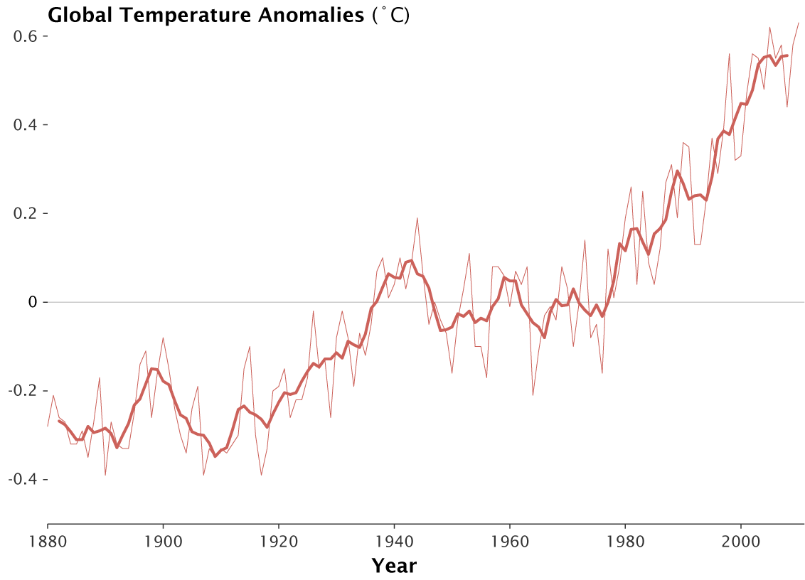
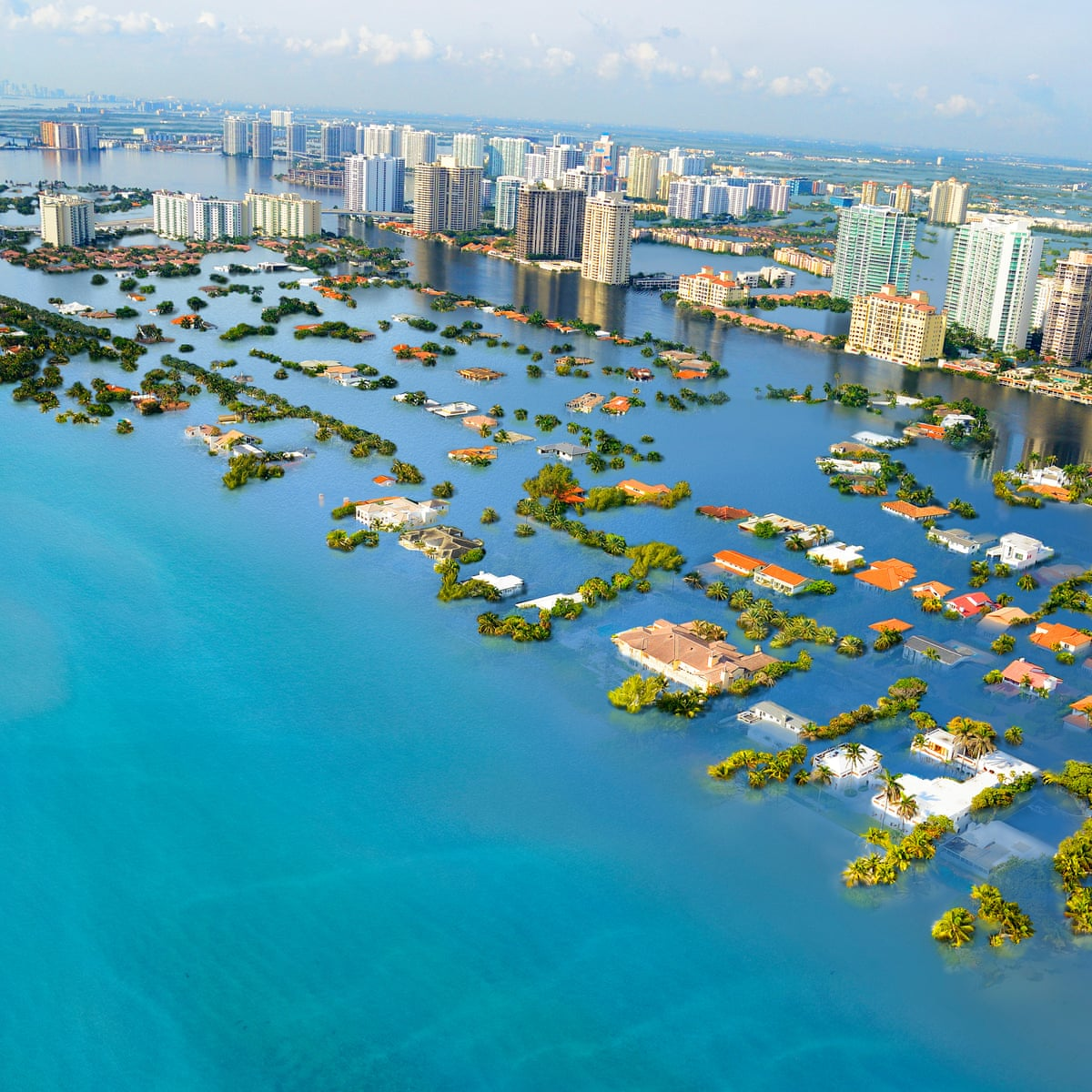
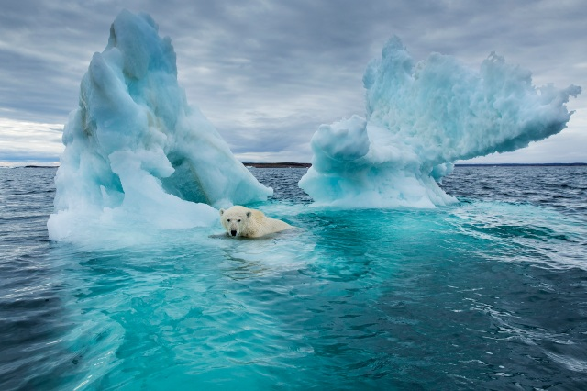
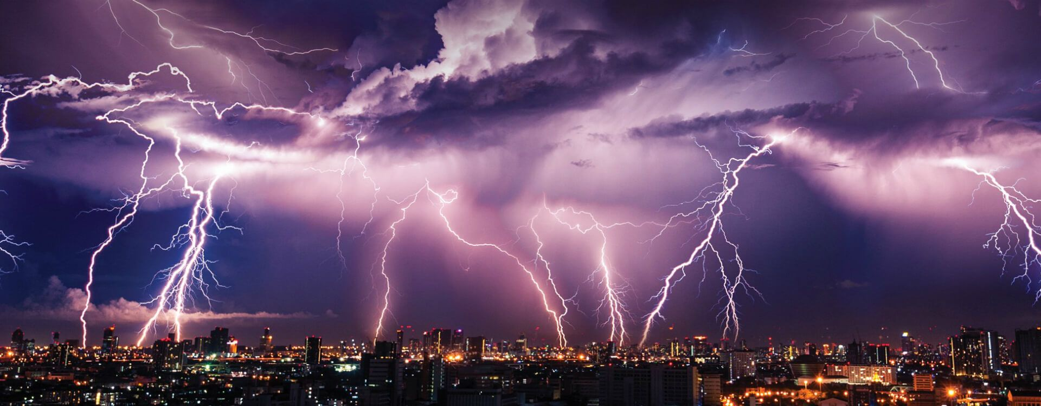
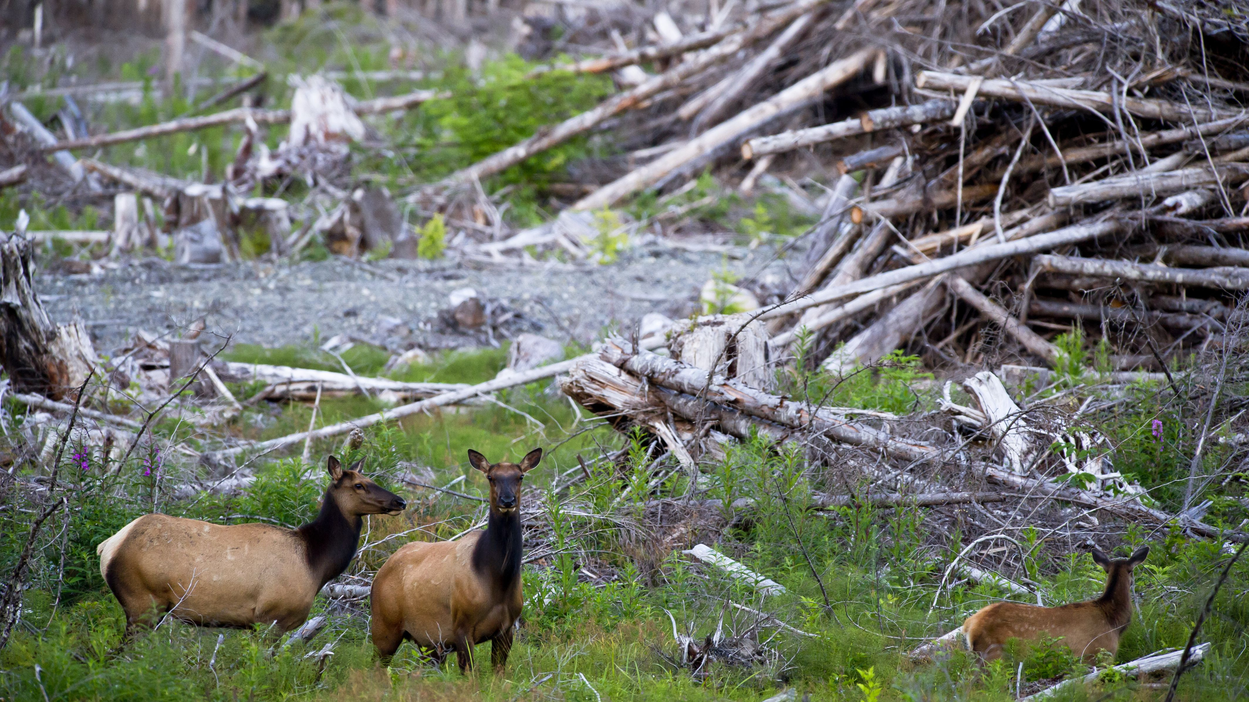
WHAT IS CLIMATE CHANGE?
CAUSE:
EARTH’S TEMPERATURE RISING AT AN ALARMING RATE
EFFECTS:
HABITAT LOSS
RISING SEA LEVELS
EXTREME WEATHER

Slide 5
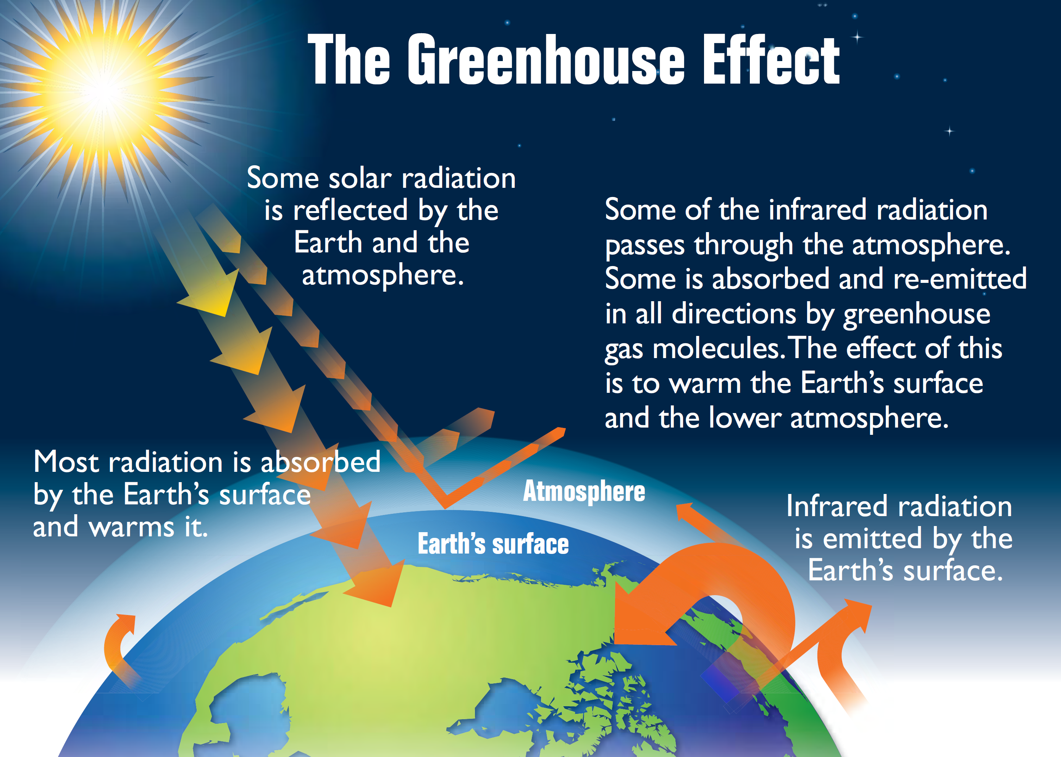
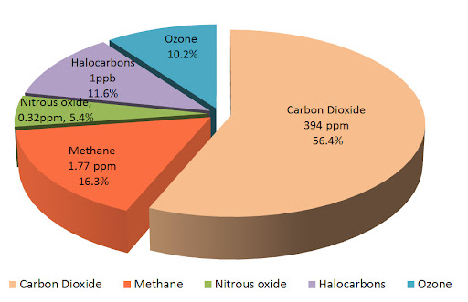
WHAT CAUSES CLIMATE CHANGE?
THE MAIN CAUSE OF CLMATE CHANGE COMES FROM GREENHOUSE EFFECT

Slide 6
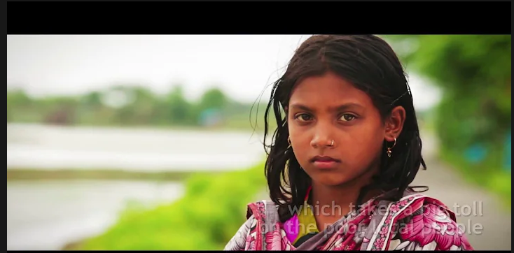
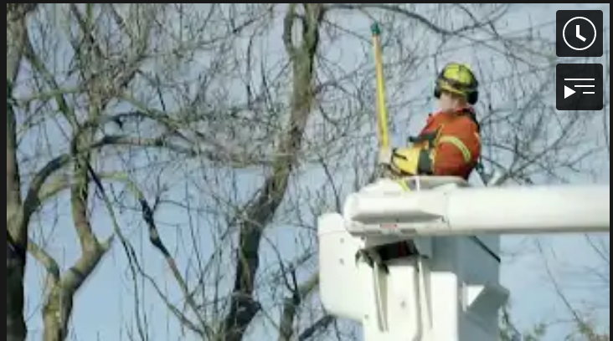
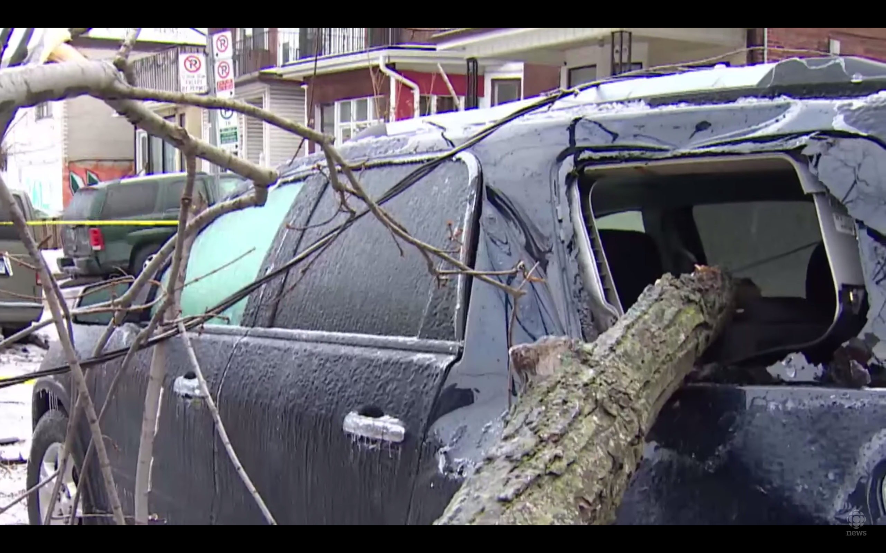
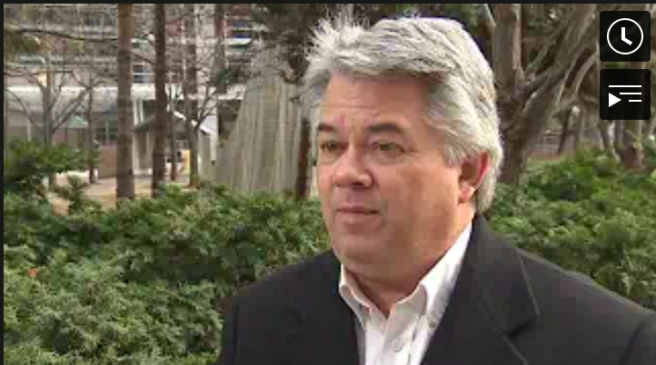
PLACES AFFECTED BY CLIMATE CHANGE
Bangledesh
Canada
The Carribean

Slide 7
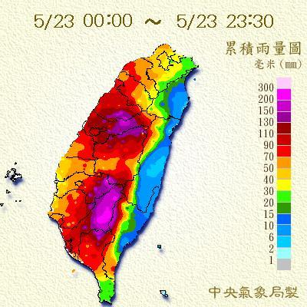
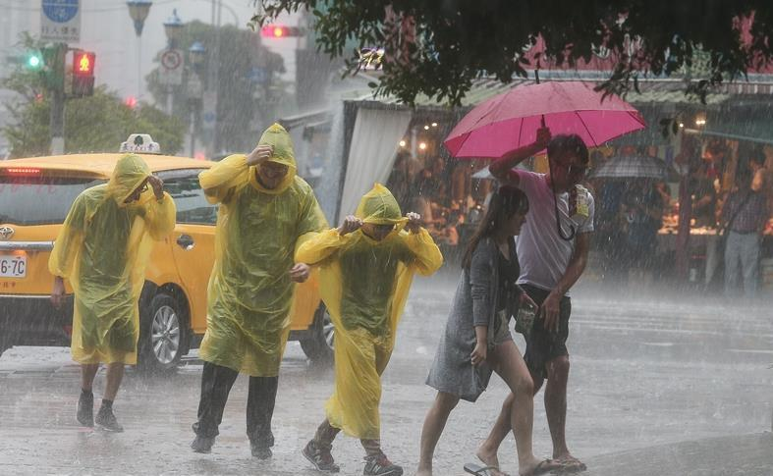
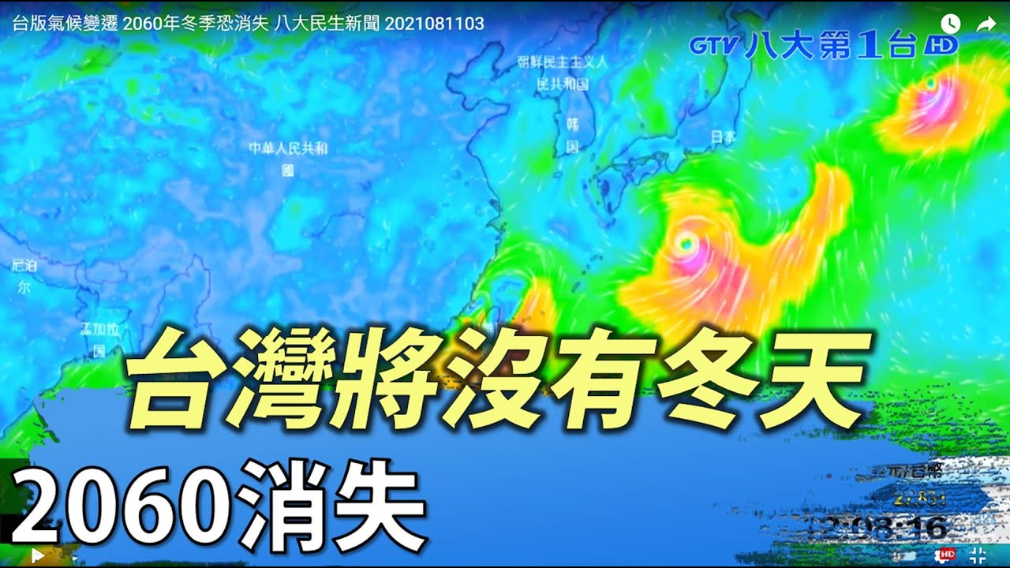
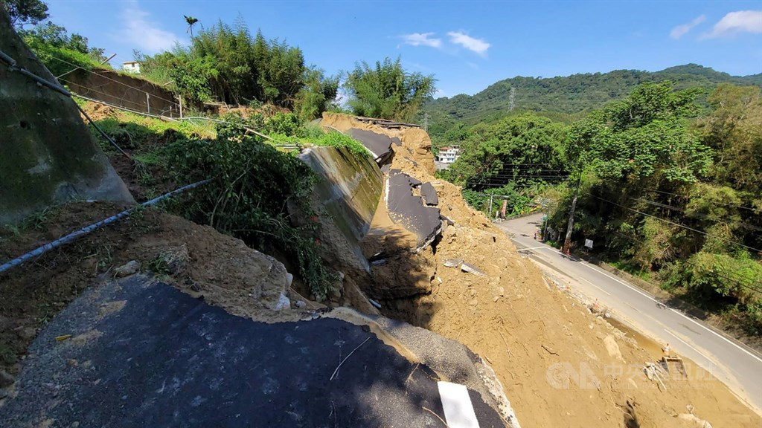
HOW DOES CLIMATE CHANGE AFFECT TAIWAN?
According to the IPCC, the main effects of climate change in Taiwan includes:
Extreme heat
Heavy rainfall
Increased frequency
Intensity of typhoons(hurricanes)
Translation:
Taiwan will be lacking the winter season by the year 2060

Slide 8
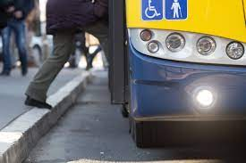
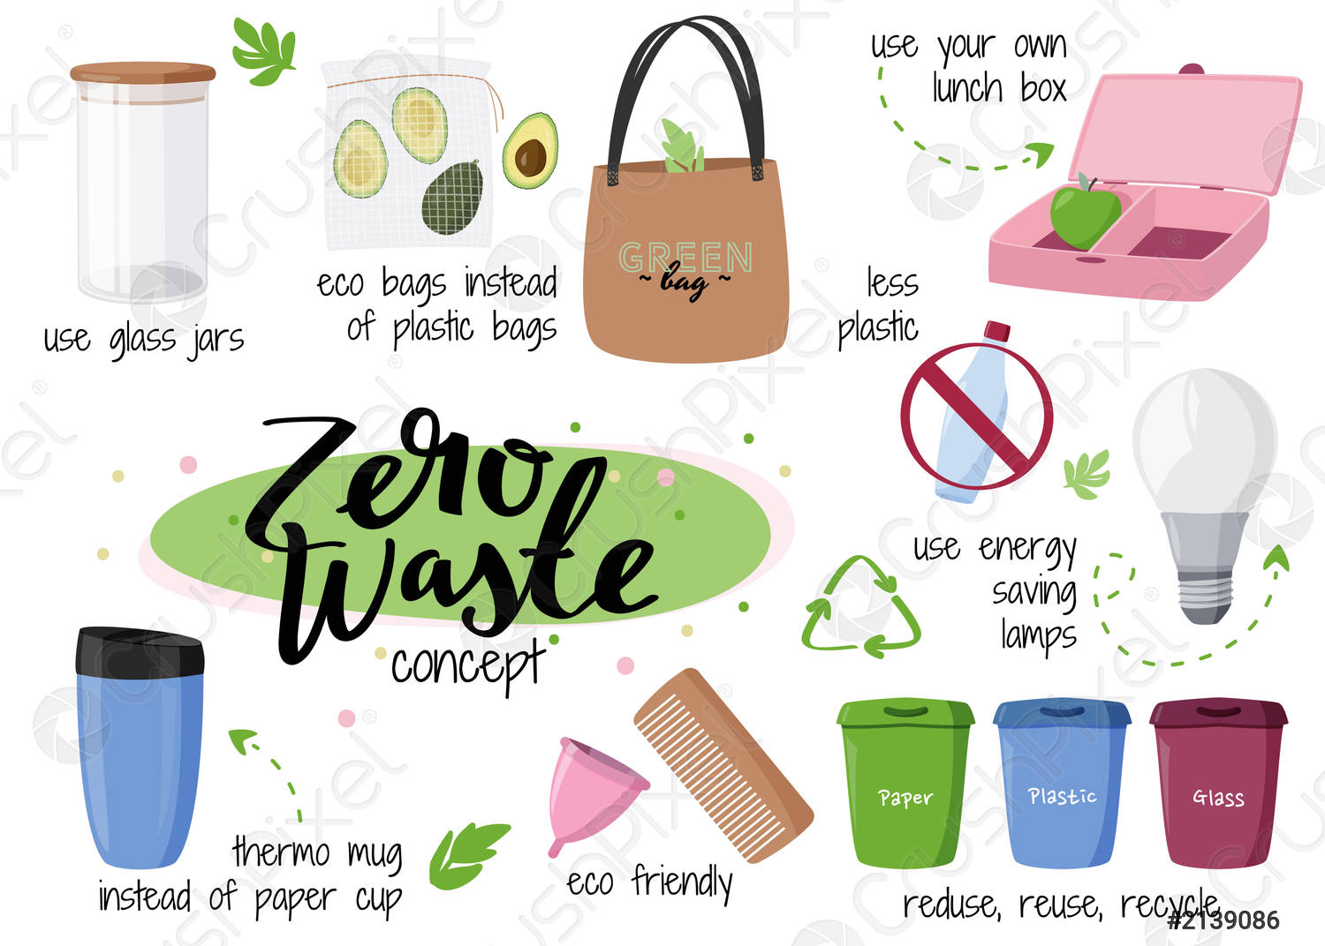
HOW WE CAN COMBAT CLIMATE CHANGE
Save energy at home
Walk, bike, or take public transport
Reduce, reuse, repair, recycle
Choose eco-friendly products

Slide 9
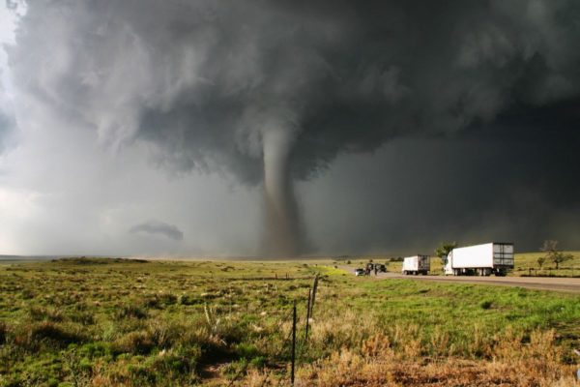
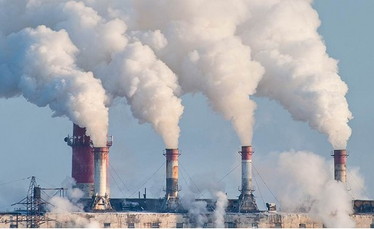
~Climate Change~
In our country we have some problems with climate. For example three or four years ago we have many snow in winter (about 2-3 meters), but now it’s little snow or no snow. It’s sometimes very hot in summer (about +30°С..+35°С).
This is due to the greenhouse effect. It’s normal natural phenomenon, but when industrial factories updating many year ago this effect became bad for our country. Because people often burning different bad things for nature. And now this greenhouse gases in atmosphere too much. It’s contributes high temperature. I also think that high temperature in summer contributes melting glaciers. When glaciers melts, the water level in our seas (Azov sea and Black sea) is rising. Through high temperature we also can have droughts. Every year temperature in our country is rising. Now we haven’t cold winters it’s only about -1°С..-10°С.
Nataliia Mazurenko 7-D

Slide 10
Climate change
Over the past 30 years, the average annual temperature in Ukraine has risen by 1 ° C.
In Ukraine, abnormal weather phenomena, which previously occurred every 50-100 years, have become more frequent.
There are also sharp pressure drops, which will lead to weather instability with significant temperature fluctuations and rising sea levels.
Oleksandra Kucher 7-D

Slide 11
Energy resources
Sherry, Lucas, Alex

Slide 12
Kinds & sources of energy
Renewable Energy :
Will never be used up
example:
Oil
Coal
Natural gas
Nonrenewable energy :
Will be used up one day
example :
Hydropower
Solar
Wind power

Slide 13
oil

Slide 14
Solar energy

Slide 16
The biggest problem in Ukraine is indifference of people. This is big problem of our country . Of nature , economic , urbanistic and people.

Slide 17
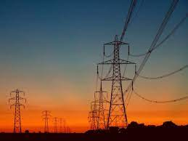
Energy resources
I recently heard on the news that there are few electricity supplies in Ukraine. I was surprised because there were no such problems before. That is why I want to share with you the information that I have learned.
It turned out that coal reserves for power plants account for a quarter of the planned costs. Therefore, most likely Ukraine will resume the supply of electricity from Belarus.
Sofia Didenko

Slide 18
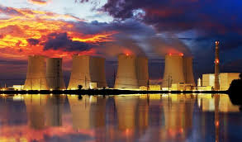
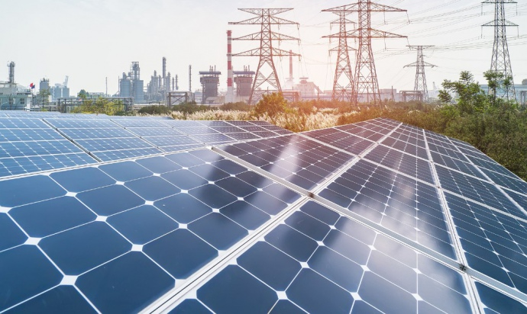
But the problems associated with the negative impact of energy on the environment have become particularly acute. Emissions from this industry account for 30% of all particulate matter entering the atmosphere due to human economic activity. According to this indicator, power plants are equal to metallurgical enterprises and are ahead of all other industries. In addition, energy produces up to 63% of sulfur dioxide and more than 53% of ozone oxides entering the air from stationary sources of pollution. they are the main source of acid rain in Ukraine.
Hydropower has a negative environmental impact on Ukraine. The construction of hydropower plants on the Dnieper led to the flooding of large areas. Reservoirs have increased the level of surrounding groundwater, have caused intense destruction of steep shores.
Vlad Bevza 7-А

Slide 19
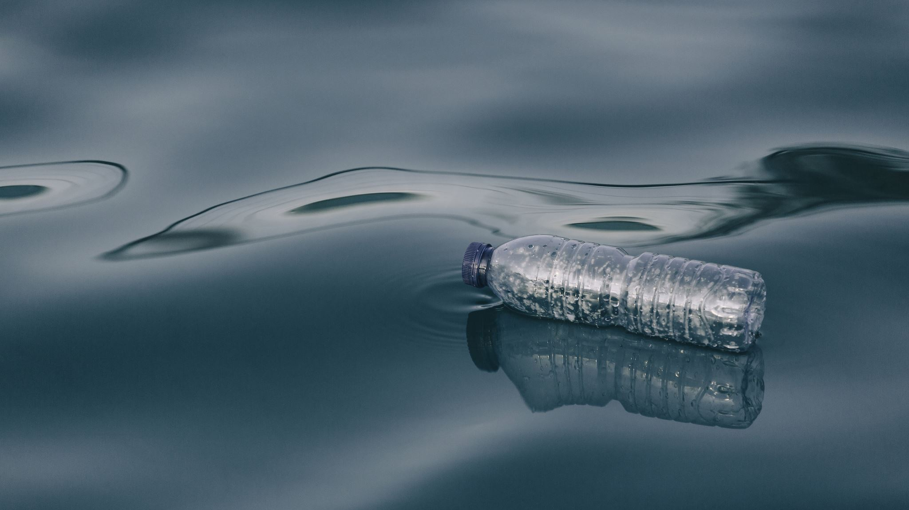
Water resources
Samantha, Janet, Yuni, Claire, Wenny

Slide 20
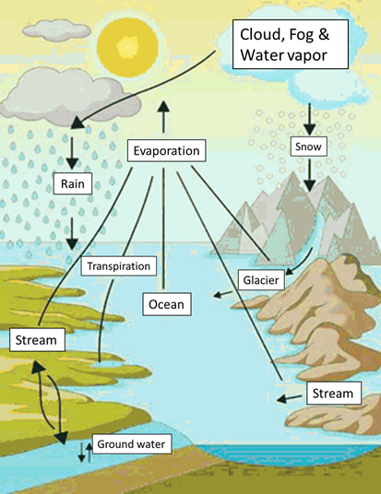
WHAT ARE WATER RESOURCES ?
Water resources, any of the entire range of natural waters that occur on the Earth,
regardless of their state (i.e., vapour, liquid, or solid) and that are of potential use to humans.
Include surface water and groundwater controlled by human beings and directly available for
irrigation, power generation, water supply, shipping, aquaculture and other purposes,
as well as rivers, lakes, wells, springs, tides, harbors and aquaculture waters.
Water resource is an indispensable natural resource for the development of national economy.
In many parts of the world, the demand for water has exceeded the load of water resources.
At the same time, many areas are also close to the imbalance of water resources utilization.
⭐️not so fun fun fact: 97% water of the Earth is salt water and the other 3% is fresh water ⭐️
15 Claire

Slide 21
SOME OF THE WATER PROBLEMS IN TAIWAN
10 Samantha
1. WATER IS WASTED❗️ ❗️
2. LESS TYPHOON OR RAINING
BECAUSE OF CLIMATE CHANGE

Slide 22
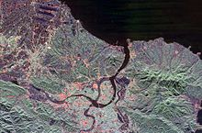
THE BIGGEST RIVER RESOURCES IN TAIWAN
THE BIGGEST LAKE RESOURCES IN TAIWAN
The Tamsui River(淡水) begins at the confluence of Xindian River and Dahan River at the western boundary of Taipei and New Taipei City, just north of Banqiao District, and flows northward and northwestward, passing the eponymous Tamsui District, then emptying into the Taiwan Strait. Formerly known as the "Dolatok River", it is one of the few rivers in the island that flows along a north–south direction.

Slide 23
HOW CAN WE SOLVE THE PROBLEM ⬆️ ?
1 Janet
1. WATER IS WASTED ❗️
Save water and reuse household water. For example, hand-washing and
rice-washing water can be used for watering flowers and mopping the floor.
2. LESS TYPHOON & RAINING BECAUSE OF CLIMATE CHANGE
Less using plastic based products (ex plastics bags, bottles, etc.), like bring your own reusable bags and straws.
Also recycle, reduce and reuse, don’t use too much eletricty and more using public transportation.

Slide 24
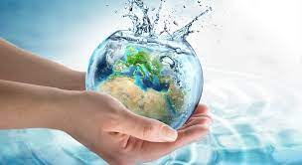
WHAT CAN WE DO TO SAVE WATER ?
❗️Prevent Water Pollutions❗️
Use environmentally friendly cleaners to reduce environmental protection and reduce environmental pollution.
Avoid picnicking and splashing in the reservoir area.
Take it with you when you go out for a picnic and barbecue.
And reduce the pollution of agricultural fertilizers, chemical fertilizers, and chemical fertilizers.
❗️ Easy Things You Can Do To Protect Drinking Water Sources❗️
1. Properly dispose of hazardous products Put up signs. ...
2. Use and dispose of harmful materials properly. ...
3. Volunteer in your community. ...
4. Join in a beach, stream or wetland cleanup. ...
5. Prepare a presentation about your watershed for a school or civic organization.
32 Wenny, 34 Yuni

Slide 25
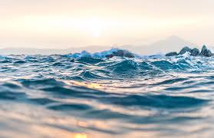
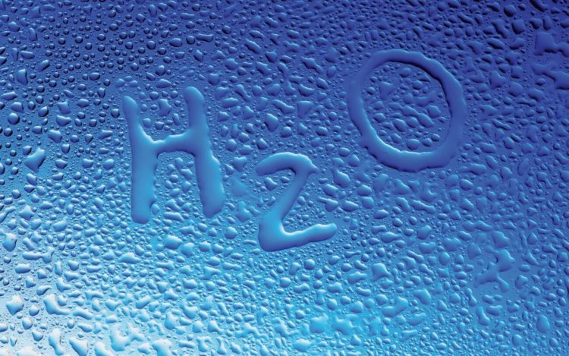
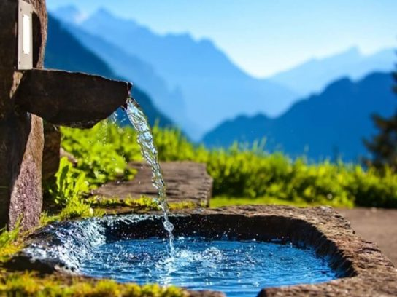
Water resources
On average, fresh water reserves are about 94.1 billion cubic meters. M. Water resources of Ukraine delight with their diversity.
They include almost all possible types of water resources. The total volume of our waters is limited to 139,500 km3.
The total number of lakes is about 20 thousand, rivers - about 77 thousand.
And therefore, with this information, we can conclude that we have no problem with water.
Polina Kholiavko

Slide 26
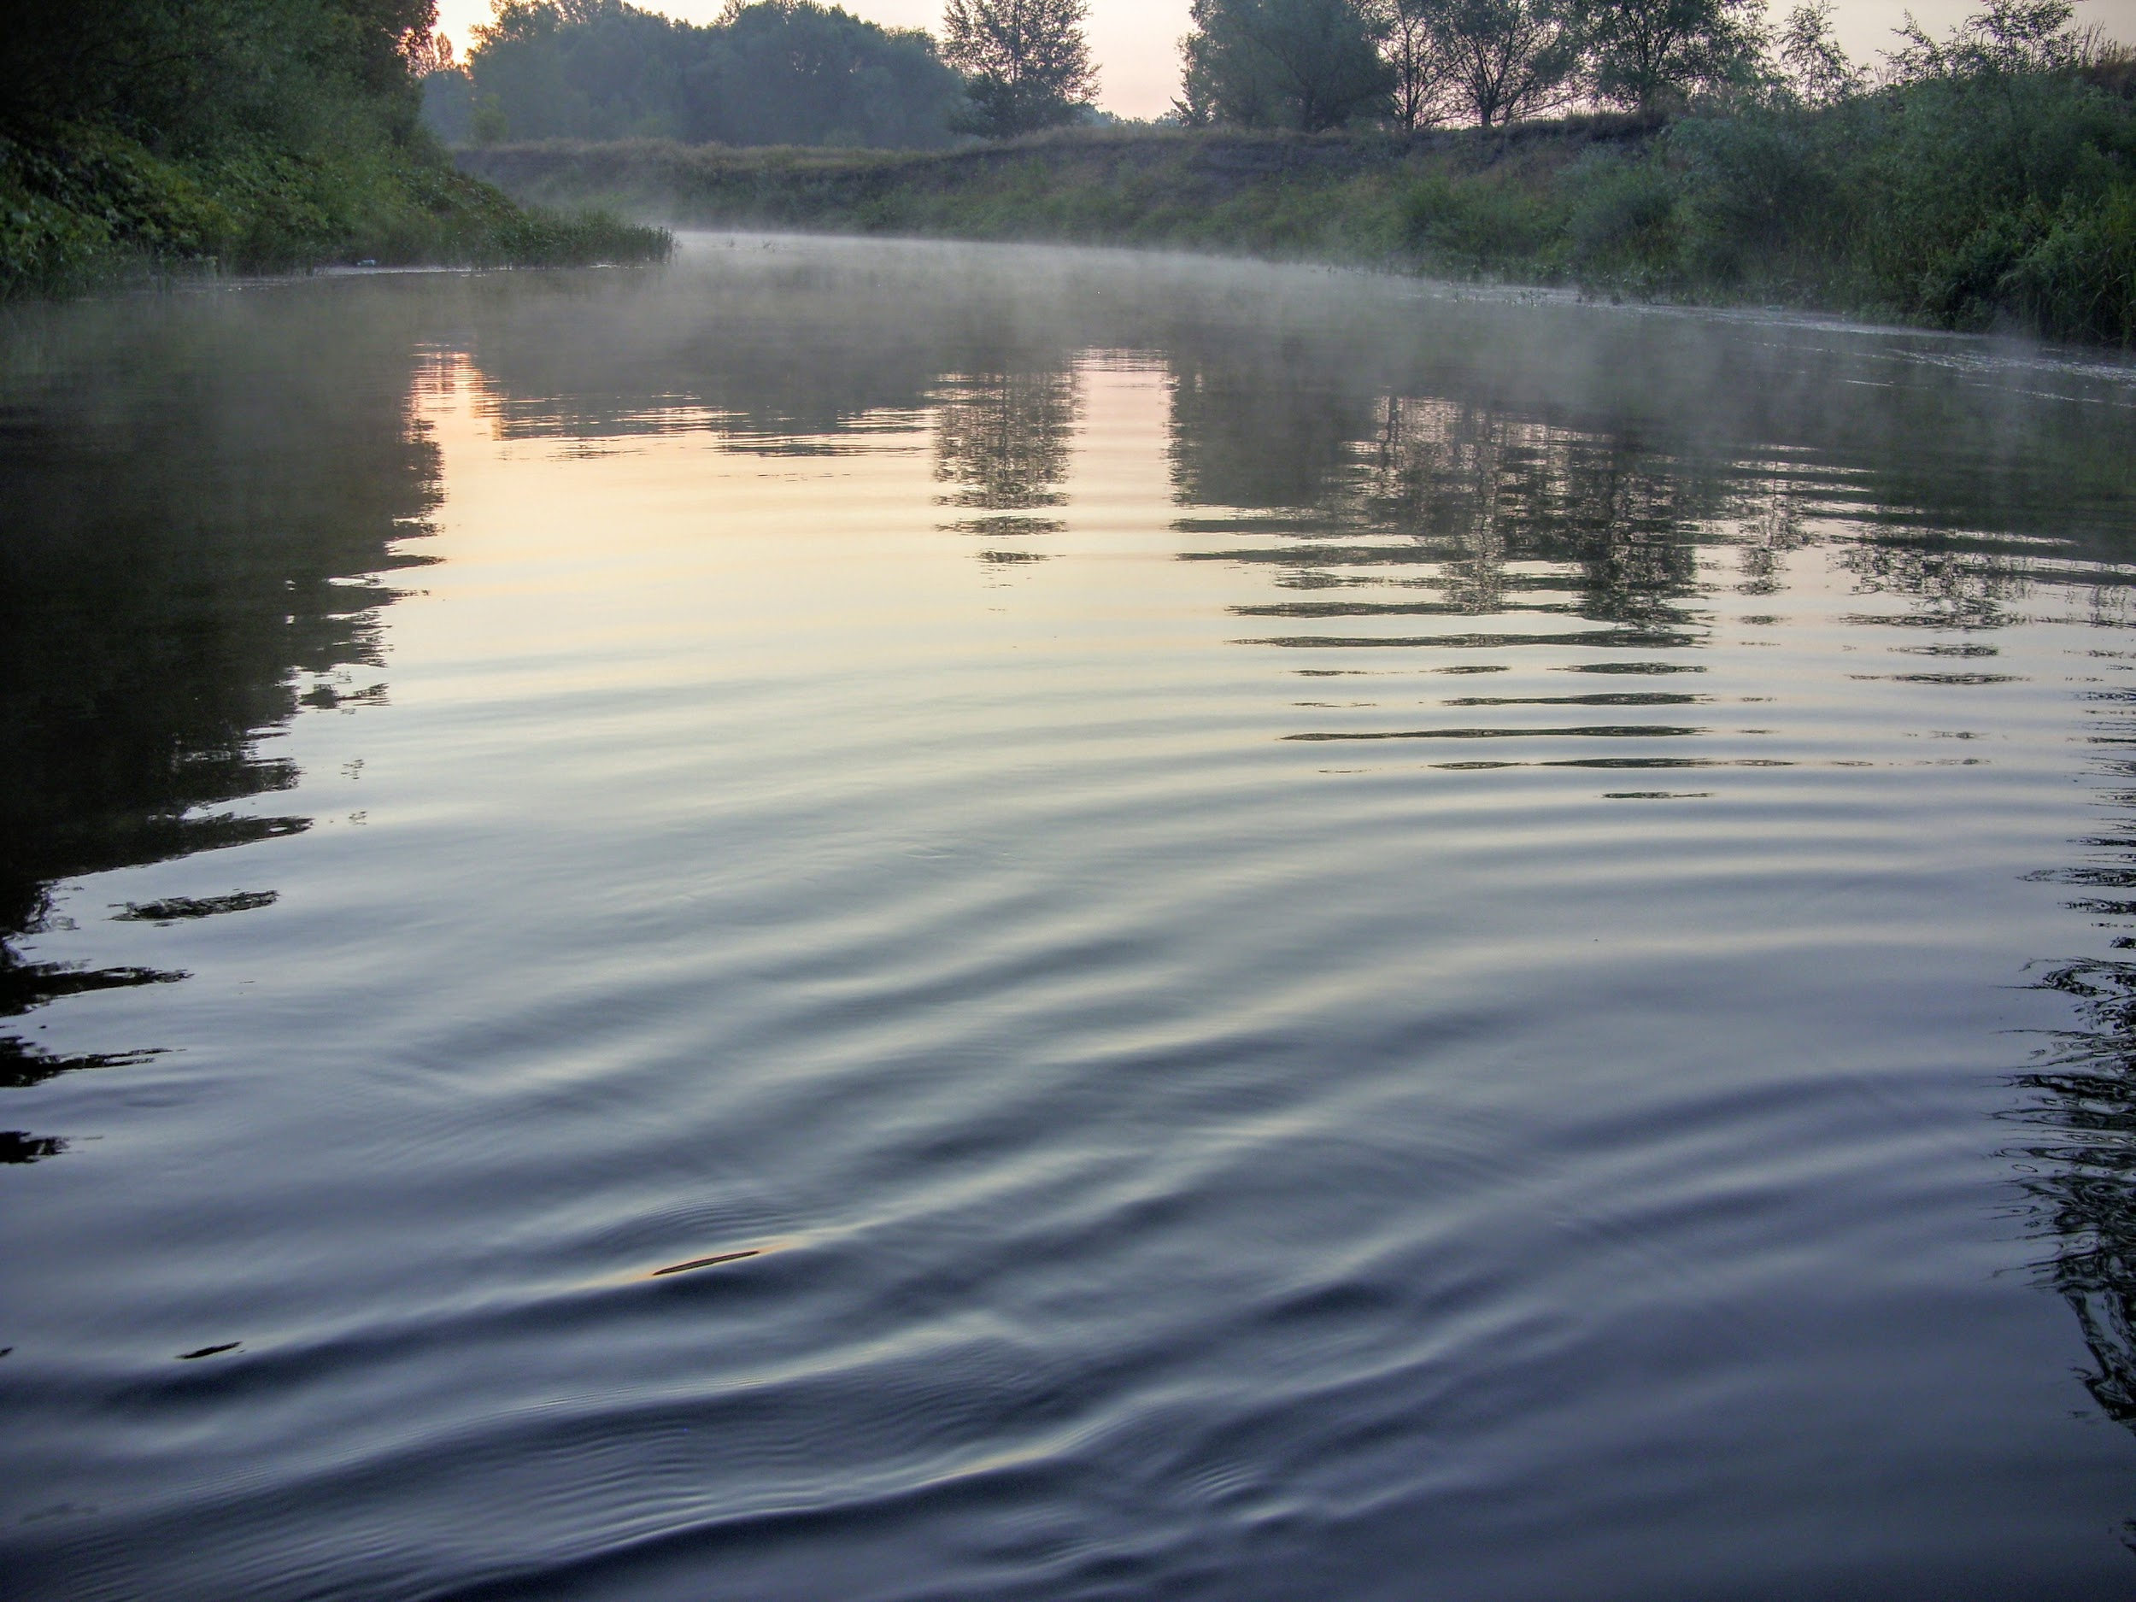
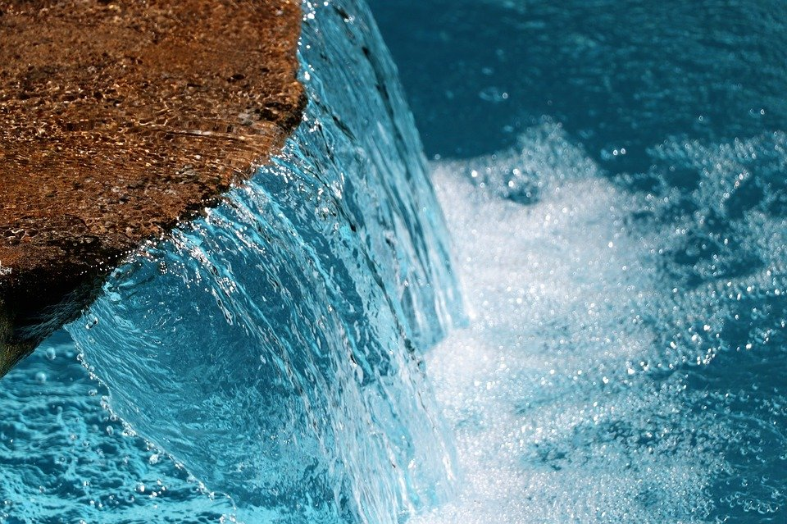
In Ukraine in reservoirs 55315 million cubic meters water.
Ukraine has the largest river Dneper with a length of 2.201 kilometrss and 504.000 km² water
In Ukrain 63 thousand rivers and 20 thousand lakes
In Ukraine water is polluted with garbage and waste
Vadim Avramchuk

Slide 27
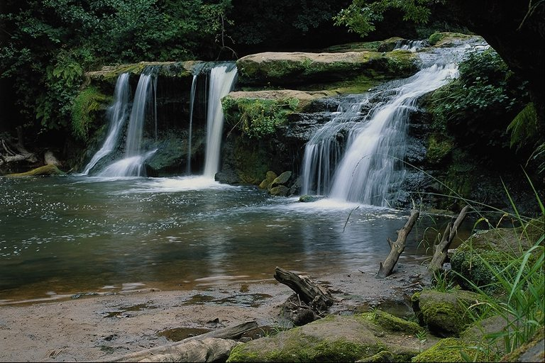
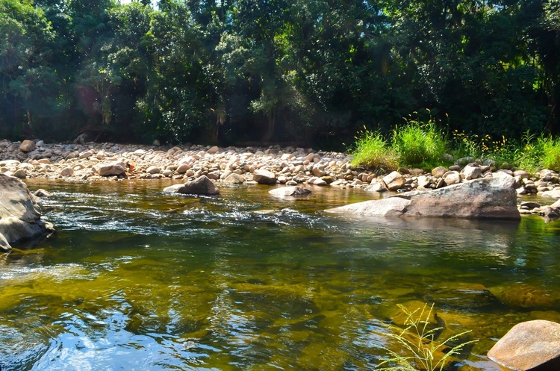
Water resources
Ukraine has large water reserves. It has never been lacking. Some people unknowingly consume a lot of water that they do not need. Also, many rivers become clogged and dry up. People need to rethink their attitude to water.
Rivers of Ukraine - 30,000; lakes - 20,000; seas - 2: Azov and Black Seas
Liza Dovhopol Vika Zinoruk

Slide 28
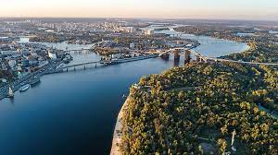
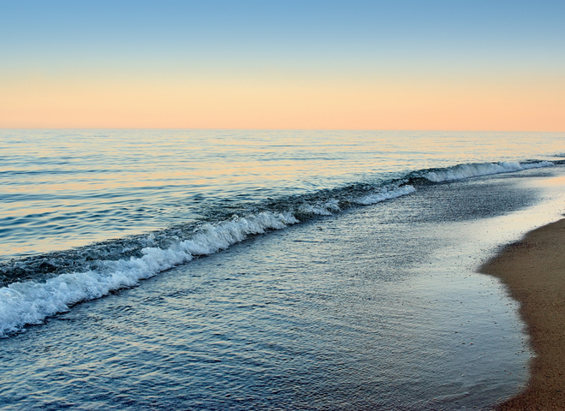
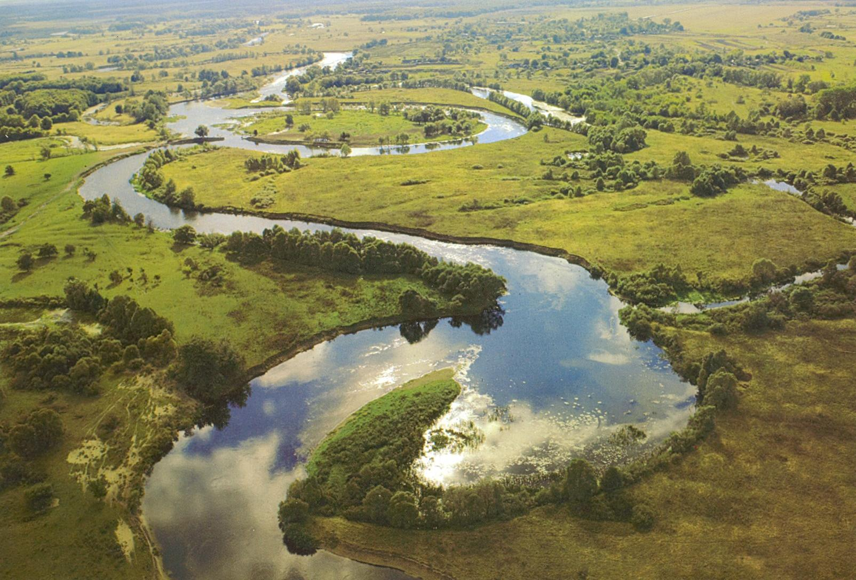
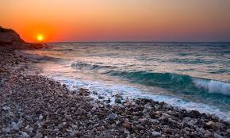
Water resources
Aydan Ozbay 7A
Dnieper is the longest river in Ukraine.
There are two seas, about 63 thousands of rivers and over 20 thousands of lakes in Ukraine.
Happily, we don’t have huge problems with water resources in Ukraine now, but anyway we !have! to keep water and don’t waste it.
But I noticed that some rivers became not so deep as they were 4-6 years ago.

Slide 29
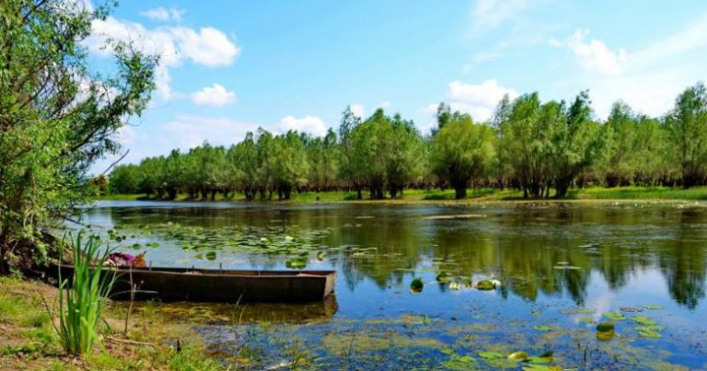
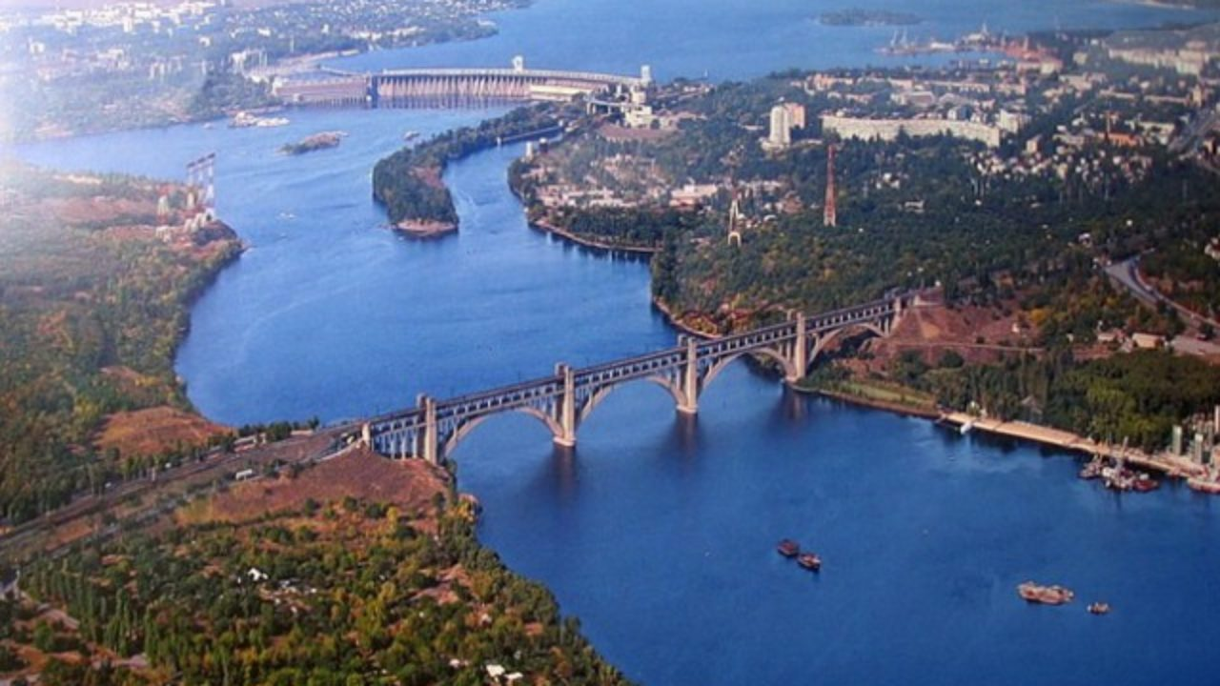
Water resource
Nikita Harlamov 7-D
Yalpug is the largest lake in Ukraine and the second largest in Europe. In hot months, the water temperature rises to 25-26
The Dnieper is the largest river in Ukraine, and is 981 kilometers, the river flows into the Black Sea.The depth of the river is 6-12 meters.Flows through 3 countries Ukraine Russia Belarus.

Slide 30
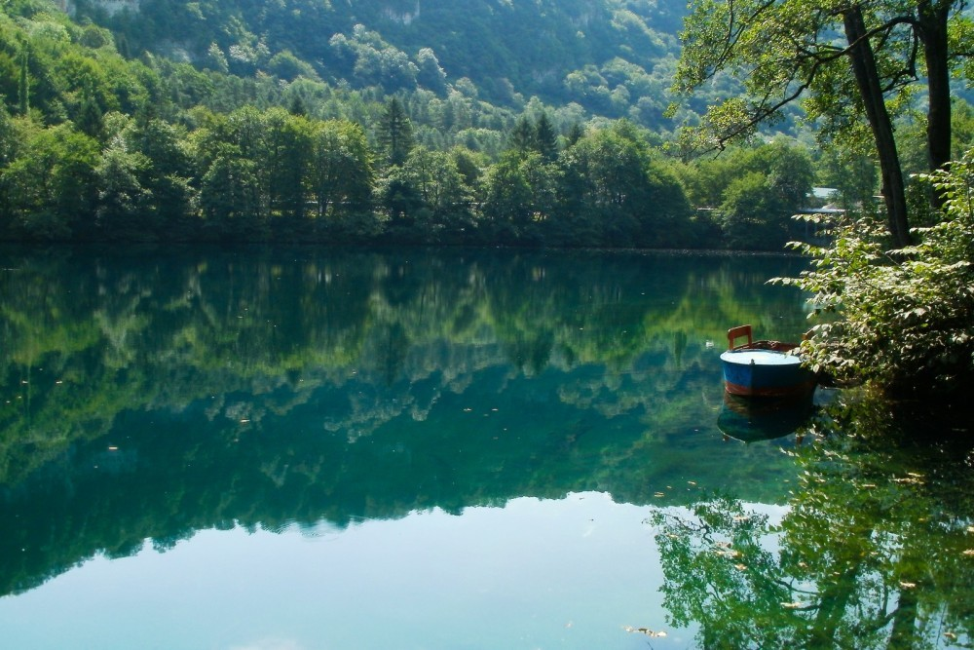
Water resources of Ukraine are inland seas, large and small rivers, underground sources, lakes, swamps and other bodies of water.
There are more than 71 thousand rivers and streams in Ukraine, their total length exceeds 248 thousand km. The total volume of water resources is 209.8 km3 per year, including 52.4 km3 per year - the flow of the local formation.
According to government statistics, the total average value of fresh water resources is estimated at 94.1 billion cubic meters. The main part - 92.6% - falls on the river runoff.
Nikita Leshchenko 7-D

Slide 31
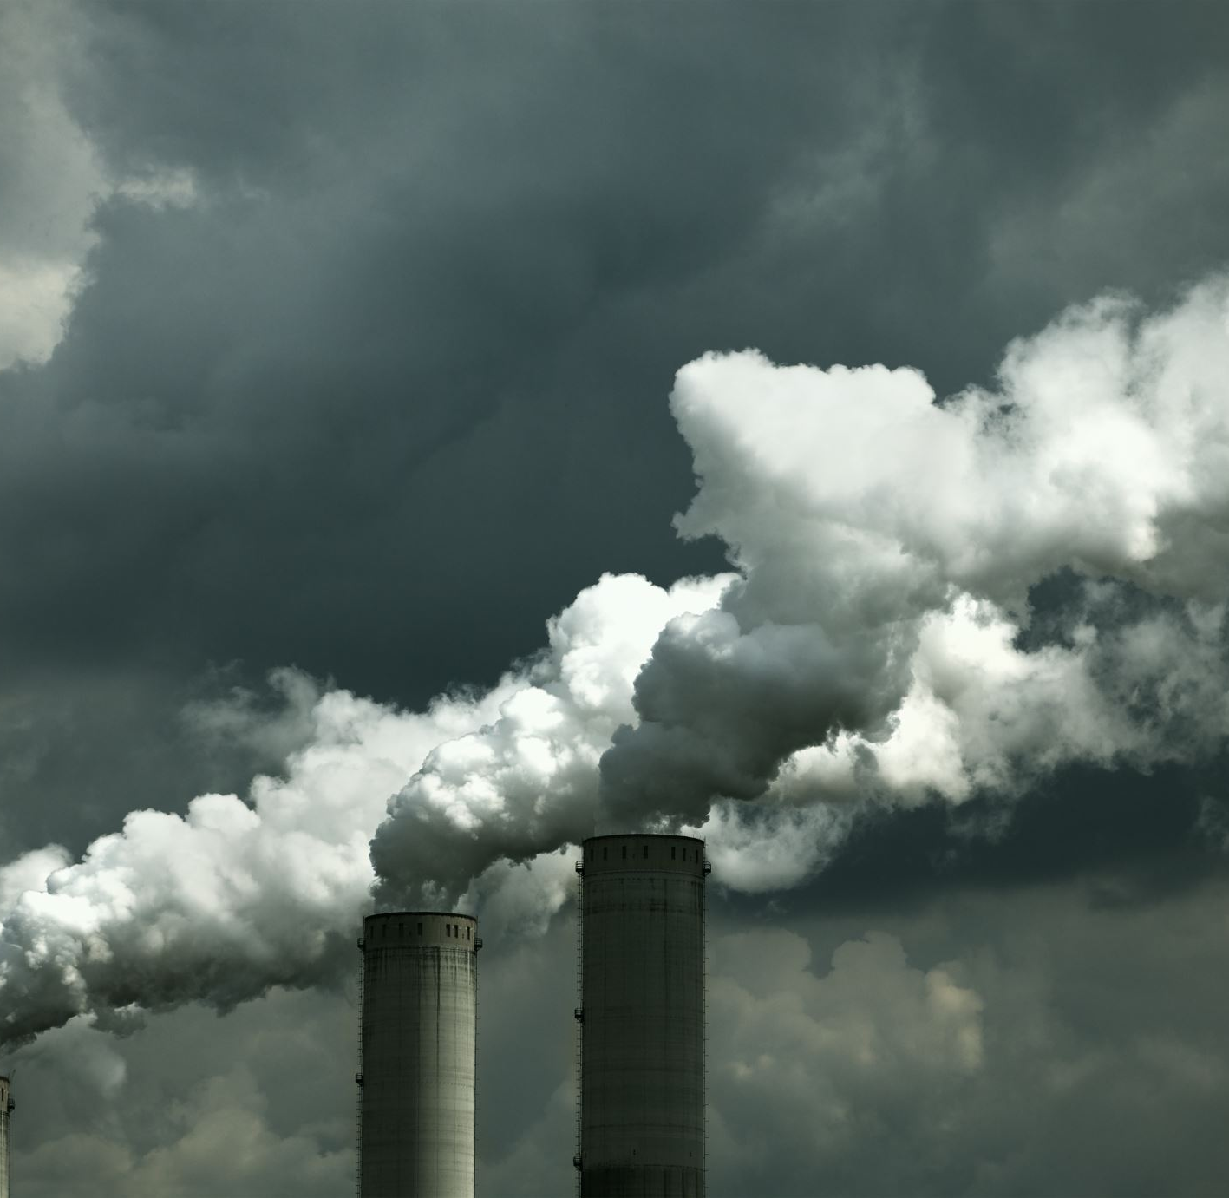
Pollution
Wendy, Sandy, Ariana, Benson

Slide 32
Pollution introduction from news article
Pollution is the introduction of harmful materials into the environment. The harmful materials are called pollutants.
Pollution is the introduction of harmful materials into the environment. Landfills collect garbage and other land pollution in a central location. Many places are running out of space for landfills.
Pollutants can be natural, such as volcanic ash. They can also be created by human activity, such as trash or runoff produced by factories. Pollutants damage the quality of air, water, and land.
Many things that are useful to people produce pollution. Cars spew pollutants from their exhaust pipes. Burning coal to create electricity pollutes the air. Industries and homes generate garbage and sewage that can pollute the land and water.
Although urban areas are usually more polluted than the countryside, pollution can spread to remote places where no people live.
Sources of information : https://www.nationalgeographic.org/encyclopedia/pollution/
.

Slide 33
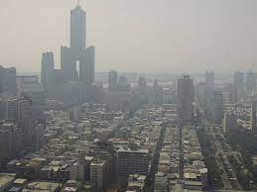
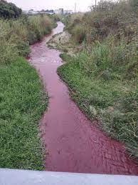
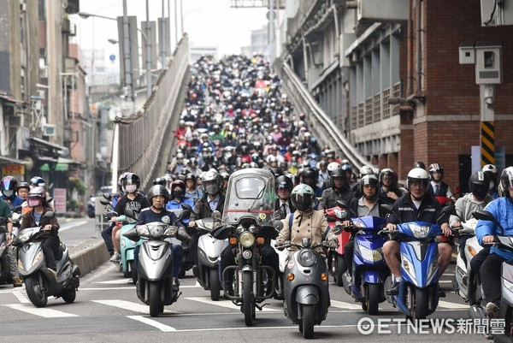
Pollution problems in Taiwan
Air pollution is the main pollution in Taiwan.
Air pollution in Taiwan is mostly derived from sources of domestic combustion, primarily the burning of fossil fuels.
Taiwan's topography has been noted to be a contributing factor to its air pollution problem, leading to poor dispersal and trapping pollutants.
Taipei, Taiwan's capital and largest city for example, is surrounded by mountains, and other industrial centers along the northern and western coasts of Taiwan are surrounded by high mountains.
Water pollution and heavy metal pollution are also serious in Taiwan.
Most of the pollutions in Taiwan are from factories and cars.
Sources of information: Google

Slide 34
Opinions
Wendy: Besides the three major types pollution (water, air and land pollution), there are also have pesticide pollution and plastic pollution, etc. Pollutions is a global problem. Let’s take action on it to protect our beautiful and health Earth.
Sandy: There are many kinds of pollution on the earth. These pollutions may make the earth unsightly, so we must start to care for the earth, reduce pollution, and make the earth a better place.
Ariana: Although there is no way to avoid pollution now, we can reduce pollution together in a number of ways (such as taking more public transport）.
Benson: It’s everyone’s responsibility to protect the earth, but we must start with ourselves first.

Slide 35
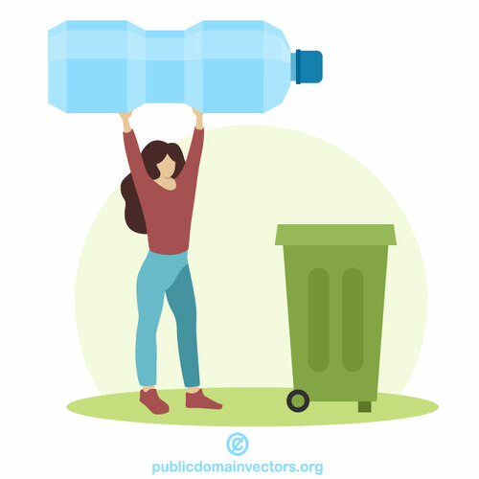
In Ukraine, very few people sort garbage.
There is a lot of garbage in dump,which decomposes for centuries.
In Ukraine, there are almost no containers for garbage processing, and if there are, then all the garbage will still be in the dump
Olena Chepurko 7A

Slide 36
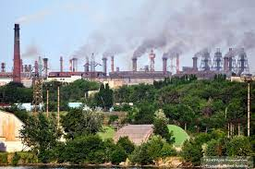
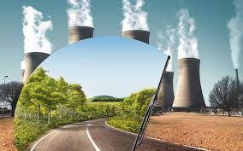
Environmental problems of Ukraine
contamination of drinking tap water;
air pollution (especially in the industrial regions of the country);
destruction of land resources (degradation of black soil in Ukraine);
destruction of green spaces;
pollution of water resources (water area of ​​the Black Sea, surface waters)
Pollution problems in Ukraine
Most often, people themselves pollute nature. People litter on the street, burn garbage cans, woods, fields. Also, the nature is affected by emissions from factories - acid, smoke. Also, nature is polluted by exhaust gases from cars, buses, airplanes and other vehicles. And such problems are not only in our country, but in most countries around the world. And if we ourselves do not want to cleanse nature and continue to do the same, then soon the entire planet will simply sink in debris and dirt.
Sofia Shevchenko 7-D

Slide 37
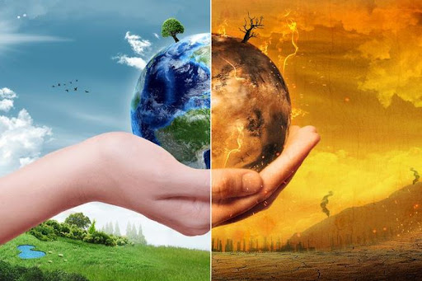
Pollution
In Ukraine, environmental pollution is one of the main problems. The air is unclean, because there are lots of cars. Polluted air can cause headaches. People pollute water bodies, streets. When you come to a lake or river, waste floats in the water. In the parks on the ground are used napkins, papers, wrappers. In some areas, there are dumps near houses for recycling, but unfortunately there are very few.
Anna Vashchenko

Slide 38
Pollution
I think, in our country and in the world in total, pollution is a global problem.
At first, it’s a reason of other environmental problems. Also, in some places you can see a lot of rubbish or you can feel air pollution.
It sounds so global, but people can correct this. You only need to send garbage for recycling and keep clean. On an industrial scale pollution problem is more global,
but you will help the nature.
Dima Ilinov 7-A
Good
Not good

Slide 39
Pollution problem in Ukraine
I think our country has a really big problems with pollution.A lot of people in Ukraine don’t sort trash,throw it right on the floor and buy many cars ,that pollute the air.Also some industries pollute lakes by dumping waste .All of them pollute our country and don’t fix what they left behind.I think we need to stop it,because our planet and country must be clear .
Ivan Kravchenko

Slide 40
Problem with pollution in Ukraine
In ukraine there are many problems with pollution because our people don’t understand that it is necessary to throw out garbage in garbage cans, and throwout it simply on a grass.
People in Ukraine must understand that when they pollute the environment, they harm themselves
If people in Ukraine continue to throw garbage anywhere, our country will turn into a garbage can
Artem Klymenko 7-A

Slide 41
Endangered habitats in Taiwan
Cindy, Sienna, Tauma, Lawrence, Andrew

Slide 42
What is Habitats?
In ecology, habitat includes a series of resources, physical and biological factors that exist in an area. The habitat of a species can be regarded as the physical manifestation of its ecological niche. Therefore, "habitat" is a term for a specific species, which is fundamentally different from concepts such as environment or vegetation combination. Geographical habitat types include polar, temperate, subtropical and tropical regions. The types of land plants can be forests, grasslands, grasslands, semi-arid or deserts; freshwater habitats include swamps, streams, rivers, lakes and ponds; marine habitats include salt marshes, coasts, intertidal zones, estuaries, coral reefs, bays, open seas, Seabed, deep water and seabed vents.
Notes:
S

Slide 43
Distribution of Shihu (石虎) in Taiwan
According to the records of Japanese naturalist Tadao Shikano in 1940, stone tigers are widely distributed in low-altitude mountainous areas throughout Taiwan. However, it can only be found in the mountainous area between Miaoli and Tainan.
How do we kill Shihu ?
1.Overexploitation path.
2.Destroy their habitat.
3.Overexploitation of low-altitude forests.
4.Ingested rat poison or poisoned bird that died.
5.Mistake trap

Slide 44
How do we protect the Shihu ?
1. Don't abandon pets (reduce the threat of cats and dogs to stone tigers)
2. Do not buy or raise wild animals (reduce hunters to catch)
3. Report illegal beasts (to reduce the damage of stone tigers)
4. Slow down when driving in the suburbs (to reduce the road death of Shihu)
5. Purchase and use environmentally friendly products (reduce pollution in Stone Tiger Forest)
6. If you see a stone tiger who has been captured, injured, or accidentally ran to someone's house, please report to the rescue unit.

Slide 45
Habitat preservation
Habitat conservation is an important part of saving nature. To preserve the natural habitat, you can economically use natural resources, not pollute the nature and not cut down forests. It is also necessary to preserve endangered species of animals and plants. The Red Book helps us in this.The Red Book is the main document containing materials on the state of rare and endangered species of animals and plants.
Yaroslava Kovalchuk 7-D

Slide 46
monk seal
Habitat preservation in Ukraine
The fauna of Ukraine numbers more than 33 thousand species of animals. About 400 species of animals are listed in the Red Book of Ukraine. Mammals include the monk seal, bison, lynx, river otter, badger, ermine and some other species.
bizon
Milana Yurchenko
ermine
badger
river otter
lynx

Slide 47
Food supply
Debby, Sharmaine, Leo, Jacky

Slide 48
Places In Our World Who Are Trying To Survive With Food Problems
Africa, Especially in the south.
Haiti
And Many More
Bolivia
India

Slide 49
Health Problems Related To Our Food Supply
Malnourishment : A body problem that will occur when your body doesn’t get enough nutrients and Have symptoms like severely Visible Bones, Bloating, Hair Loss, Crankiness and even Death.
Obesity: Basically it’s the opposite of malnourishment. You eat too much and your body gets too much nutrients, plus an unhealthy lifestyle, those nutrients turn into fats and may lead to heart problems, breathing problems and even death.
Food Poisoning: Very common in contaminated food and drinks that may have germs like e.coli that will cause the body to throw up and have diarrhea and must be sent to emergency right away.

Slide 50
Problems with Taiwan’s Food Supply
Natural Hazards may cause food prices to go up and make it harder to buy.
Taiwan has encountered different sorts of issues with meat. Perhaps something like the African Swine Flu, Bird Flu, Mad Cow Disease. etc…

Slide 51
Reasons Why Some Countries Lack Food Supply
Natural Hazards: Will Cause a Bad Harvest and Food Prices Will Increase.
Environment: Some countries have a different kind of soil, and it depends on how much nutrients it has, plus some countries can have a higher risk with either a typhoon or drought.

Slide 52
How We Help Countries That Lack Food Supply
Food Aid : One of the most common ways to provide food for hungry children and people.
Food Banks : A special store where they get donated food from different countries and will send these foods to many poor countries.
Education: Some doctors and teachers will teach the people how to prevent health problems related to food supply and also teach the people how to plant and harvest food with the special environment they have. Sometimes they even teach the people how to filter contaminated food and water and give unscheduled lessons and speeches about nutrition to everyone.
Charity and Donations: Countries will either donate money, food or clothing to countries that needed them the most.

Slide 53
I recently saw on TV a program about the Swedes. They really care about the environment. They have cafes in which they make dishes from products that in 3-4 days would be expired! Many tourists are even afraid to try, they are afraid that the dishes are spoiled! I'll tell you how it happens. In stores, there are products that will become expired after about 4 days, they sell these cafe products for half the price and the chefs in the cafe prepare dishes from them! They give new life to these products! That is, if it were not for these people working in the cafe, the food would go bad and end up in a landfill! Cool, isn't it? Unfortunately, we do not have such establishments in Ukraine, but Ukrainians also care about nature. We recycle the leftover food, recycle and get fertilizer for the plants, we sort the garbage. And I still hope that in the near future we will also "give new life" to products that have already "lost hope of salvation"
Valeriia Tseba, 7-D
sad products
happy products

Slide 54
Food supply:
What are the food issues in your country?
One of the main problems with food supply in Ukraine is that there are almost no import goods in this field. Most of the products are either made in Ukraine or are being supplied from enormous companies like Coca Cola. You can’t just find some lesser known foods from other countries like in America or in other countries. There are some problems with the fact that there isn’t as much variety as in other countries, but it’s pretty minor, so I don’t consider it a major issue.
By Dima Baliuk 7-A

Slide 55
Globalization
Sophia, Willy, Tina, Jason Lai

Slide 56
Globalization is the process of international integration brought about by the exchange of worldviews, products,concepts and other cultural elements. The advancement of infrastructure such as telecommunications,including the telegraph and the subsequent rise of the internet,has resulted in globalization and cultural and economic interactions.
What is the globalization ? (Willy)

Slide 57
Advantage 1.Promote international competitiveness 2.Promote the world economy Disadvantages 1.Large gap between rich and poor 2.Economy instability
Globalization’s advantage and disadvantages
(Tina)

Slide 58
China and U.S.A are two countries who are the biggest winner of globalization. Because these two countries connect economy of Taiwan, Taiwan has a special position. If Taiwan take advantage of globalization,Taiwan’s economy will grow up with China and U.S.A.
Taiwan’s globalization (Sophia)

Slide 59
Taiwan’s industries are dominated by small and medium-sized enterprises, and globalization has brought Taiwan’s economic growth and population growth
What advantage does globalization bring to Taiwan? (Jason Lai)

Slide 60
2020 Taiwanese international brands

Slide 61
Globalization in Ukraine has increased in recent decades. This is due to advances in areas such as technology, communications, science, transport and industry. Globalization also applies to language. Some people wonder why not choose one language and communicate with the whole planet? However, each country will want to keep its own language in order to preserve traditions and culture. According to a recently published study by the World Economic Forum, Ukraine ranks 79th out of 140 countries.
Advantages of globalization for Ukraine: rapid spread of information technologies, greater opportunities to find partners around the world, not only among the nearest neighbors, free movement of Ukrainian citizens around the world, the possibility of global regulation of the environmental situation in the country, education and work abroad.
Inga Surzhko

Slide 62
Migration
June, Ann, Daisy, Edward, Jason Chang

Slide 63
What is Migration?
Why do people Migrate?
Human Migration is a person moving across an international border or a state away from his/her’s habitial place
People migrate for different reasons,it can be about economic, social, politics, and enviorment.

Slide 64
Pull-Factors
more wealth
better services
good climate
safer, less crime
political stability
lower risk from natural hazards

Slide 65
Push-Factors
lack of services
lack of safety
high crime
crop failure
drought
flooding
poverty
war

Slide 66
Migration in Ukraine.
Is this a problem?
There are quite a few migrants in my country. They have different goals. People want to have good money, to have a good education, to have a better life abroad.Especially Ukrainians go to Europe (Poland, Czech Republic)
In my opinion, this is a big problem. After all, this shows that not everyone in our country can live well, not everyone earns enough money, education isn't as good as in other countries. So, this is a global problem. Because the country will lose a lot of smart people if the economy doesn't develop.
Evelina Plaksiuk

Slide 67
Migration
In Ukraine, people often migrate because of poor earnings. Mostly people move to European countries. Such as: Poland, Czech Republic, Russia. People also leave for Canada. Moving to these countries, people will run out of a better life, Ukrainians want to earn a lot of money.
Holodova Veronika

Slide 68
Migration
Many Ukrainians move from their home country to others to earn money because not everyone can find a normal job here and with a normal salary. Also, some move because of politics, problems in the country,
due to high prices for accommodation, meals and more. People go to Poland, Germany, the Czech Republic, America.
Veronika Kuzmenko 7-E

Slide 69
migration in Ukraine
a little bite history and reason
Migration began in Ukraine in 1877 and now Ukrainians are migrating, by the way, at the moment the most popular country for migration is Poland. Why did people start looking for work and a new life abroad? In my opinian on the first place is salary. For example, a nurse. in Ukraine this work is estimated at about $ 450, while in America (gross) about $ 6,000. People also migrate because of a change of place of work and also their family`s or person's own reasons for migration
Currently, there are about 3 million migrants from Ukraine
Uliana Moshkova 7-D class

Slide 70
Planting Tree in St.Paul School Campus
Final project

Slide 71
Planting trees in our school yard

