Slide 1
Is Air Pollution A Global Issue？

Slide 2
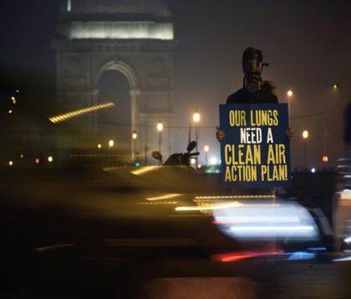
Global air pollution-related mortality
●The WHO report in 2018 also pointed out that 90% of the world's population is exposed to harmful air pollution, and air pollution has indirectly caused about 7 million deaths each year; many epidemiological studies have proved that air pollution can cause a variety of health effects hazards, and mortality from many diseases.

Slide 3
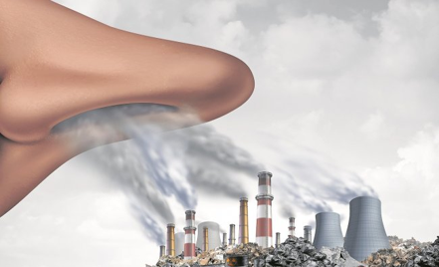
Ranking of the countries with the most air pollution in the world
Top 5 1. Bengail(孟加拉)
2. Republic of Chad(查德)
3. Pakistan(巴基斯坦)
4. Republic of Tajikistan(塔吉克斯坦)
5. India(印度)
61.Taiwan(台灣)

Slide 4
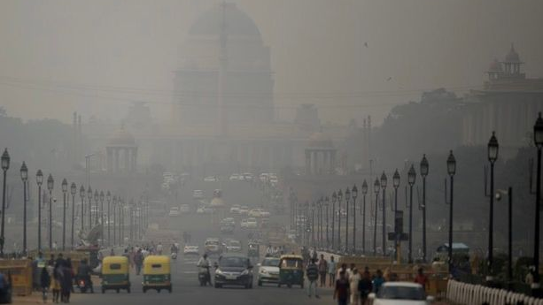
Q:Would the situation be very different if places with severe air pollution banned all cars and motocycles from entering the city?

Slide 5
Zoleka Mandela
Safe Streets Advocacy Hub launched to support StreetsforLife campaign
for 30 km/h urban streets
•Child Health Initiative Global
Ambassador
•she is an author, global advocat e and campaigner on road traffi c injury and Non- Communicable Diseases (NCDs)

Slide 6
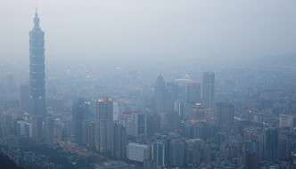
Q: How to make more people know about the problem of air pollution?

Slide 7
Thanks for listening

