Slide 1
Let’s Investigate Air Pollution

Slide 2
01
Introduction of Air Pollution

Slide 3
Sources of Air Pollution
Sources of industrial pollution:
Thermal power plants and various types of factories, exhaust gases, soot and soot emitted by burning fuel.
Traffic pollution sources:
Vehicles such as automobiles, locomotives, planes, trains and ships emit pollutants such as carbon monoxide, nitrogen oxides, hydrocarbons and lead.
Sources of domestic pollution:
Daily life produces substances that pollute the air, such as second-hand smoke, oil fumes, refrigerators, refrigerants leaked from air conditioners, etc.

Slide 4
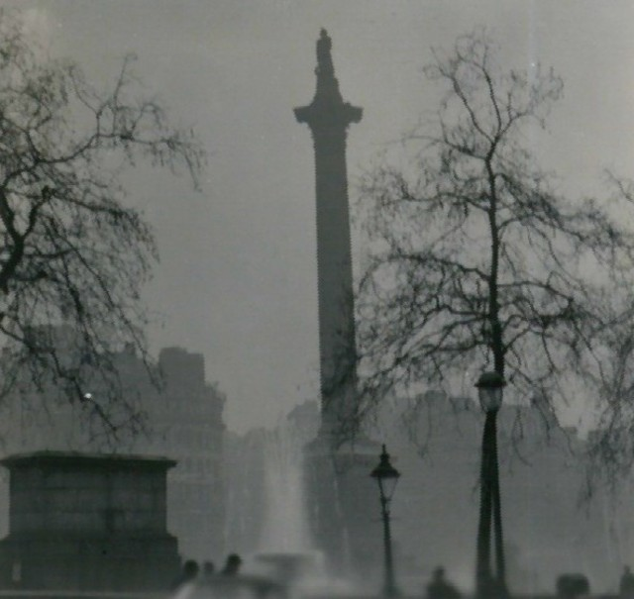
Ｗhen did air pollution start？
Great Smog of 1952：
London's winter foggy weather, after the Industrial Revolution, brought a large number of coal fuels, coal after the soot mixed with fog, stuck on the surface, known as black fog.

Slide 5
02
Impacts of Air Pollution

Slide 6
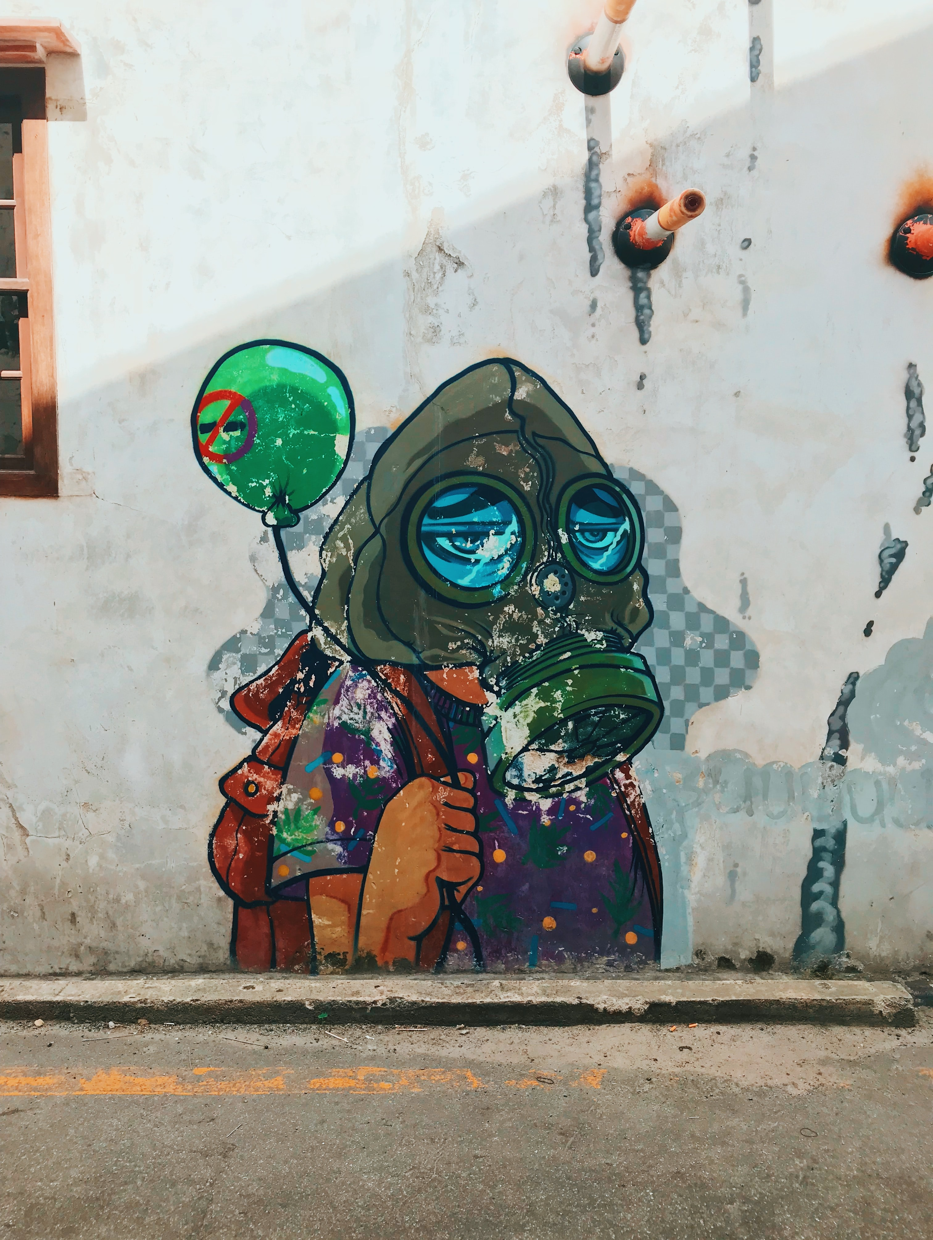
Health Effects
How does air pollution affect our health?
It may cause some diseases such as Respiratory Disease, Cardiovascular Disease, or worse, a cancer.
Whom does air pollution affect the most?
Air pollution affects everyone’s health, but certain groups such as children, older adults, and people with heart or lung diseases may be harmed more.

Slide 7
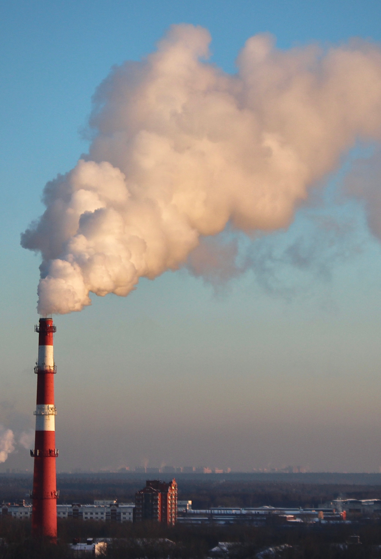
Environmental Effects
Acid Rain
Acid rain damages trees and causes soils and water bodies to acidify.
Haze
Haze obscures the clarity, color, texture, and form of what we see.
Effects on wildlife
Toxic pollutants can impact wildlife in a number of ways.

Slide 8
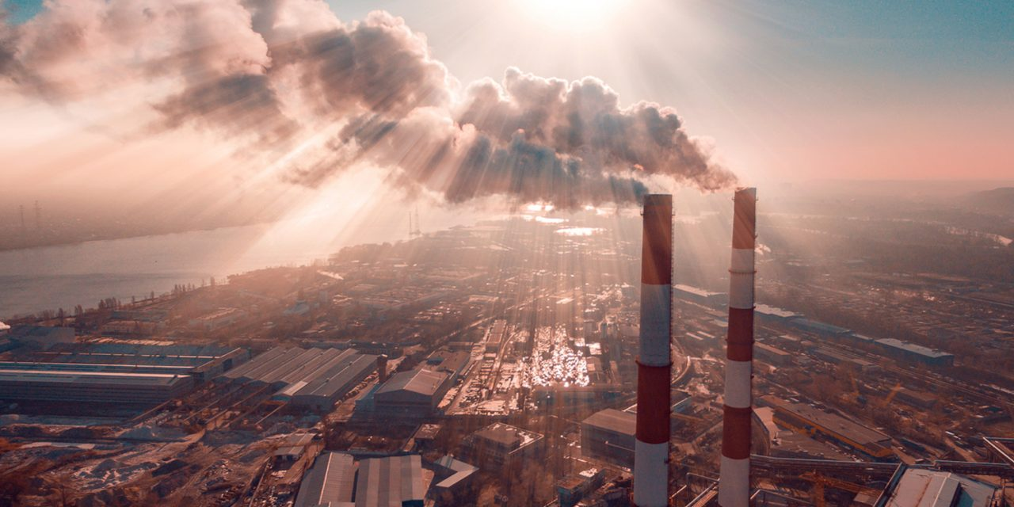
The Future Impact on the Planet
There are many CO2, CFCs, NOx, SOx, CH4, particulate matter and other chemical substances in the air, which will cause the death of organisms and damage the environment.
For example, CO² and CH⁴ contribute to global warming, our temperature will get higher and higher, triggering the greenhouse effect, CFCs will cause the ozone hole, and too much UV light will affect biological health.

Slide 9
03
Policies of Other Countries

Slide 10
United Kingdom
In the UK,concentration of key pollutants in air are regulated by regulations.
For example,
Air Quality Standards Regulations 2010
These Regulations set:
Numerical value for concentrations of major air pollutants affecting public health in outdoor air by law.
Targets for levels in outdoor air for four elements.

Slide 11
Japan
Japan had participated in the Kyoto protocol signed by the United Nations in Kyoto,Japan.
The main purpose in this protocol:
Reduce global emissions of air pollutants.
Control air pollution and global warming for the planet.

Slide 12
South Korea
In 2019, the air pollution in South Korea is becoming more and more serious, and it has become the most important “national security crisis” for the people of the country.
To reduce air pollution, Korea decided to:
Close to 14 coal-fired power plants
Restrict vehicle traffic

Slide 13
04
UN Sustainable Development Goals

Slide 14
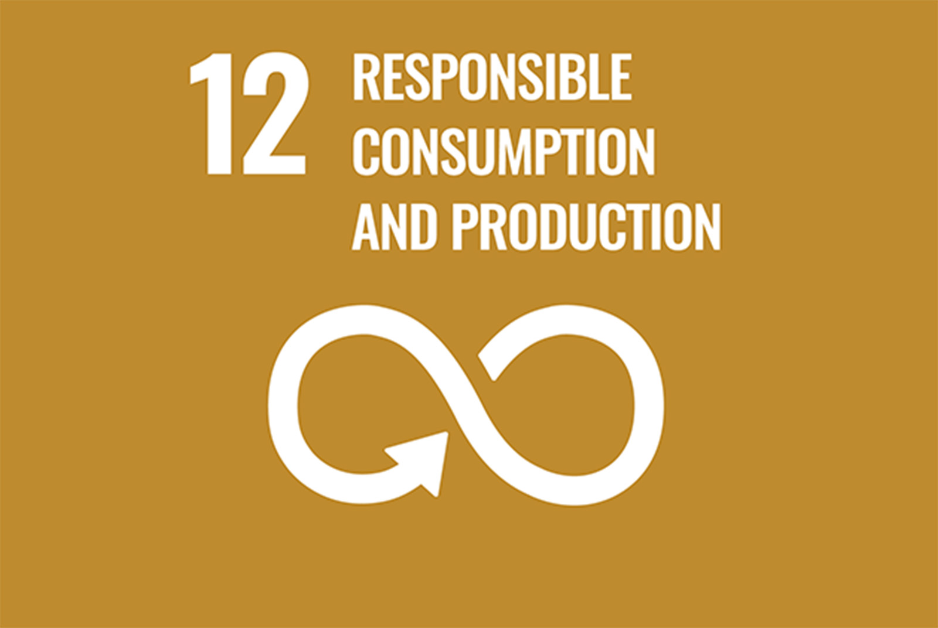
SDGs 12
12.5 By 2030, substantially reduce waste generation through prevention, reduction, recycling and reuse.
12.8 By 2030, ensure that people in every where have the relevant information and awareness of sustainable development, as well as a way of living in harmony with nature.

Slide 15
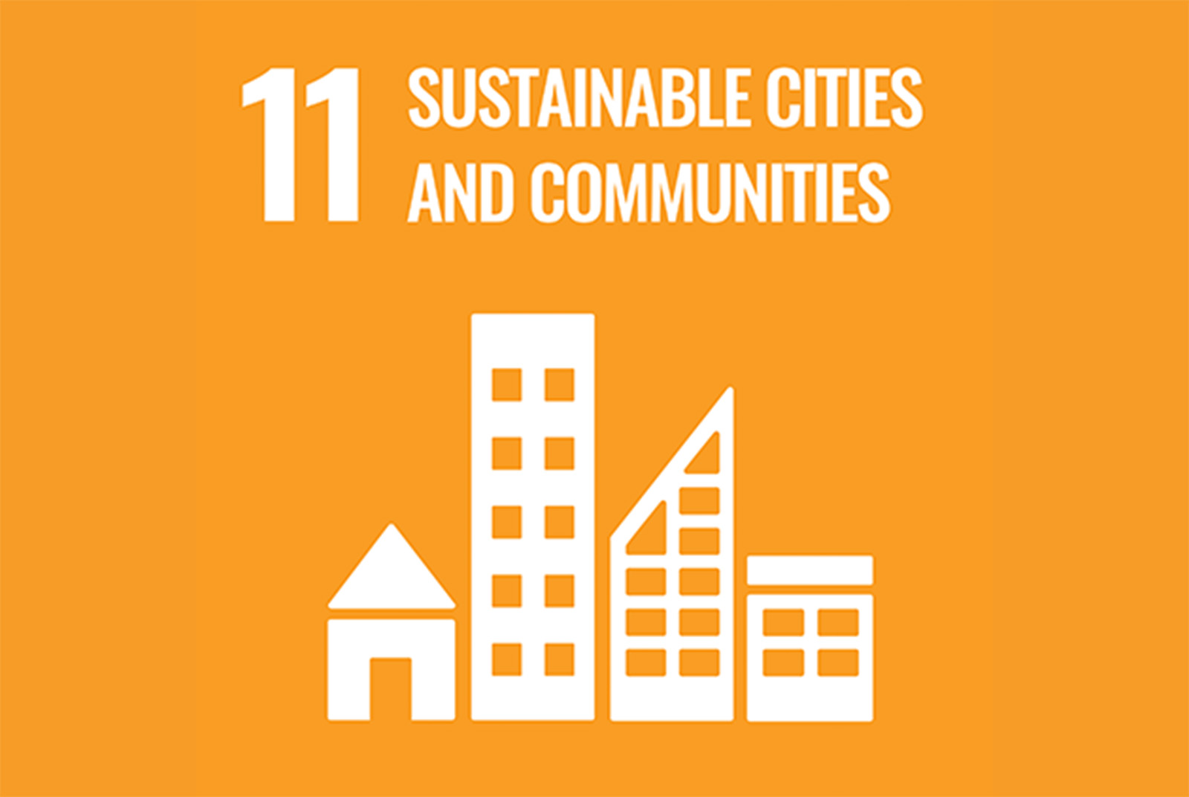
SDGs 11
11.6 By 2030, reduce the negative per capita environmental impact of cities, including paying special attention to air quality.....
Base on the above ,Taiwan lists this target.
The number of air pollutants exceeding the standard is 0.

Slide 16
05
Air Pollution in Taiwan

Slide 17
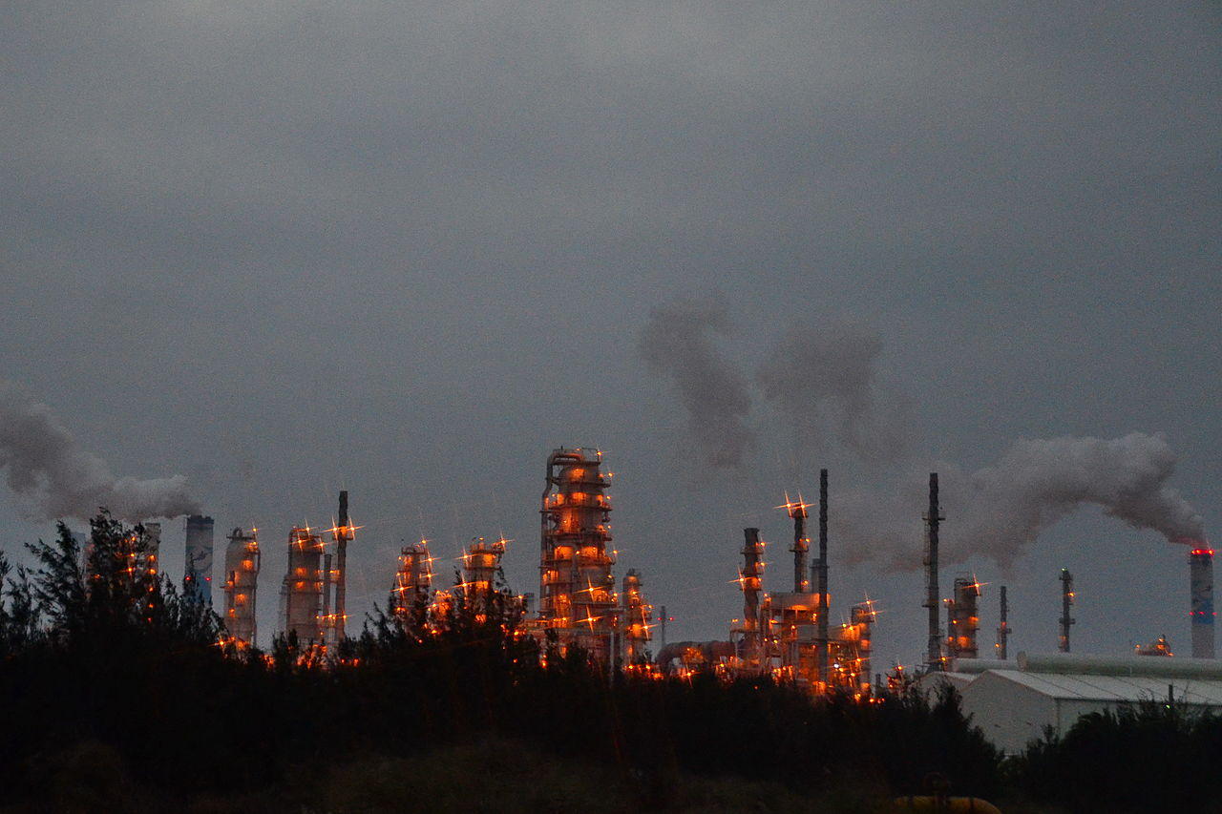
Air Pollution in Taiwan
With regards to research conducted on PM2.5 particles in Taiwan, the National Taiwan University in March 2015 claimed that traffic is the major source of air pollutants in Taipei. In central Taiwan, on the other hand, fine particles are primarily produced by thermal power plants.

Slide 18
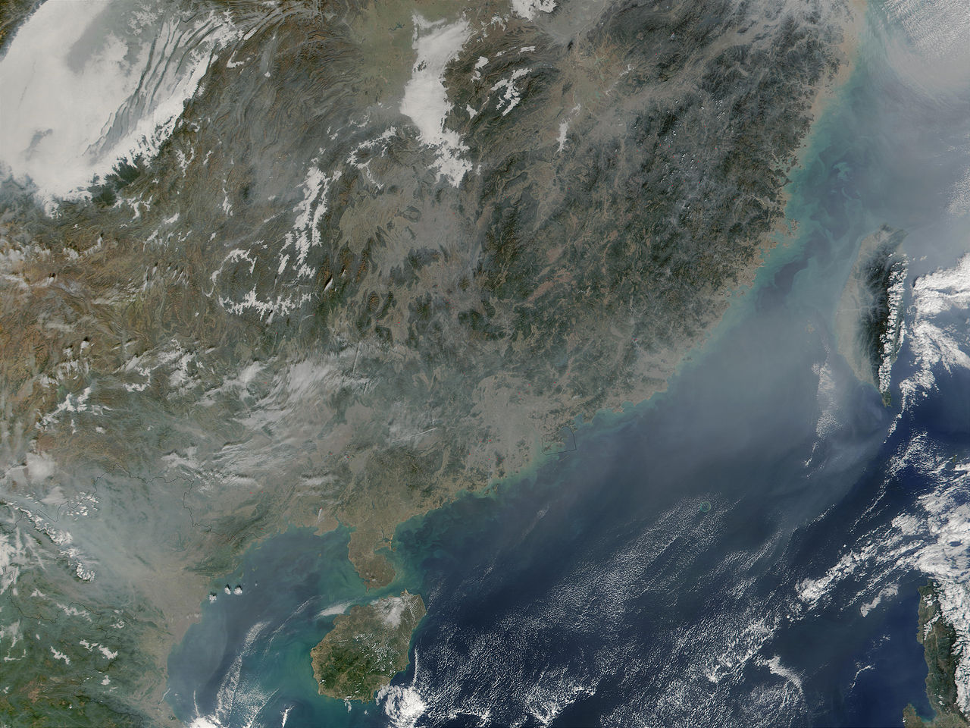
Cross-Border Pollution from China
In February 2014, the Environmental Protection Administration's (EPA) claimed there had been seven haze and dust storms since December 2013.For the largest part based on recent weather phenomena and air pollutant monitoring data from China's major cities, China's air pollution generally deteriorates the air quality in Taiwan significantly every winter.

Slide 19
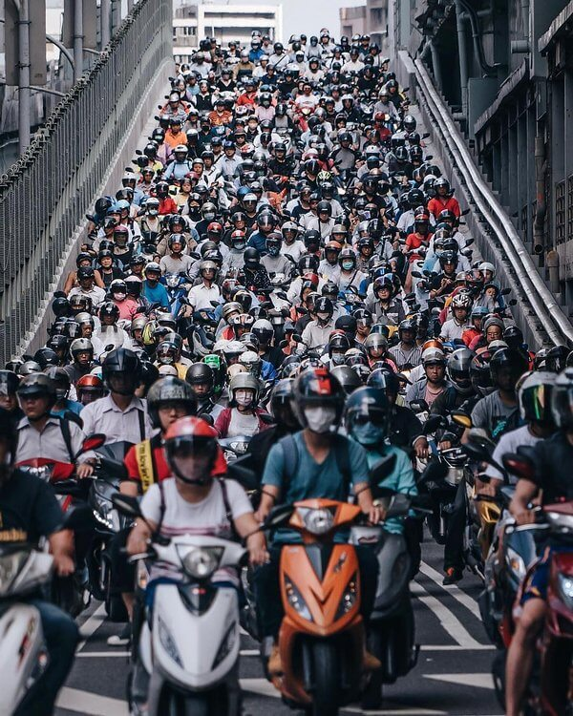
Scooters
There were 8.8 million motorcycles and 4.8 million cars on Taiwan's roads, with motorcycles being called the primary means of transport for the majority of the island's adult population. Motorcycles with two-stroke engines were claimed to be the biggest single source of vehicular pollution in Taiwan, while also being the majority of the motorcycles operating in Taiwan.

Slide 20
Thanks for Listening

Slide 21
question
1.How do you think we can do for the earth to solve the problem of air pollution?
feedback from classmates
Take public transportation
Variety of trees
Save electricity, don't smoke
Participate in environmental protection activities
Eat less barbecue-type food

Slide 22
question
Do you think we can completely solve the problem of air pollution in the future? Why or why not?
feedback from classmates
There is no way, because in the industrial age, there will inevitably be sources of air pollution, so it cannot be completely solved.

