Slide 1
Climate Action & It’s Impact on Environment
-By: Yassin wael Wahba

Slide 2
CONTENT TITLE
Introduction
1-Cause ,Impact &
consequences of Climate
change
2-Egypt’s Action plan on
Climate Change
3-Mitigation Strategy & Conclusion

Slide 3
What is climate Change?
-Change in long term weather patterns is termed as climate change . It caused
major shifts in temperature, Rainfall &Wind patterns.
-The climate change has resulted in Global Warming as Earth has warmed unprecedently over the last few decades.
-Climate Change is a serious Environmental concern.

Slide 4
Impact of Climate change
-Rise of sea level
-Loss of Biodiversity
-Melting of Glaciers
-Landslides & Droughts
-Fluctuations in Monsoon patterns
-Bleaching of corals

Slide 5
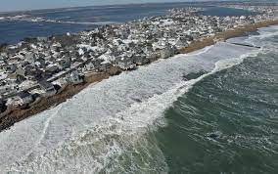
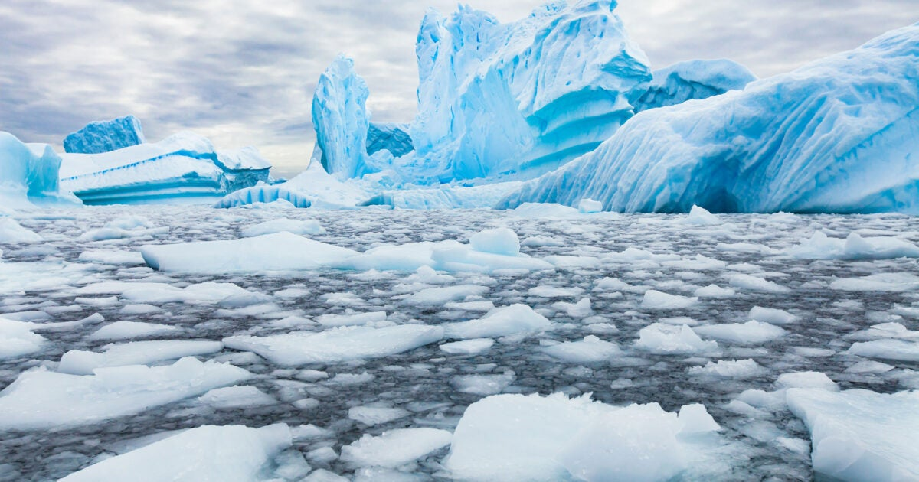
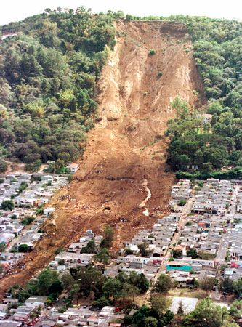
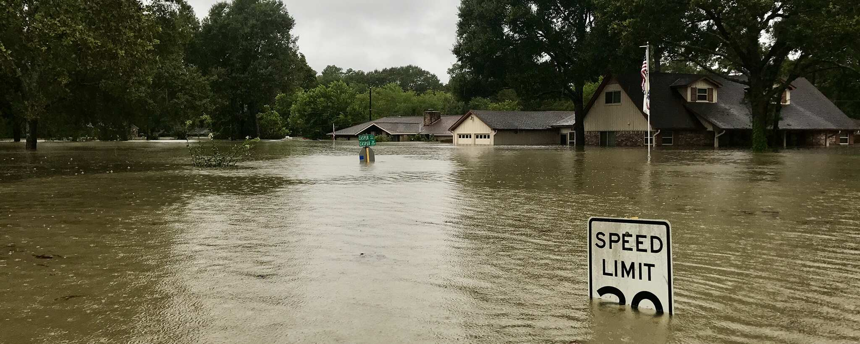
Rising sea level
Melting glaciers
Land sliding
Flood

Slide 6
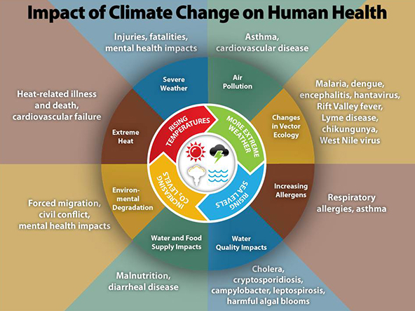
Consequences of Climate change
-Ocean Acidification
-Ozone Depletion
-Biodiversity loss
-Coral bleaching

Slide 7
Egypt’s national Action plan on climate change
-National Solar Mission (NSM)
-National Mission for Sustainable Habitat (NMSH)
-National Water Mission (NWM)

Slide 8
Thank You

